Slide 1
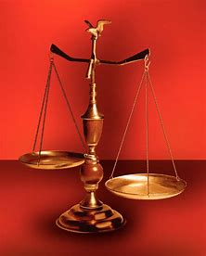
Straight and Balanced
(Luke 3:4-6)
#1 – Simeon & Anna seek, see, & speak (Luke 2:22-40)
#2 – No guile Nathanael (John 1:43-51)
#3 – Here a little, there a little (Isaiah 28:1-29)
#4 – Honor or dishonor in battle (Judges 5:12-23)
#5 – Jael severed from the past to win a battle (Judges 4-5)
#6 – Deborah: wife & mother, prophetess & judge (Judges 4-5)
#7 – General Barak honored by God (Judges 4-5, Heb 11:32)
OT: Ps 5:8, Pr 4:25-27
Amos 7:7-8, Is 28:13, 17
NT: Mt 3:3, Acts 9:11
Hebrews 12:13
OT: Deut 25:13-16
Daniel 5:25-28
NT: Hebrews12:1
1 Cor 3:11-15
Fellowship Church, September 27, 2023, by Bill Heath

Slide 2
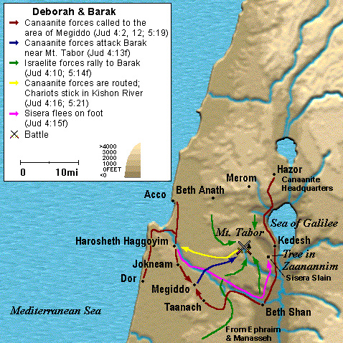
Straight & Balanced
Romans 15:4 things written before are for our learning, that we through patience and comfort of the Scriptures might have hope.
1 Corinthians 10:11 these things are written (1 Cor 10) for our admonition, upon whom the ends of the world are come.
Context: Judges 21:25, In those days there was no king in Israel: every man did that which was right in his own eyes.
Time: 12 judges from Othniel to Samson, 1450-1050 B.C.
Five Messages from Judges 4-5
1. Honor or dishonor in battle
2. Jael severed from the past to win a battle
3. Deborah: wife & mother, prophetess & judge
4. General Barak honored by God (Hebrews 11:32)
5. God ‘s deliverance today!
Deborah, 1204-1144 BC
(Merneptah Stele, 1206 BC Pharoah, 1213-1203 BC
King Jabin’s oppression, Judges 4:3, 5:6-8)
Kishon River

Slide 3
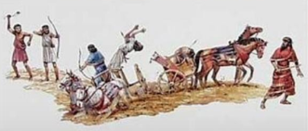
General Barak is Honored by God (Heb 11:32) Hebrews 11:32 Gideon, Barak, Samson, and Jephthae; . Why does God honor the faith of Barak and not honor Deborah in Hebrews 11:32? . .Battle 4:6-7 Lord God’s command, Go… I will, I will 4:10-12 Barak leads, Heber helps 4:14-16 the LORD goes out before you 4:23-24 God subdued on that day . Song about battle 5:4-5 History – LORD marches before Barak 5:12b-17 General Barak leads & recognizes 5:31a Let the LORD’s enemies perish 5:31b Strength for them who love the LORD . Decision: Is God going on before you?
Megiddo
Kishon River

