Slide 1
Straight and Balanced
(Luke 3:4-6)
#1 – Simeon & Anna Seek, See, & Speak (Luke 2:22-40)
#2 – No Guile Nathanael (John 1:43-51)
#3 – Here a Little, There a Little (Isaiah 28:1-29)
#4 – Honor or Shame in Battle (Judges 5:12-23)
OT: Ps 5:8, Pr 4:25-27
Amos 7:7-8, Is 28:13, 17
NT: Mt 3:3, Acts 9:11
Hebrews 12:13
OT: Deut 25:13-16
Daniel 5:25-28
NT: Hebrews12:1
1 Cor 3:11-15
Fellowship Church, August 23, 2023, by Bill Heath

Slide 2
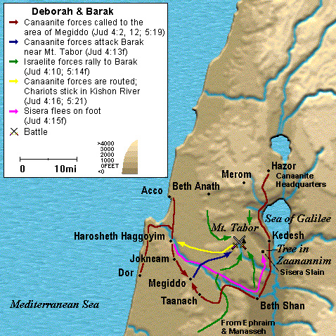
Straight & Balanced:
2Ti 2:19 ¶ Nevertheless the foundation of God standeth sure, having this seal, The Lord knoweth them that are his. And, Let every one that nameth the name of Christ depart from iniquity. 2Ti 2:20 But in a great house there are not only vessels of gold and of silver, but also of wood and of earth; and some to honour, and some to dishonour. 2Ti 2:21 If a man therefore purge himself from these, he shall be a vessel unto honour, sanctified, and meet for the master's use, [and] prepared unto every good work.
Deborah 1204-1144 BC
Merneptah Stele 1206 BC
Other Messages from Judges 4-5
1. Barak the General (Hebrews 11:32)
2. Deborah, the Wife of Lapidoth,
and a Mother in Israel
3. Deborah, a Prophetess, and a Judge
4. Jael, the Wife of Heber the Kenite

Slide 3
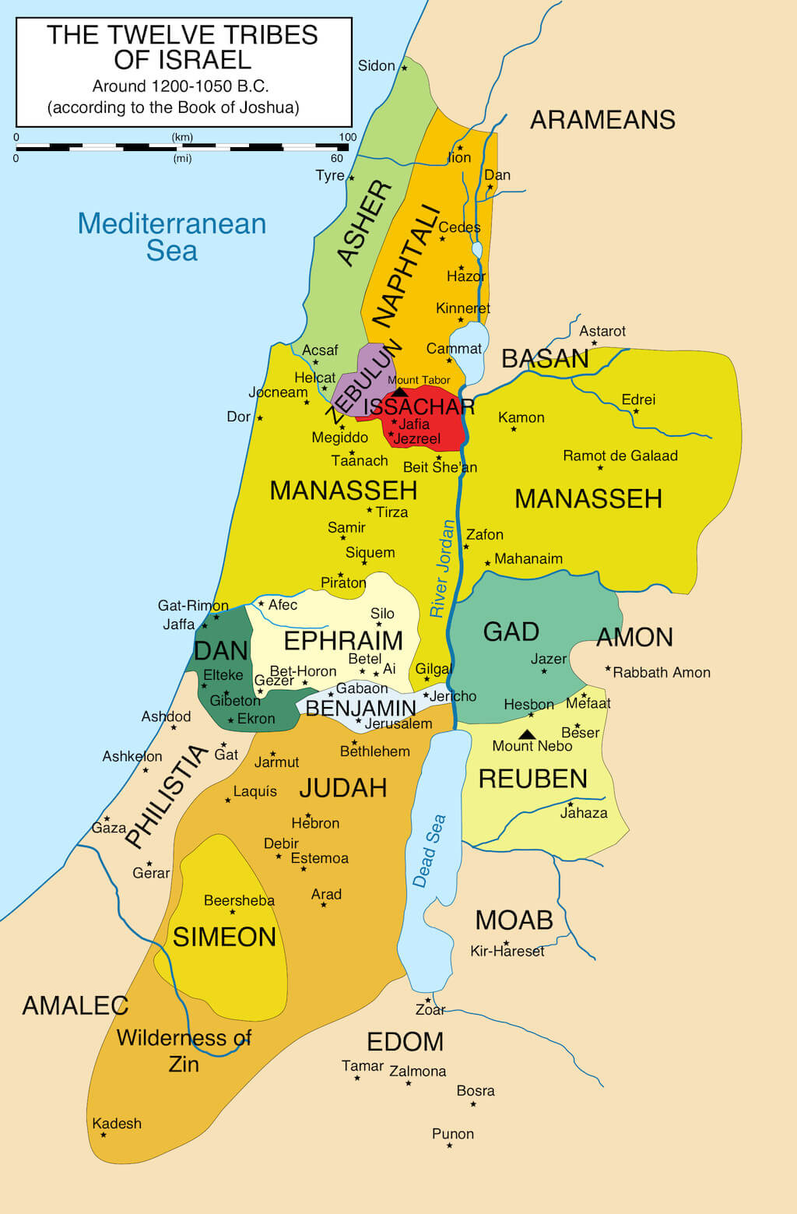
Honor or Shame in Battle (Judges 5:12-23) 4:1-2. 20 yrs. Evil > Bondage 4:3 Repentance > Freedom 5:14-15a. Honor (prepared by education and training) Ephraim, Benjamin, Manasseh, Zebulun, Issachar - Barak 5:18-22. Zebulun & Naphtali 215b-17. Shame Reuben, Gilead, Dan, Asher 5:23. Cursed (angels watching) 5:31. Love God & 40 years of freedom Decision: Where am I in the battle?

