Slide 1
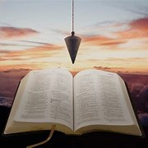
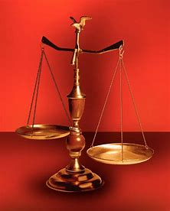
Straight and Balanced
(Luke 3:4-6)
#1 – Simeon & Anna seek, see, & speak (Luke 2:22-40)
#2 – No guile Nathanael (John 1:43-51)
#3 – Here a little, there a little (Isaiah 28:1-29)
#4 – Honor or dishonor in battle (Judges 5:12-23)
#5 – Jael severed from the past to win a battle (Judges 4-5)
#6 – Deborah: wife & mother, prophetess & judge (Judges 4-5)
#7 – General Barak honored by God (Judges 4-5, Heb 11:32)
#8 – How to win a major battle like Barak (Judges 4-5)
#9 – Samson (Judges 13-16)
#10 –
OT: Ps 5:8, Pr 4:25-27
Amos 7:7-8, Is 28:13, 17
NT: Mt 3:3, Acts 9:11
Hebrews 12:13
OT: Deut 25:13-16
Daniel 5:25-28
NT: Hebrews12:1
1 Cor 3:11-15
Fellowship Church, October 25, 2023, by Bill Heath

Slide 2
Learning for Major Battles from Judges 4-5
1. The people: honor or dishonor in battle
2. Jael severed from the past to win the battle
3. Deborah: wife & mother, prophetess & judge
4. General Barak honored by God (Hebrews 11:32)
5. How to win a major battle like Barak!
Spiritual Warfare of Ephesians 6:10-20 (type and duration, defensive and offensive) Skirmish (daily) Conflict (one a week or longer) > Temptations (James 1:12-16)
Operation (up to 2 weeks) Blitz Boot Camp/Specialty Training (intense & quick, 100 days) Battle (short & intense) Campaign (long over a territory) > Trials (James 1:1-8) The Old Testament was written for our learning (Romans 15:4)
King David’s life: Seek and Obey God (2 Samuel 5:23-24, 2 Samuel 8:15, Job 37:23-24) or Do NOT Seek and Obey God (2 Samuel 11:1-12:15, 2 Samuel 24)
Conclusion: Spiritual warfare is defensive and offensive. Pray for wisdom (James 1:5-8),
and draw near to God (James 4:7-10) and help other brethren (James 5:19-20).

Slide 3
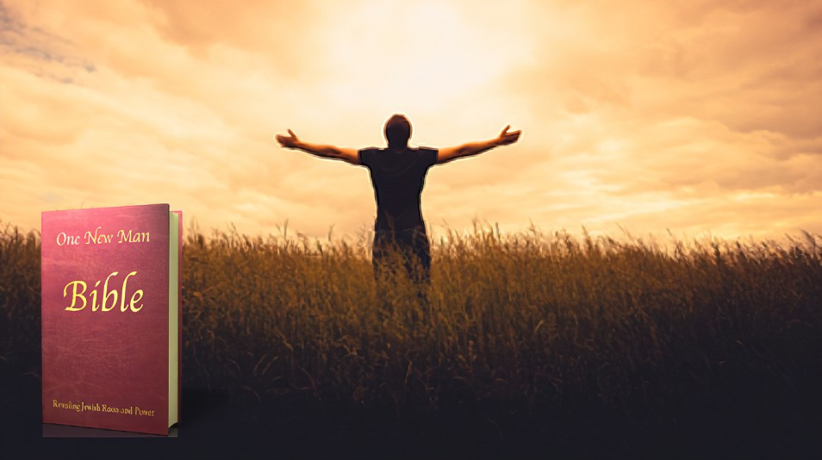
How to Win a Major Battle like Barak (Hebrews 11:32 Gideon, Barak, Samson, and Jephthae;) . 1. Cry unto the LORD. 20 years of mighty oppression before crying out to the LORD. (Judges 4:3) Today: Matthew 6:33, James 4:7-10, 2 Peter 1:1-21 . 2. Know God is working in His time with other people besides me. Jael, the wife of (4:11-12, 5:24) Deborah, the wife of – a mother (5:6-8, 5:28-30) Today: Romans 8:17b-38 . 3. Wait for the timing of the Lord, so He goes out before you. Deborah the prophetess (GO, 4:6-7; UP, 4:14) Today: Isaiah 40:31, Jeremiah 12:5, 2 Thessalonians 2:1-12 . 4. Praise after the battle is won in Judges 5 Deborah and Barak look back at what God has done. Today: 1 Peter 4:7-11 . Application: Identify your major battle for God’s glory; then cry, know, and wait; then praise. . Decision: I press toward the mark for the prize of the high calling of God, Philippians 3

