Slide 1
Straight and Balanced
(Luke 3:4-6)
#1 – Simeon & Anna Seek, See, & Speak (Luke 2:22-40)
#2 – No Guile Nathanael (John 1:43-51)
#3 – Here a Little, There a Little (Isaiah 28:1-29)
#4 – Honor or Dishonor in Battle (Judges 5:12-23)
#5 – Jael Severed from the Past to Win a Battle
(Judges 4:11-12, 4:17-21, 5:24-27)
#6 –
OT: Ps 5:8, Pr 4:25-27
Amos 7:7-8, Is 28:13, 17
NT: Mt 3:3, Acts 9:11
Hebrews 12:13
OT: Deut 25:13-16
Daniel 5:25-28
NT: Hebrews12:1
1 Cor 3:11-15
Fellowship Church, September 13, 2023, by Bill Heath

Slide 2
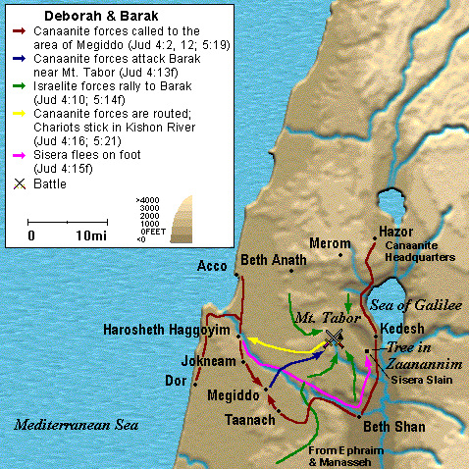
Straight & Balanced
Romans 15:4 things written before are for our learning, that we through patience and comfort of the Scriptures might have hope.
1 Corinthians 10:11 these things are written (1 Cor 10) for our admonition, upon whom the ends of the world are come.
Judges 21:25 In those days there was no king in Israel: every man did that which was right in his own eyes.
Six Messages from Judges 4-5
1. Honor or Dishonor in Battle
2. Jael Severed from the Past to Win a Battle
3. Deborah, the Wife of Lapidoth,
and a Mother in Israel
4. Deborah, a Prophetess, and a Judge
5. Sasera the General and Jabal the King
6. Barak the General (Hebrews 11:32)
Deborah 1204-1144 BC
Merneptah Stele 1206 BC

Slide 3
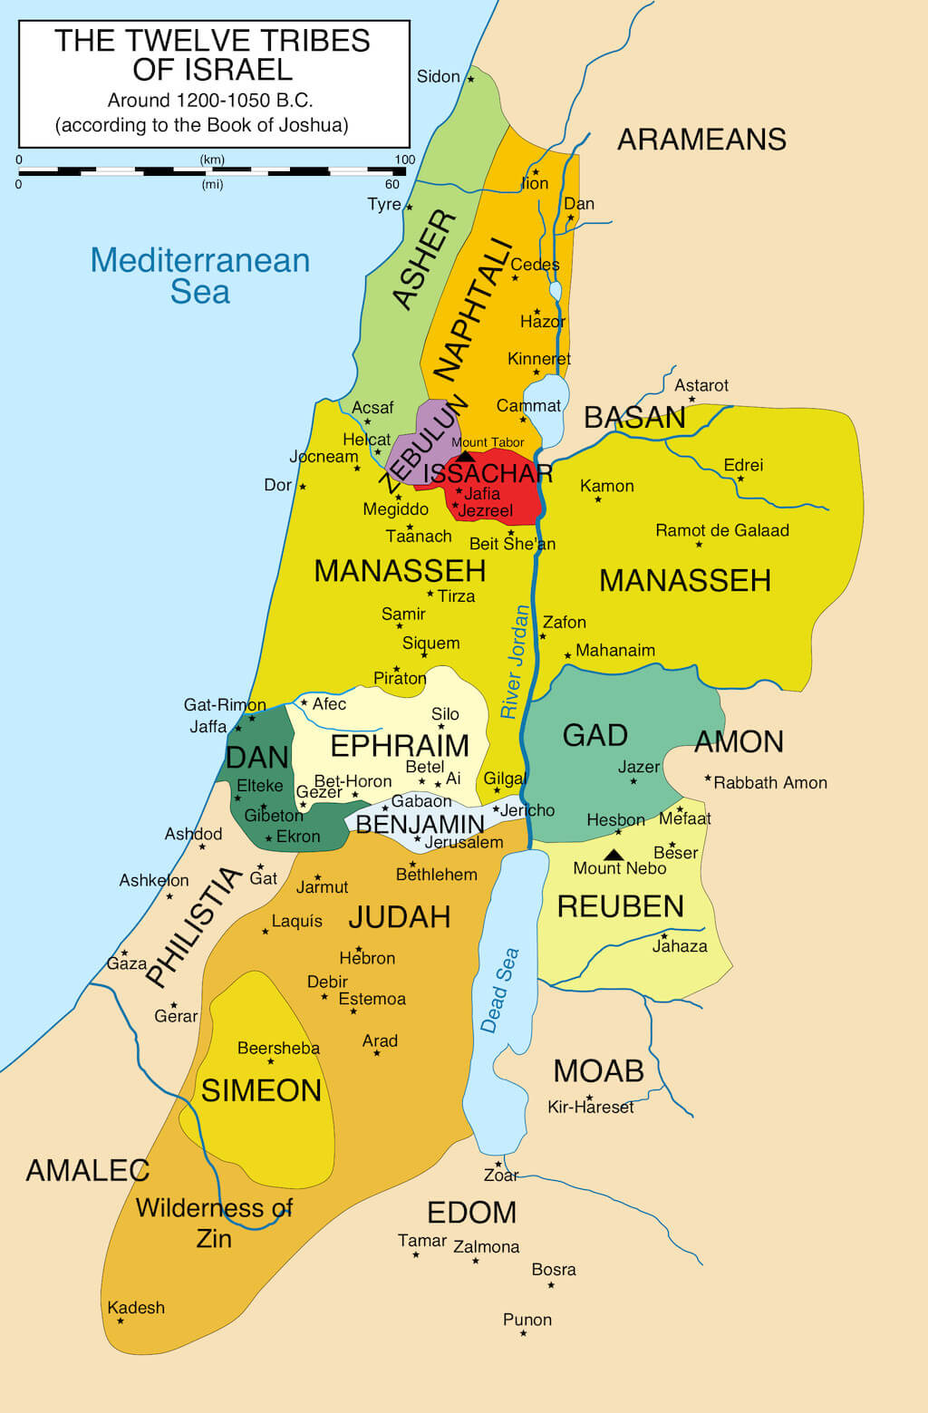
Jael, the Wife of Heber the Kenite Introduction: 4:1-2. 20 yrs. Evil > Bondage 4:3. Repentance > Freedom (the deliverer is Jesus Christ) 4:11-12 SEPARATION (Luke 14:33) Severed from their past (Kenites: family & culture) set tent up (Lot is opposite), influence of Moses 4:17-21 CONSECRATION (Romans 6) Jael, the wife of Heber the Kenite / General Sasera 5:24-27 RECOGNITION (1 Peter 1:17) from God (using my/our limited resources) Conclusion: 5:31. Love God first, then comes freedom Decision: Do you need to sever from your past?

