Slide 1
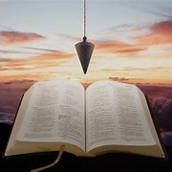
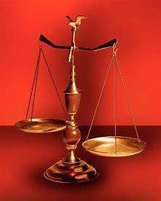
Straight and Balanced
(Luke 3:4-6)
Biblical characters (Hebrews 11:32)
Barak the Battle Winner
#1 – Honor or dishonor in battle (Judges 5:12-23)
#2 – Jael severed from the past to win a battle (Judges 4-5)
#3 – Deborah: wife & mother, prophetess & judge (Judges 4-5)
#4 – General Barak honored by God (Judges 4-5, Heb 11:32)
#5 – How to win a major battle like Barak (Judges 4-5)
Samson the Carnal Strongman
#6 – Samson is chosen & gifted (Judges13)
Samson rejects parents & Scripture authority (Judges 14)
#7 – Samson is angry & alone (Judges 15)
#8 – Samson is shelved & saved (Judges 16, Heb 11:32)
#9 – Jephthah’s past, vow and victories (Judges 11:1-12:7)
Gideon Goes from Nothing to Something
#10 – Gideon‘s fear and the enemy of self (Judges 6)
#11 – Gideon’s faith and the enemy without (Judges 7)
#12 – Gideon’s failure and the enemy within (Judges 8-9)
OT: Ps 5:8, Pr 4:25-27
Amos 7:7-8, Is 28:13, 17
NT: Mt 3:3, Acts 9:11
Hebrews 12:13
OT: Deut 25:13-16
Pr 20:10, Dan 5:25-28
NT: Hebrews12:1
1 Cor 3:11-15
Fellowship Church, February 14, 2024 B. Heath

Slide 2
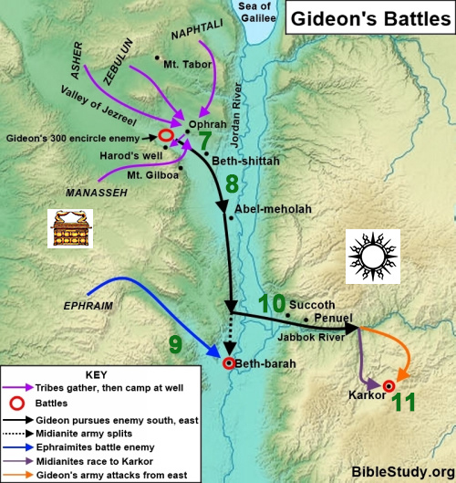
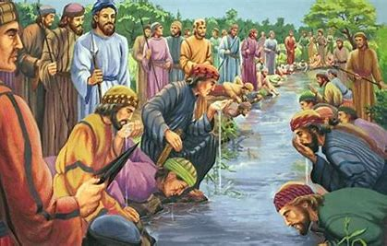
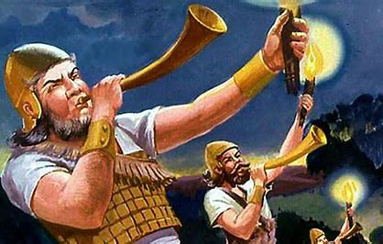
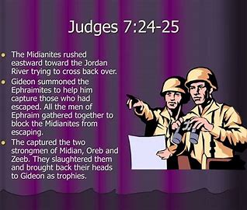
(Hebrews 11:32 Gideon, Barak, Samson, and Jephthah;) Gideon’s Faith (victory over the enemy without) 7:1-8 Gideon’s Army Reduced (of the LORD) victory when time is near - they rose up early (Ps 5:1-3) victory with less - 32,000 to 10,000 to 300 men victory preparing for a battle – with God on my side 7:9-15 Gideon’s Fear - Final Help (of the LORD) speaking through circumstances and others (Acts) victory over weaknesses from self / my old man (Ro 7:21-25) 7:16-25 Gideon’s Victory Battle (of the LORD) victory with wisdom from above (James 1: 5-7) victory in the execution of the battle (7:16-22) others join to finish the war (7:23-25) The sword of Gideon, and of the LORD Decision: Trust and Obey God for Victories

