Slide 1
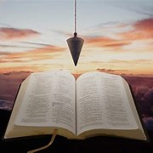
Fellowship Church, March 28, 2024 B. Heath
Straight and Balanced
(Luke 3:4-6)
Biblical characters (Hebrews 11:32)
Barak the Battle Winner
#1 – Honor or dishonor in battle (Judges 5:12-23)
#2 – Jael severed from the past to win a battle (Judges 4-5)
#3 – Deborah: wife & mother, prophetess & judge (Judges 4-5)
#4 – General Barak honored by God (Judges 4-5, Heb 11:32)
#5 – How to win a major battle like Barak (Judges 4-5)
Samson the Carnal Strongman
#6 – Samson is chosen & gifted (Judges13)
Samson rejects parents & Scripture authority (Judges 14)
#7 – Samson is angry & alone (Judges 15)
#8 – Samson is shelved & saved (Judges 16, Heb 11:32)
#9 – Jephthah’s past, vow and victories (Judges 11:1-12:7)
Gideon Goes from Nobody to Faith to Somebody
#10 – Gideon‘s fear and the enemy of self (Judges 6)
#11 – Gideon’s faith and the enemy without (Judges 7)
#12 – Gideon’s failure and the enemy within (Judges 8-9)
OT: Ps 5:8, Pr 4:25-27
Amos 7:7-8, Is 28:13, 17
NT: Mt 3:3, Acts 9:11
Hebrews 12:13
OT: Deut 25:13-16
Pr 20:10, Dan 5:25-28
NT: Hebrews12:1
1 Cor 3:11-15

Slide 2
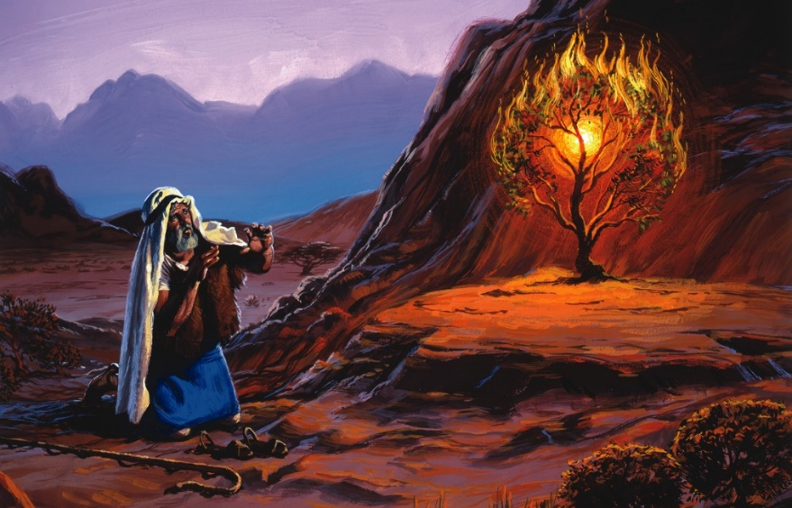
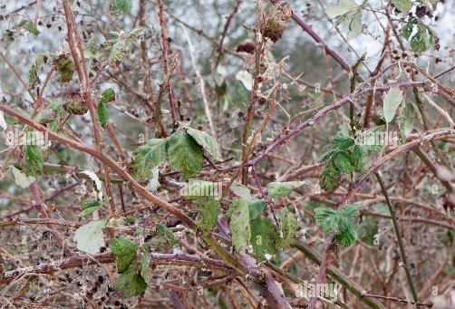
(Hebrews 11:32 Gideon, Barak, Samson, and Jephthah;) Gideon’s failure and the enemy within (Judges 8-9) 8:1-3 E1. Ephraimite Pride (tribe of Ephraim) 8:4-7 E2. Men of Succoth (tribe of Gad) 8:8-9 E3. Men of Penuel (tribe of Gad) 8:18-21 E4. Gideon’s a Coward with family & wealth 8:22-26 E5. Idea of power and wealth as a king 8:27 E6. Gideon makes an ephod image that becomes an idol (1 John 5:21) 8:28-32 E7. Gideon names his concubine’s son Abimelech = son of a king 8:33-35 E8. Gideon dies in Ophrah – Israel returns to the Baalim god 9:1-6 E9. Abimelech slays 69 brothers of another mother – Jotham escapes 9:7-21 Parable of the Trees, Vine, or Bramble by Jotham from Mount Gerizim 9:22-25 E10. God sends an evil spirit between Abimelech & the men of Shechem 9:26-41 E11. Gaal causes Shechem to revolt against King Abimelech 9:42-49 E12. King Abimelech destroys the city of Shechem Decision: Be a burning bush non-consuming fire and not a bramble consuming fire

