Slide 1
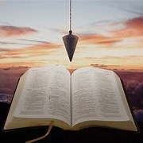
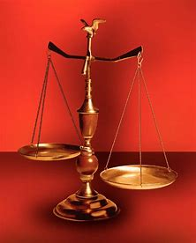
Fellowship Church, March 13, 2024 B. Heath
Straight and Balanced
(Luke 3:4-6)
Biblical characters (Hebrews 11:32)
Barak the Battle Winner
#1 – Honor or dishonor in battle (Judges 5:12-23)
#2 – Jael severed from the past to win a battle (Judges 4-5)
#3 – Deborah: wife & mother, prophetess & judge (Judges 4-5)
#4 – General Barak honored by God (Judges 4-5, Heb 11:32)
#5 – How to win a major battle like Barak (Judges 4-5)
Samson the Carnal Strongman
#6 – Samson is chosen & gifted (Judges13)
Samson rejects parents & Scripture authority (Judges 14)
#7 – Samson is angry & alone (Judges 15)
#8 – Samson is shelved & saved (Judges 16, Heb 11:32)
#9 – Jephthah’s past, vow and victories (Judges 11:1-12:7)
Gideon Goes from Nobody to Faith to Somebody
#10 – Gideon‘s fear and the enemy of self (Judges 6)
#11 – Gideon’s faith and the enemy without (Judges 7)
#12 – Gideon’s failure and the enemy within (Judges 8-9)
Application: Hebrews 11:32 for the Church Today
OT: Ps 5:8, Pr 4:25-27
Amos 7:7-8, Is 28:13, 17
NT: Mt 3:3, Acts 9:11
Hebrews 12:13
OT: Deut 25:13-16
Pr 20:10, Dan 5:25-28
NT: Hebrews12:1
1 Cor 3:11-15

Slide 2
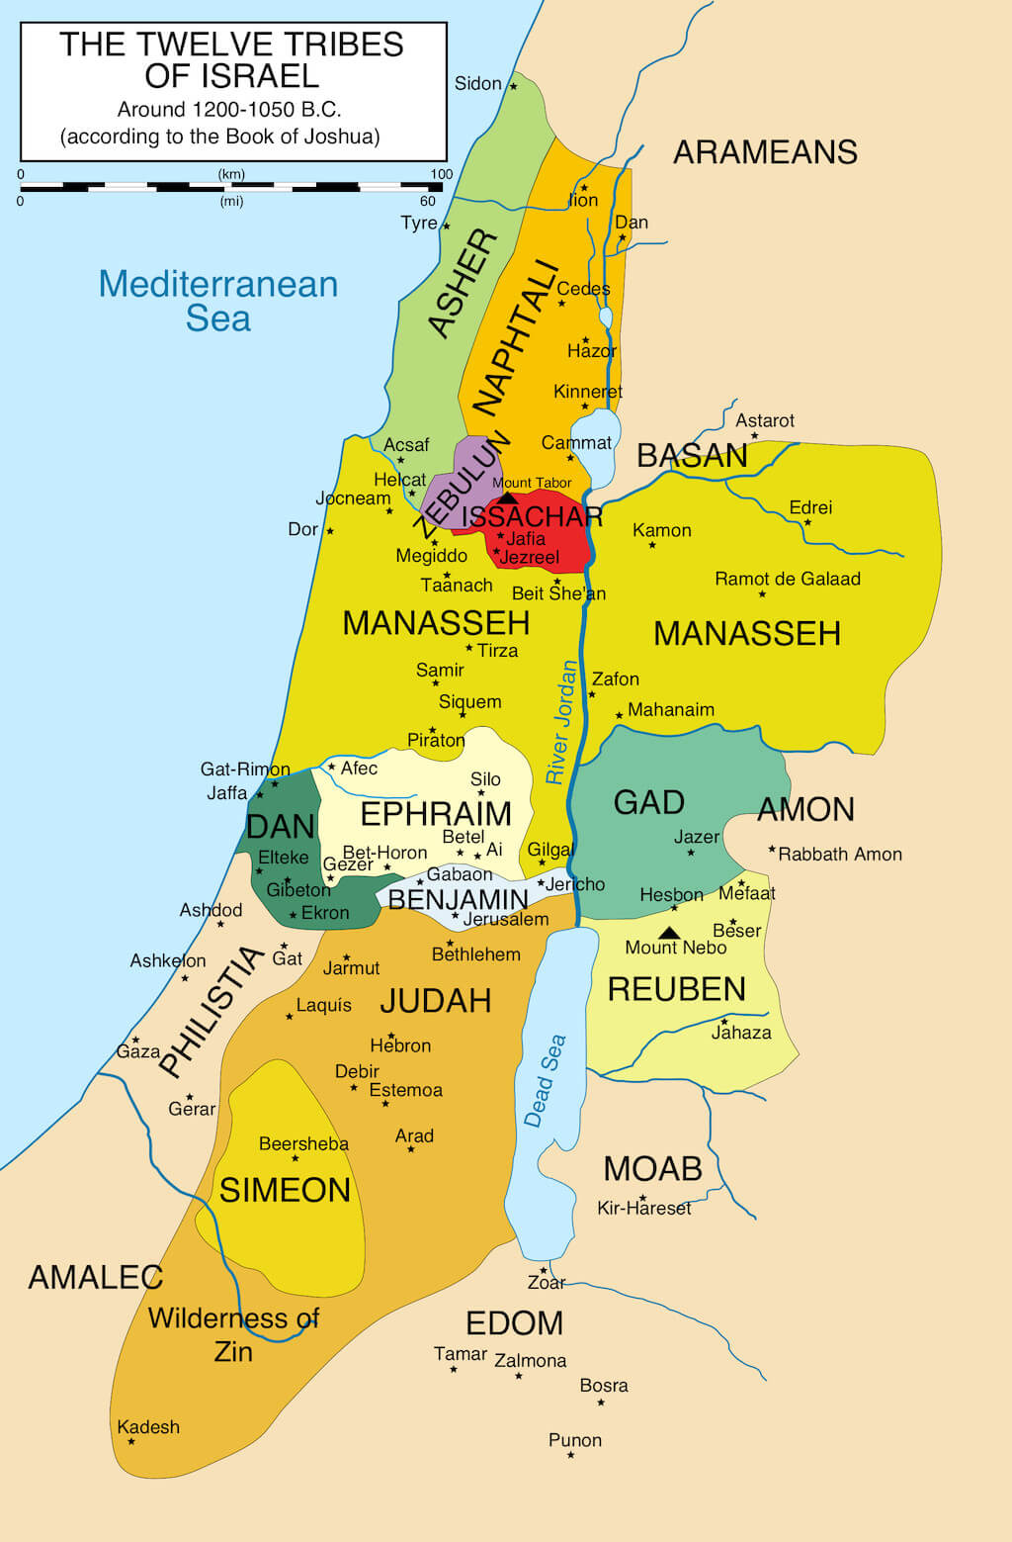
(Hebrews 11:32 Gideon, Barak, Samson, and Jephthah;) Application: Hebrews 11:32 for the Church Today - Intro: 1-3 2:1-3 angel. Sin > Bondage > Repentance > Deliverance - Judge Chapter Tribe Enemy Calling Today order - Barak the Battle Winner Barak: 4-5 Naphtali Canaanites Adult man Female #1 - Gideon Goes from Nobody to Faith to Somebody Gideon: 6-9 Manasseh Midianites Young man Lukewarm #4 - Jephthah’s past, vow, and victories Jephthah: 11-12 Gad Ammonites Birth Vows #3 - Samson the Carnal Strongman Samson: 13-16 Dan Philistines Conception Male #2 1 Samuel 12:9-11. Gideon, Barak, Jephthah, and Samuel. Rev 7:5-6 . Ending: 17-18 Levi & Dan. Money, ignorance of Scripture 19-21 Levi & Benjamin. Sexual immorality. Defend few. - Today: Rom 15:4, 1 Cor 10:11, 2 Tim 3:1-9/10-17, Rev 3:14-22

Slide 3
MONARCHY
Times: Every man did what was right in his own eyes
(Judges 21:25)
Old Testament:
And the times of ignorance God winked at; but now commands all men everywhere to repent
(Acts 17:30)
New Testament:
The believer has the best gift, the indwelling Holy Spirit, the perfect example - Jesus Christ, completed Scripture, and the body of Christ (Romans 12-16)

