Slide 1
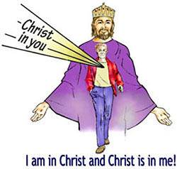

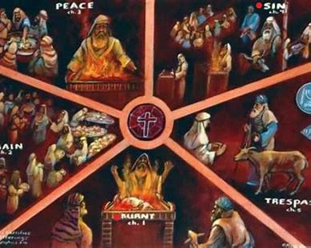
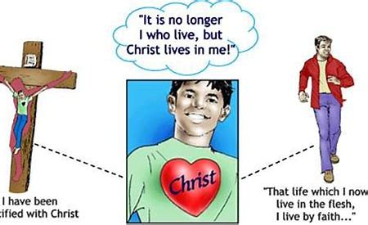
Fellowship Church – Sunday School – June 27, 2021
Title: Bring Your Offerings unto Our Father in Heaven
Text: Leviticus 1-7 and Hebrews
9:55 Countdown
Christ revealed in the New Testament
Christ concealed in the Old Testament
and

Slide 2

Title: Bring Your Offerings unto Our Father in Heaven
Text: Leviticus 1-7 and Hebrews

Slide 3
Congregational Scripture reading – Hebrews 1:1-3 (KJV)
1:1 God, who at sundry times and in divers manners
spake in time past unto the fathers by the prophets,
1:2 Hath in these last days spoken unto us by [His] Son,
whom He hath appointed heir of all things, by whom also He made the worlds;
1:3 Who being the brightness of [His] glory,
and the express image of His person,
and upholding all things by the word of His power,
when He had by Himself purged our sins,
sat down on the right hand of the Majesty on high;

Slide 4
Bring Your Five Offerings unto Our Father in Heaven
# | Old Testament | Burnt | Grain | Peace | Sin | Trespass | New Testament – Hebrews 10:1
Leviticus 1-7 |  | FREEWILL / VOLUNTARY |  |  | MANDATORY |  | Romans 15:4, 1 Cor 10:11, 2 Tim 3:16
1 | All Commandments of the LORD | 1st Three Offerings Burnt – Consecration Grain – Daily Peace – Fellowship “A sweet savor unto the LORD” Self, Others-Time, Thanksgiving Lev 7:13 grain w/leaven or Lev 22:23 blemish allowed |  |  | X | X | Hebrews 1:1-3 (4:12)
2 | Sin |  |  |  | X | X | Walk after the flesh Romans 8:1, 4 Wisdom from below, James 3:14-16 Works of the flesh, Galatians 5:19-21
3 | Guilt |  |  |  | X | X | Hebrews 10:22 (9:13-14) Pure conscience & heart
4 | Confess |  |  |  | X | X | 1 John 1:9 Who, what, when, where, why, how? Depends on the sin. Mathew 18:15-35
18 steps to please the LORD |  | 7 | 7 | 11 | 7 | 8 | = 40 offering options/variables
Source: Leviticus 1-7 writes shadows of the substance in the New Testament, in Christ and in every Christ-follower.
New Testament commandments. Hebrews 13 has 20 commandments, Romans 12 is 41 commandments.
.

Slide 5
Bring Your Five Offerings unto Our Father in Heaven
# | Old Testament | Burnt | Grain | Peace | Sin | Trespass | New Testament – Hebrews 10:1
Leviticus 1-7 |  | FREEWILL / VOLUNTARY |  |  | MANDATORY |  | Romans 15:4, 1 Cor 10:11, 2 Tim 3:16
5 | Offeror Bring his offering | X | X | X | X | X | Hebrews 4:14-16, 12:1 We have a Great High Priest
6 | Add Salt Oil & Frankincense | X | X X | X | X | X | (1:9)
7 | Altar | X | X | X | X | X | Hebrews 7:11-16
8 | Lay hand on head | X |  | X | X | X
9 | Kill the animal | X |  | X | X | X | Hebrews 9:15-16
10 | Make restitution in silver or kind + 1/5 |  |  |  |  | X | Hebrews 10:24-25

Slide 6
Bring Your Offerings unto Our Father in Heaven
# | Old Testament | Burnt | Grain | Peace | Sin | Trespass | New Testament – Hebrews 10:1
Leviticus 1-7 |  | FREEWILL / VOLUNTARY |  |  | MANDATORY |  | Romans 15:4, 1 Cor 10:11, 2 Tim 3:16
11 | Priest Lev 10:1-11 (discern & teach) | X | X | X | X | X | Hebrews 5:11-6:1
12 | Administer the fire (holy or strange) | X |  | X | X | X | Hebrews 12:29
13 | Blood (life in the blood) | X |  | X | X | X | Hebrews 13:20-21
14 | Fat (internal organs) | X |  | X | X | X
15 | Eat the offering |  | X | X - all | X | X | Hebrews 13:10
16 | Burn outside camp (priest /cong. -elders) |  |  |  | X |  | Hebrews 13:11-14
17 | Atonement Lev 7:7 | X (1x) |  |  | X | X (6x) | Hebrews (0x) OT: 94x, appease Ge 32:20 Reconcile: Ro 5:11, 11:15, 1 Cor 5:18-19
18 | Forgiven | Filled with the Spirit - Lu 2:40, Ac 2:4, Eph 5:8. Led of the Spirit - Ro 8:14, Ga 5:18. |  |  | X | X | Hebrews 13:15 Walk after the Spirit, Romans 8:1, 4 Wisdom from above, James 3:13-17-18 Fruit of the Spirit, Galatians 5:22-23
The assurance of eternal life means equal access, fair play, and equal outcome for all individual believers.

Slide 7
Today: Bring Your Five Offerings unto Our Father in Heaven
Freewill: Burnt
Freewill: Grain
Freewill: Peace
Required: Sin
Required: Trespass
John 15:5
He that abideth in me,
and I in him,
John 15:7
If ye abide in me,
and my words abide in you,
Galatians 2:20 I am crucified with Christ: nevertheless I live; yet not I, but Christ liveth in me:
and the life which I now live in the flesh I live by the faith of the Son of God, who loved me, and gave himself for me.

