Slide 1
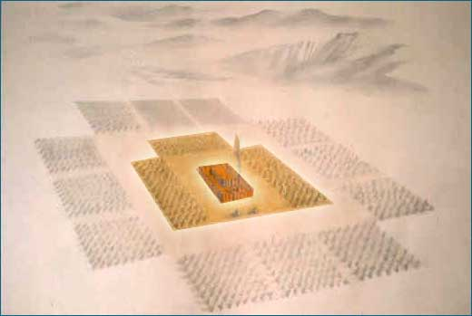
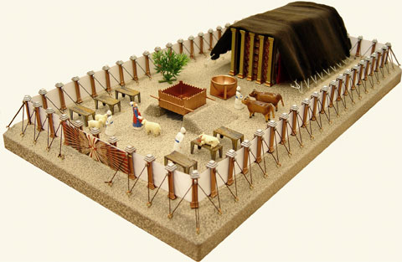
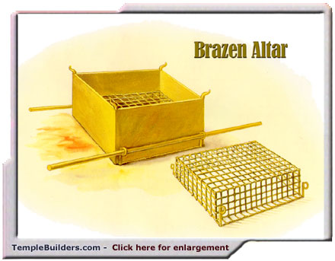
Fellowship Church – Sunday School – May 9, 2021
Title: Daily Surrender
Text: Leviticus 2 and Luke 9:23
The Church in the Wilderness
(22 days from Red Sea to Mount
Sinai. 2 years @ Mt Sinai)
The Tabernacle in the Wilderness
(3 curtains and 6 furnishings.
Silver, bronze, and gold.)
The Altar of Sacrifice
(fire and 4 horns)

Slide 2


Slide 3
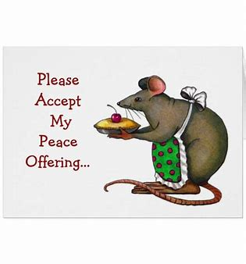
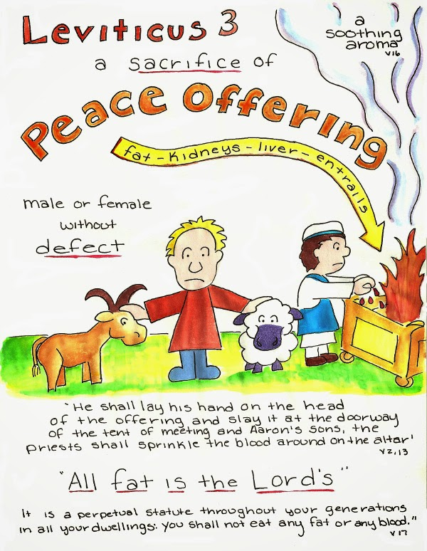
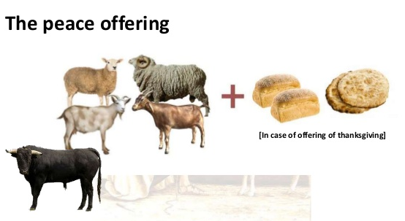
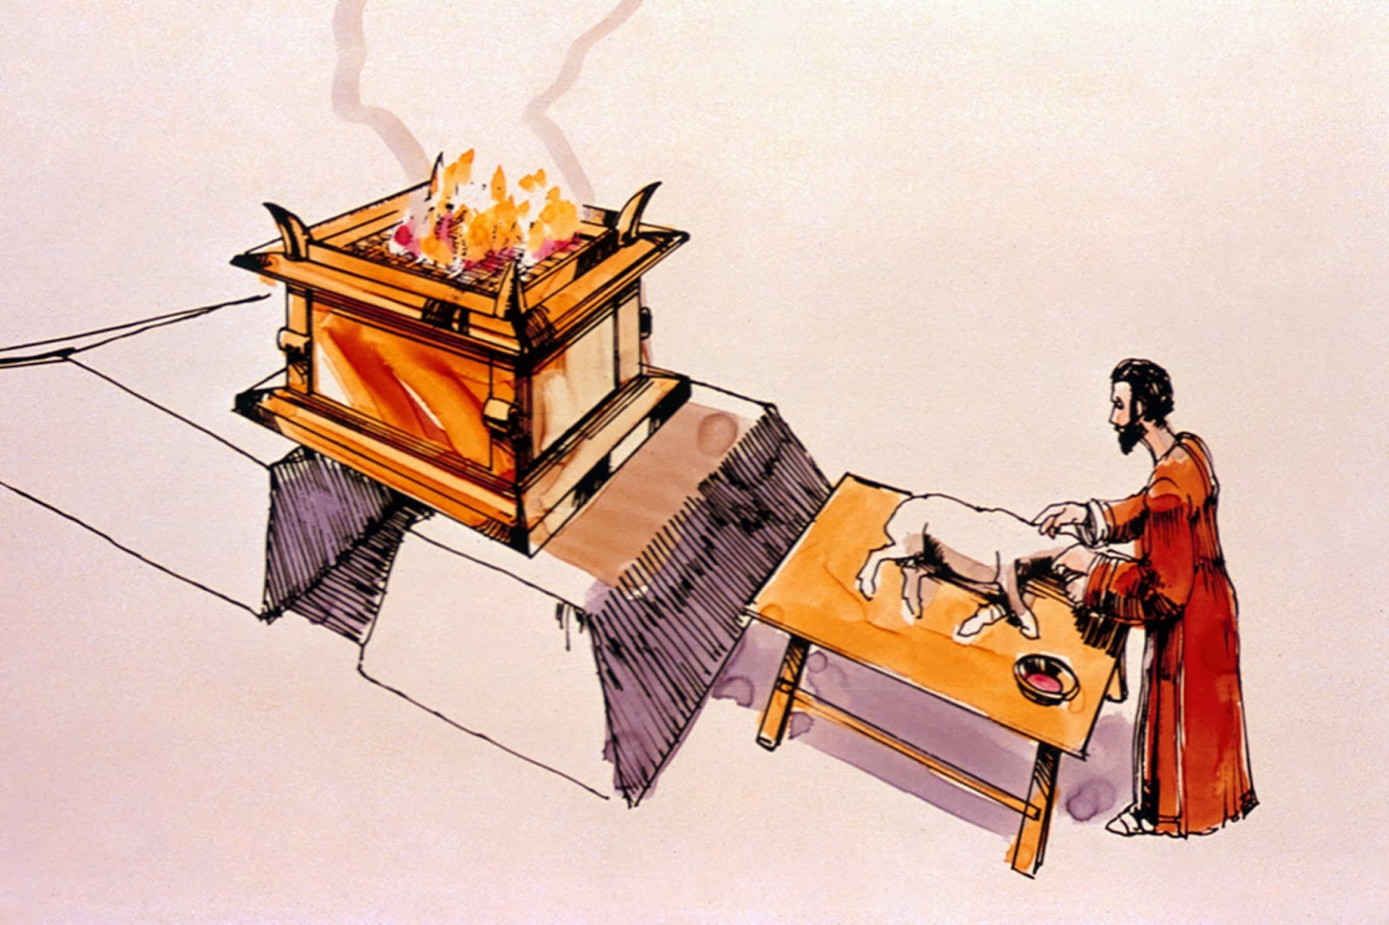
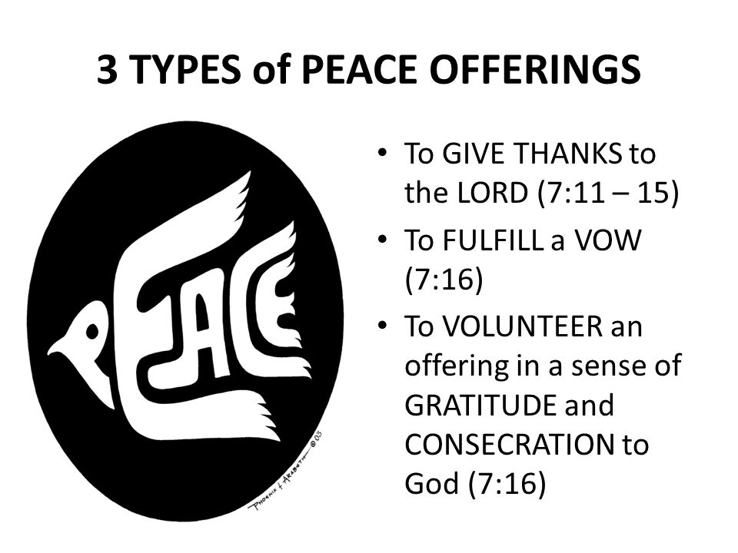
Thanksgiving

Slide 4
Leviticus 3 – the peace or fellowship offering
¹ And if his oblation [be] a sacrifice of peace offering, if he offer [it] of the herd; whether [it be] a male or female, he shall offer it without blemish before the LORD.
² And he shall lay his hand upon the head of his offering, and kill it [at] the door of the tabernacle of the assembly: and Aaron's sons the priests shall sprinkle the blood upon the altar round about. ³ And he shall offer of the sacrifice of the peace offering an offering made by fire to the LORD; the fat that covers the inwards, and all the fat that is upon the inwards, ⁴ And the two kidneys, and the fat that is on them, which is by the flanks, and the caul above the liver, with the kidneys, it shall he take away. ⁵ And Aaron's sons shall burn it on the altar upon the burnt sacrifice, which is upon the wood that is on the fire: [it is] an offering made by fire, of a sweet savour unto the LORD.
¹⁷ [It shall be] a perpetual statute for your generations throughout all your dwellings, that ye eat neither fat nor blood.

Slide 5
Leviticus 3 – the PEACE offering represents my fellowship surrender (Then - Moses for Israel, Today - Jesus for christians, Ro 15:4)
(1) Offerer: 2:1 Brings a peace offering
unto the LORD
(2) His own will
//First 3 offerings//
At the altar
* Burnt, Grain, Peace
(3b) Vow or Voluntary (7:16)
Eat on same or next day, not the 3rd day.
(4) Determines animal: Herd (cow or ox) or lamb, or goat - male or female. Without blemish.
(5) Lays his hands on the head of the offering and kills it; the blood drains from the throat into a bowl.
(6a) Removes the fat & inwards, kidneys, and liver (remove toxins from body) cuts the animal into parts.
(6b) Unto the LORD. Wave offering of breast for Aaron-sons and heave offering of R. shoulder for priests.
(7) Offeree -Priests: Maintain the altar fire & administer the offering.
(8) Priests sprinkle the blood on the altar.
Cooks the meat on the altar.
(9) Eat wave and heave offering on same day for thanksgiving, and before 3rd day for vow or voluntary offering.
(10)Result: 3:5, 16
a sweet savour unto the LORD
//First 3 offerings//
(3a) Determines purpose of sacrifice:
Thanksgiving with bread, unleaven and unleaven (7:11-13)

Slide 6
Look ahead
Leviticus 4 (sin offering) - June 13
Leviticus 5 (trespass offering) – June 20
Take it home
I volunteer fellowship surrender (eat at the table)
To follow Christ in thanksgiving and peace with the saints
To be a sweet savor unto the LORD
Leviticus 1 (Burnt Offering) Jesus’ perfect life (not my
will but thy will be done)
Leviticus 2 (Grain Offering) daily obedience of jesus
Leviticus 3 (peace offering) Resurrection of jesus

