Slide 1
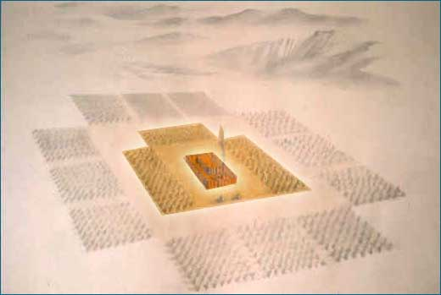
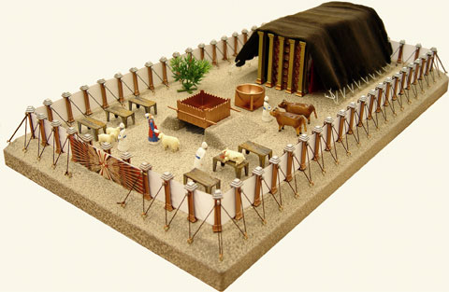
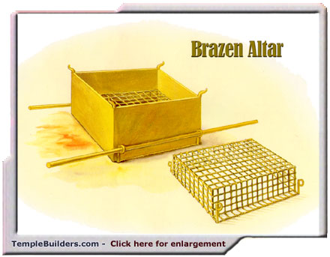
Fellowship Church – Sunday School – June 13, 2021
Title: Bring Your Sin Offering to God
Text: Leviticus 4 and John 1:29
The Church in the Wilderness
(22 days from Red Sea to Mount
Sinai. 2 years @ Mt Sinai.)
The Tabernacle in the Wilderness
(3 curtains and 6 furnishings
Silver, bronze, and gold
90’ by 175’)
The Altar of Sacrifice
(fire, wood, and 4 horns
Fire from above)

Slide 2


Slide 3
Congregational Scripture reading – Leviticus 4
4:1 ¶ And the LORD spake unto Moses, saying,
4:2 Speak unto the children of Israel, saying,
If a soul shall sin through ignorance against any of the commandments of the LORD
[concerning things] which ought not to be done, and shall do against any of them:
4:27 ¶ And if any one of the common people sin through ignorance,
while he doeth [somewhat against] any of the commandments of the LORD
[concerning things] which ought not to be done, and be guilty;
4:28 Or if his sin, which he hath sinned, come to his knowledge:
then he shall bring his offering, a kid of the goats, a female without blemish,
for his sin which he hath sinned.

Slide 4
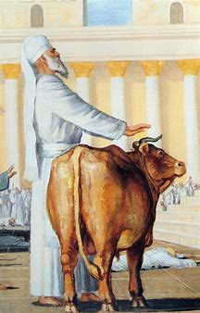
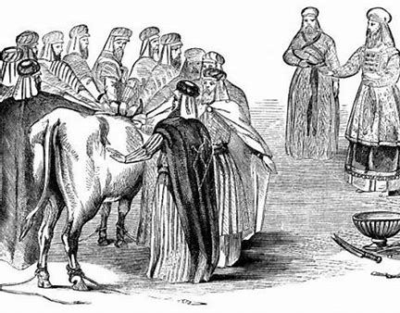
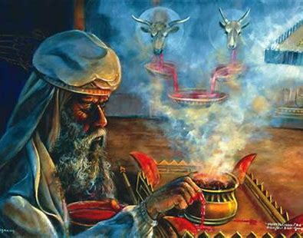
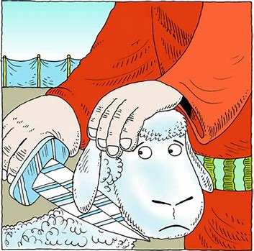
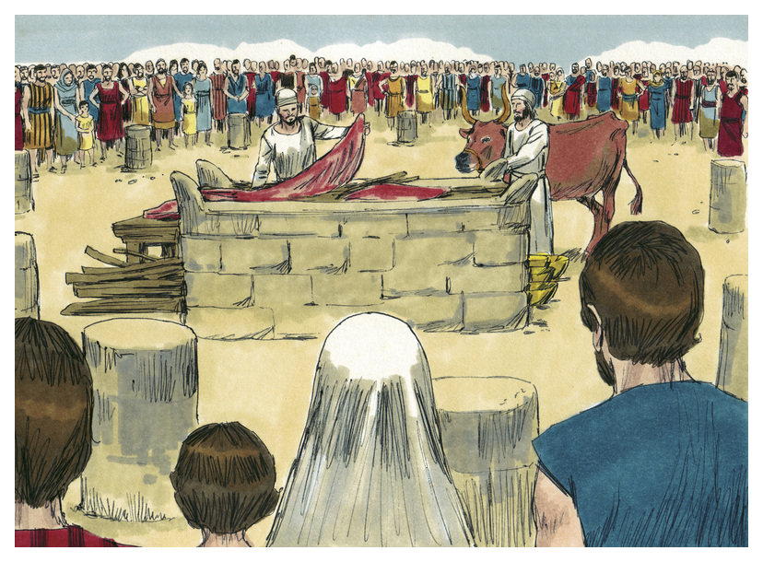
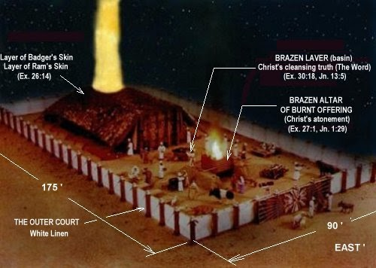
Priest-Bull
Nation- Elders-Bull
Blood at altar of incense
King or Common People
Priests eat Meat (BBQ)
Tabernacle at Night

Slide 5
Offeror | Offering | Offeree (Priest) | Blood | Comment
Priest (brings offering lay hands, kill) “more accountable” | Young Bullock (male-bull or ox) | Burn fat and carry bullock outside the camp to burn and pour ashes (not eaten) | Sprinkle 7 x before the veil. Put on horns of altar of incense. Pour at bottom of the altar at the door. | Moses: Aaron & sons/priests Today: Pastor/elder/ teacher (James 3:1)
Assembly (elders bring offering, lay hands, kill) | Young Bullock (male bull or ox) | Burn fat and carry bullock outside the camp to burn and pour ashes (not eaten) | Sprinkle 7 x before the veil. Put on horns of altar of incense. Pour at bottom of the altar at the door. | Moses: Israel -12 tribes Atonement-sin forgiven Today: United States Individual state
Ruler (brings offering, lay hands, kill) | Kid goat -female | Priest eats in a holy place in the court of the tabernacle | Put on burnt offering altar horns. Pour at bottom of the altar at the door. | Moses: King Atonement-sin forgiven Present: President
Common People (brings offering, lay hands, kill) | Kid goat or sheep -female | Priest eats in a holy place Offering “a sweet fragrance unto the LORD” | Put on burnt offering altar horns. Pour at bottom of the altar at the door. | Moses: 99% of people Atonement-sin forgiven Present: 99% of people
4:1-35. Divine order for 4 categories of offerors. Commandments of the LORD > sin by ignorance (hurry, carelessness, mistake, maturity) > guilty > come to knowledge > bring offering > atonement > forgiven. Priests: Lev 6:24-30 It is most holy, touch meat/blood - wash clothes, pot broken or scoured - rinse in water, it is most holy. 8:23-24 priests right ear, thumb, & big toe. 10:1-7 priests strange fire. 10:8-11 priests do not drink alcohol. 12 Purification of women. 14 Cleansing of leper. 15 Purification of those with issues. 16:29-34 Annual day of Atonement. 17:1-9 All herd or flock killed at the door of the tabernacle, esp. peace offering. Ex 29 consecration of priests. Nu 6 expiration of Nazarite vow (man or woman). Nu 8 consecration of Levites.

Slide 6
Look ahead
Leviticus 4 - Take it home
I am guilty for my sins of ignorance against the word
Which jesus died on the cross
for my Atonement and forgiveness
Hebrews 4:14-16 Seeing then that we have a great high priest, that is passed into the heavens, Jesus the Son of God, let us hold fast [our] profession. . .
Heb 9:13 For if the blood of bulls and of goats, and the ashes of an heifer sprinkling the unclean, sanctifieth to the purifying of the flesh:
Heb 9:14 How much more shall the blood of Christ, who through the eternal Spirit offered himself without spot to God, purge your conscience from dead works to serve the living God?
June 20: Leviticus 5, bring your trespass offering to God
June 27: Leviticus 1-5, today’s application

