Slide 1
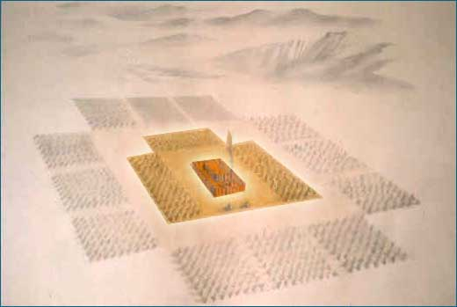
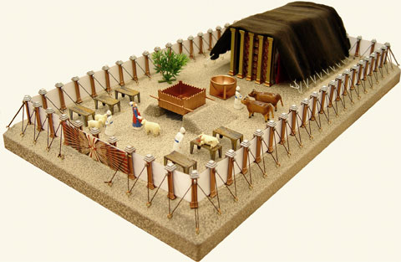
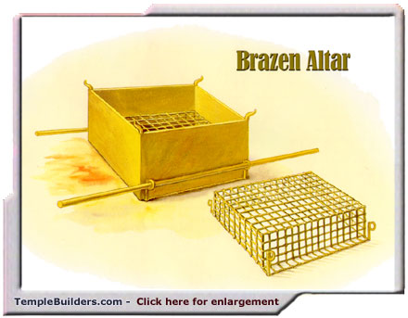
9:55 Countdown
Fellowship Church – Sunday School – June 20, 2021
Title: Bring Your Trespass Offering to God
Text: Leviticus 5:1-6:7 and John 1:29
The Church in the Wilderness
(22 days from Red Sea to Mount
Sinai. 2 years @ Mt Sinai.)
The Tabernacle in the Wilderness
(3 curtains and 6 furnishings
Silver, bronze, and gold
90’ by 175’)
The Altar of Sacrifice
(fire, wood, and 4 horns
Fire from above)

Slide 2
Congregational Scripture reading – Leviticus 6:1-7 KJV
6:1 ¶ And the LORD spake unto Moses, saying,
6:2 If a soul sin, and commit a trespass against the LORD,
and lie unto his neighbour in that which was delivered him to keep, or in fellowship,
or in a thing taken away by violence,
or hath deceived his neighbour;
6:3 Or have found that which was lost, and lieth concerning it,
and sweareth falsely; In any of all these that a man doeth, sinning therein:
Le 6:4 Then it shall be, because he hath sinned, and is guilty, that he shall restore that which he
took violently away, or the thing which he hath deceitfully gotten, or that which was
delivered him to keep, or the lost thing which he found,

Slide 3
Congregational Scripture reading – Leviticus 6:1-7 KJV
6:5 Or all that about which he hath sworn falsely;
he shall even restore it in the principal, and shall add the fifth part more thereto,
[and] give it unto him to whom it appertaineth, in the day of his trespass offering.
6:6 And he shall bring his trespass offering unto the LORD,
a ram without blemish out of the flock,
with thy estimation, for a trespass offering, unto the priest:
6:7 And the priest shall make an atonement for him before the LORD:
and it shall be forgiven him for any thing of all that he hath done
in trespassing therein.

Slide 4
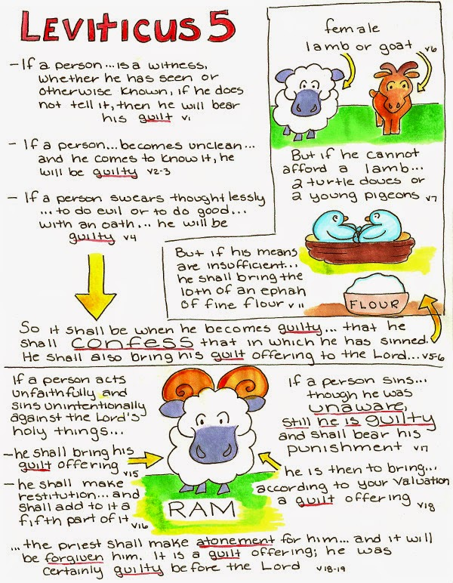
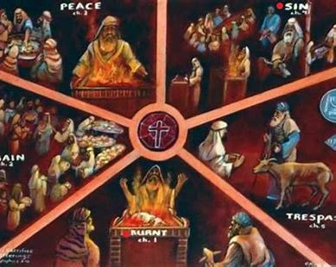
Next Sunday we will see how all 5 offerings have practical
application for today in our salvation and sanctification

Slide 5
Leviticus 5:1-6:7, Bring Your Trespass Offering to the LORD
Trespass (specific) | Offeror | Offering | Offeree (Priest) | Comment
5:1-13 1. Witness that stays silent (spiritual health) 2. Touch unclean thing (physical health) 3. Touch unclean person (physical health) 4. Pronounce an oath (spiritual health) * specific personal sins | 1. Sin > 2. Guilty > 3. Confess > 4. Bring offering to the altar/priest > 5. Forgiven | 1. Lamb or goat, female OR 2. Two turtledoves or two pigeons OR 3. Grain-fine flour (no oil or frankincense, 1/10 ephah or ½ gallon) | 1-3. Makes atonement Two doves or pigeons 1st. Sin offering – wring off head, sprinkle blood 2nd. Burnt offering * N.T.: Today, the priest is the risen Christ, our Great High Priest, (Heb 4:14) | Sin hid then known Toward other people Sin (17x) Trespass (2x, 5:6-7) Iniquity (1x, 5:1) * N.T.: For conscience sake (Ro 13:5; 1Co 10:25,27-28)
5:14-19 1. In the holy things of the LORD 2. Disobey a Commandment of the LORD/Against the LORD | 1. Sin > 2. Guilty > 3. Bring offering to the altar/priest> 4. Forgiven | 1. Ram + silver shekels + 1/5 unto the priest (your estimation) 2. Ram + your estimation | 1-2. Makes atonement * the priests shall teach and judge the people, Ezekiel 44:23-24 (read chapter 44 for duties, responsibilities, & privileges of the priest) | Ignorance/did not know Trespass (5x) Sin (2x, 5:14, 17) Iniquity (1x, 5:15)
6:1-7 1. Lie to neighbor or in fellowship 2. Theft by violence 3. Deceived neighbor 4. Find lost thing and lie about it 5. Swear falsely | 1. Sin > 2. Guilty> 3. Bring Offering> 4. Forgiven> * with mind + hands + feet | Ram + principle + 1/5 unto the person trespassed against (your estimation) Material harm against a person | 1. Makes atonement * does not include sin offering, grain offering, or burnt offering as other trespass offerings | Knowingly/willful Trespass (4x) Sin (2x, 6:2, 4) Iniquity (0x) Restitution unto the person

Slide 6

Next Sunday Title: Today, Bring My Offerings unto Our Father in Heaven
Text: Leviticus 1-6:7 and Hebrews

