Slide 1

Fellowship Church – Sunday School – July 4, 2021
“Give me liberty or give me death! “ Patrick Henry
Ye shall know the truth and the truth shall set you free. John 8:32
I am the way, the truth, and the life; no man cometh unto the Father except by me
John 14:6
My little children, let us not love in word, neither in tongue; but in deed and in truth.
1 John 3:18
9:55 Countdown

Slide 2
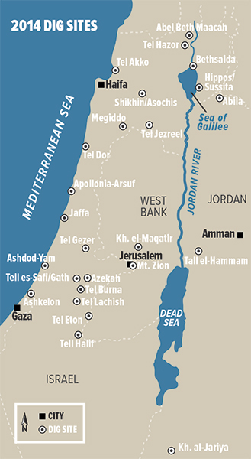
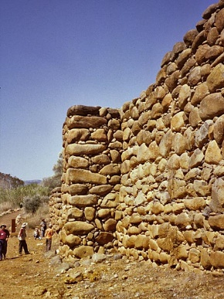
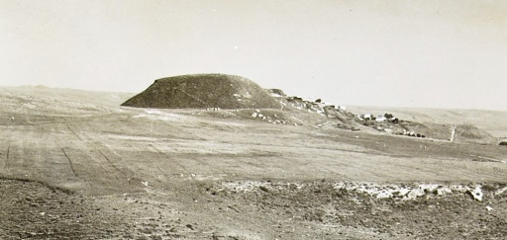
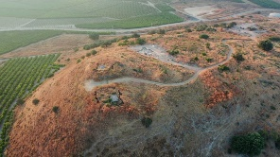
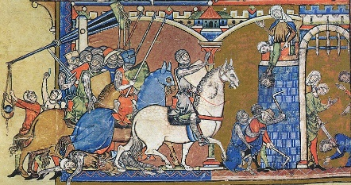
2 Samuel 20:14-22
A Wise Woman Saves a City
Deuteronomy 20:10-12
Laws about Warfare - Cities that Accept or Refuse Warfare
A wise woman knew the truth and the truth set her city free
Two major Old Testament figures to set us free today – the Red Sea and the Jordan River.

