Slide 1
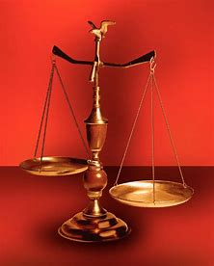
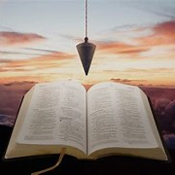
Perplexity to Praise, Trouble to Triumph, Grief to Glory
Fellowship Church, March 29, 2023 by Bill Heath
Following Christ in a
Balanced and Straight Way
Precept upon precept,
line upon line, here a little,
there a little (Isaiah 28:10,13)
#1 – Daily Scripture & Prayer Plan
#2 – Worldly Sin (Romans1:18-3)
#3 – God’s Salvation (Romans 4-5)
#4 – Who am I Connected to? (Ez 37)
#5 – Life ain’t what it use to be (1Cor 13:11)
#6 – Jesus in the Tabernacle
#7 – A Peculiar Relationship (Joab-David)
#8 – Habakkuk
OT: Deut 25:13-16
Daniel 5:25-28
NT: Hebrews12:1
1 Cor 3:11-15
OT: Ps 5:8, Pr 4:25-27
Amos 7:7-8
NT: Mt 3:3, Acts 9:11
Hebrews 12:13

Slide 2
Life ain’t what it use to be (1 Cor 13:11)
Why? for us born of the incorruptible seed
1. God never changes (Malachi 3:6) God,
2. Jesus never changes (Hebrews 13:8)
3. The Holy Spirit never changes
Paul’s example and doctrine Paul,
5. Mankind changes and I
6. I change (2 Corinthians 3:17-18, 1 Jn 2:12-14)
7. We change
The next step (personal, Joel 2:25)
The end game (2 Peter 3:11-18)
The God Squad or 9 Commanding Officers (CO)
Leader: in front, Jesus Christ with binoculars & pistol
Fire Team #1: Doctrine (by faith, from the heart)
1st: COntent
2nd: COntext
3rd: COncise
4th: COncept
Fire Team #2: Application (obey or disobey)
1st: COmfort or COnvict or Challenge
2nd: COnfirm or COnfess
3rd: COnverse or COnsult
4th: COnduit and COnduit
Help as needed from behind: Medic & grenadier
Goal: COnsistently, COnsumed for the glory of God
Inductive Bible Study
(passage-based)
Observations
Interpretations
What? What?
Application
WWJD
WDJD
WMID

