Slide 1
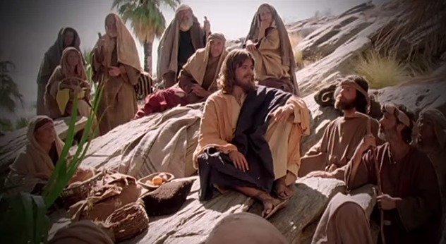
9:55 Countdown
Fellowship Church – Sunday School – April 25, 2021
Title: Five Foundations of Prayer
Text: Luke 11:1-13 Let us Pray
Ask about prayer (11:1), then follow the basics of prayer (11:2-4):
with friends (11:5-8), with actions (11:9-10), and with the Holy Spirit (11-13).
Foundation #1
PRELUDE ¹ And it came to pass, that, as he was praying in a certain place,
when he ceased, one of his disciples said unto him,
Lord, teach us to pray, as John also taught his disciples.

Slide 2
Five Foundations of Prayer from Luke 11:1-13
1. 11:1 Ask Jesus Teach (for every Christ follower)
11:2-4 Ask our Father Pattern (learn, practice, build upon, teach others)
11:5-8 Ask with friends Personal (needs, daily, here and now)
4. 11:9-10 Ask-Seek-Knock Pursuit (time, diligence, alertness, faith)
5. 11:11-13 Ask and Give Holy Spirit ( power, obedience, glory to God)
Foundation #2 Luke 11:2-4 has five (5) parts, see prayer cards
² Our Father which art in heaven, Hallowed (holy, set apart, special) be thy name.
(2) Thy kingdom come. Thy will be done, as in heaven, so in earth.
(3) ³ Give us day by day our daily bread.
(4) ⁴ Forgive us our sins; for we also forgive every one that is indebted to us.
(5) Lead us not into temptation; but deliver us from evil.

Slide 3
Foundation # 3
⁵ And he said unto them, Which of you shall have a friend, and shall go unto him at midnight, and say unto him, Friend, lend me three loaves;
⁶ For a friend of mine in his journey is come to me, and I have nothing to set before him?
⁷ And he from within shall answer and say, Trouble me not: the door is now shut, and my children are with me in bed; I cannot rise and give thee.
⁸ I say unto you, Though he will not rise and give him, because he is his friend, yet because of his importunity he will rise and give him as many as he needeth.
Ask about prayer (11:1), then follow the basics of prayer (11:2-4):
with friends (11:5-8), with actions (11:9-10), and with the Holy Spirit (11-13).

Slide 4
Foundation # 4
⁹ And I say unto you,
Ask, and it shall be given you;
Seek, and ye shall find;
Knock, and it shall be opened unto you.
¹⁰ For every one that asketh receiveth;
and he that seeketh findeth;
and to him that knocketh it shall be opened.
Ask about prayer (11:1), then follow the basics of prayer (11:2-4):
with friends (11:5-8), with actions (11:9-10), and with the Holy Spirit (11-13).

Slide 5
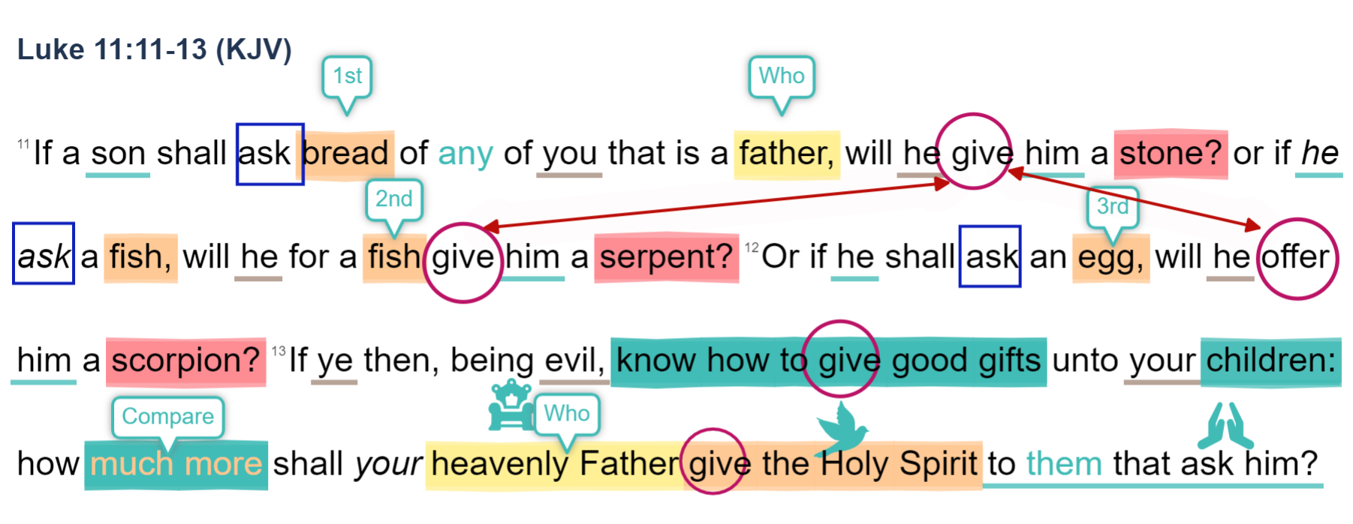
Foundation #5
Ask about prayer (11:1), then follow the basics of prayer (11:2-4):
with friends (11:5-8), with actions (11:9-10), and with the Holy Spirit (11-13).

Slide 6
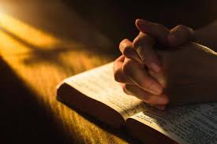
Prayer Cards in (9) areas:
Salvation for the unbeliever
Sanctification for the believer
Witness in S. Maryland Charles, St Mary’s, Calvert County
SMCA & Jude House
Missionaries & Ministries
Pastor Marvin and Sunday
Care and healing of the sick
Poor - Orphan - Widow - Outcast
Leaders in Govt and jobs Congressional District 7
Ideas for personal prayer

Slide 7
Look ahead
Take it home
Ask about prayer (11:1),
then learn the basics of prayer (11:2-4):
with friends (11:5-8),
with actions (11:9-10),
and with the Holy Spirit (11-13).
May 2 - Prayer and Praise in the Five Offerings: Leviticus 1-7
May 9 – Congregational Request ! ? __________________________
May 16 & 23 – Wayne Naylor teaches
May 30 – TBD, as the Spirit leads and teaches us (Luke 11:13)
perhaps the book of Acts
10:40 Countdown

