Slide 1
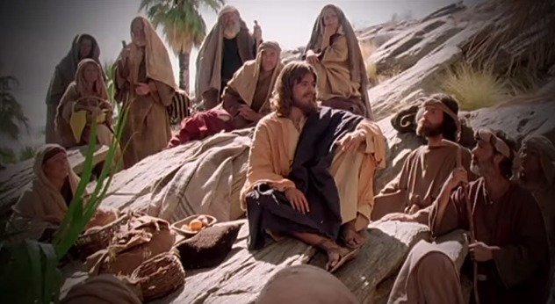
Fellowship Church - Wednesday Service – April 8, 2021
Title: Foundations of Prayer series Let us Pray series Text: Luke 11:1-13
Spotlight on Personal Revival

Slide 2
Five Foundations of Prayer from Luke 11:1-13 (put together in April 25 Sunday School)
11:1 Disciples ask Jesus Teach Feb10
11:2-4 Our Father in Heaven Pattern Feb 24
11:5-8 Ask for a friend Persist Mar 10
11:9-10 Ask-Seek-Knock Pursue Mar 24
11:11-13 Ask and Give Holy Spirit Apr 7
Luke 11:2-4 (KJV) Five (5) parts
² Our Father which art in heaven, Hallowed (holy, set apart, special) be thy name.
(2) Thy kingdom come. Thy will be done, as in heaven, so in earth.
(3) ³ Give us day by day our daily bread.
(4) ⁴ Forgive us our sins; for we also forgive every one that is indebted to us.
(5) Lead us not into temptation; but deliver us from evil.

Slide 3
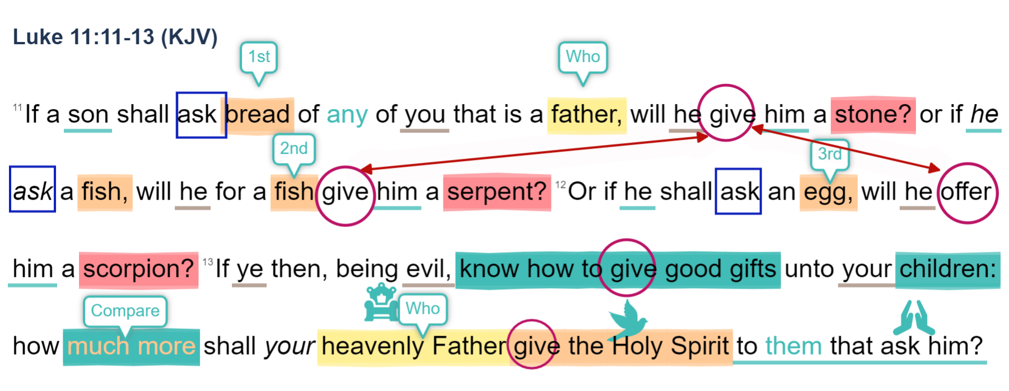

Slide 4
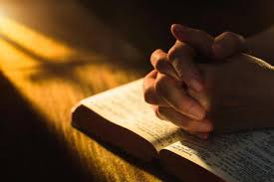
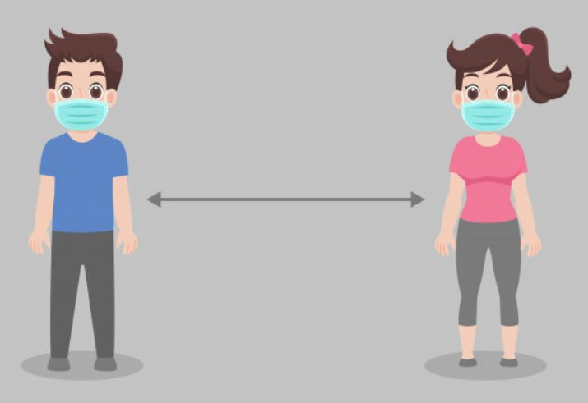
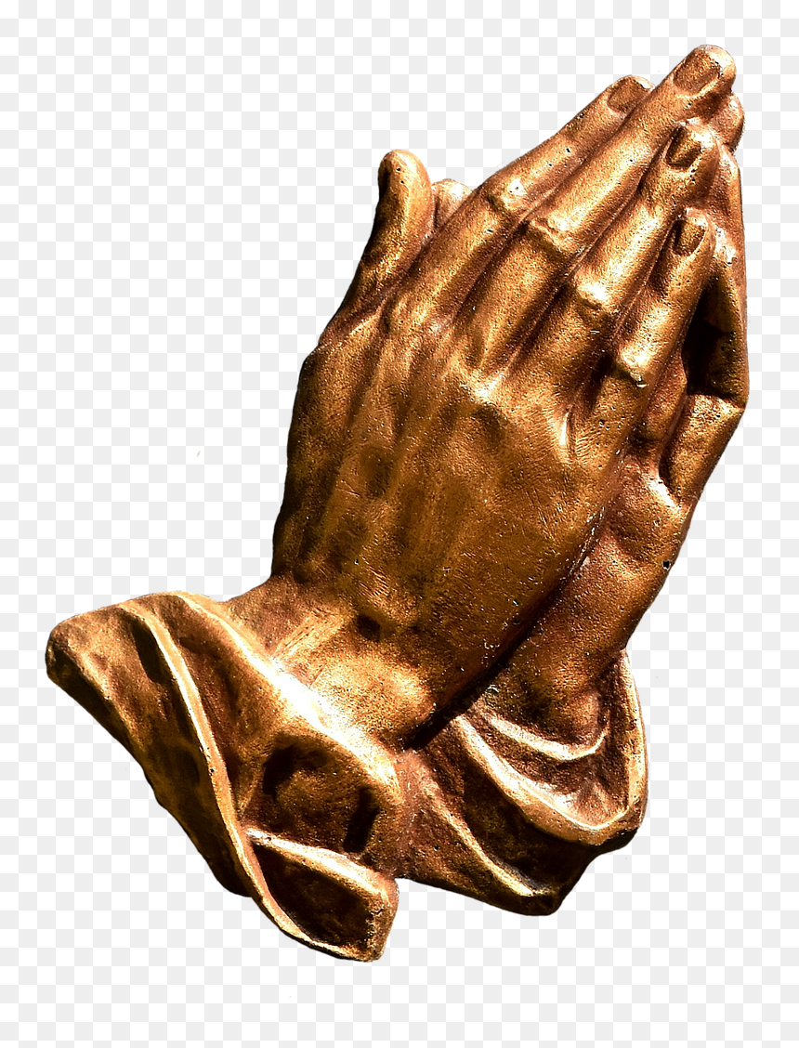
Small Group Prayer (at church and on YouTube)
Prayer Cards (9) for salvation, sanctification, witness in southern Maryland, SMCA & Jude House, Missionaries & Ministries, Pastor Marvin and Sunday, Healing, the Poor - Orphan - Widow - outcast, Our masters in Govt and jobs.
2. Groups of two. 1 microphone in center.
3. Pray from 7:15 to 7:30 (choice to continue praying until 8:30)
4. After Action Report (AAR) with people at church, and comments on YouTube

