Slide 1
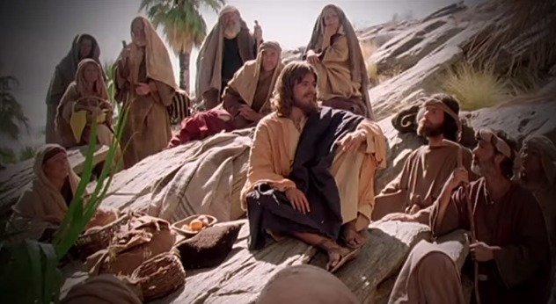
Fellowship Church - Wednesday Service – February 24, 2021
Title: Let us Pray series
Text: Luke 11
Established the need to pray together after study of Hosea and
1 Corinthians 10 in Sunday School, and Pastor Marvin’s approval “
Spotlight on Ben Carson

Slide 2
3
Faith
Feeling
Fact
2
1
Three Tiers of Sound doctrine, mind, words, speech, & faith (Timothy & Titus)
Tier (bottom-up) Severity Consequence Scripture
1st-Salvation Most Important Eternal Life or death John 3:16-17, Eph 2:8-9
2nd-Sanctification Very Important Eternal Reward 1 Thes 5:23, 1 Cor 3:1-4
3rd-Solid Rock Important Sound Doctrine Parable in Luke 6:47-49
Other
Sand Not Important Parable in Luke 6:47-49
(myths, fables, wives tales, psychology, philosophy, tradition, culture)

Slide 3
God Teaches us Five lessons on group prayer from Luke 11
11:1 Disciples ask Jesus Teach Feb10
11:2-4 Our Father in Heaven Pattern Feb 24
11:5-8 An Earthly Friend Persist Mar 10
11:9-10 Ask-Seek-Knock Pursue Mar 24
11:11-13 My Earthly & Heavenly Father Holy Spirit Apr 7
Luke 11:2-4 (KJV/WH paraphrase)
² Our Father in heaven, Hallowed (holy, set apart, special) be your name.
Your kingdom come. Your will be done, as in heaven, so in earth.
³ Give us day by day our daily bread.
⁴ Forgive us our sins; for we also forgive every one that is indebted to us.
Lead us not into temptation; but deliver us from evil.

Slide 4
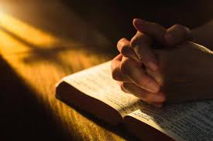
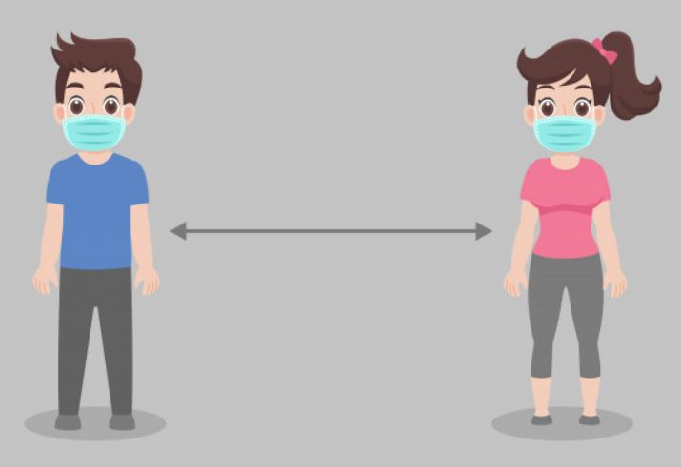
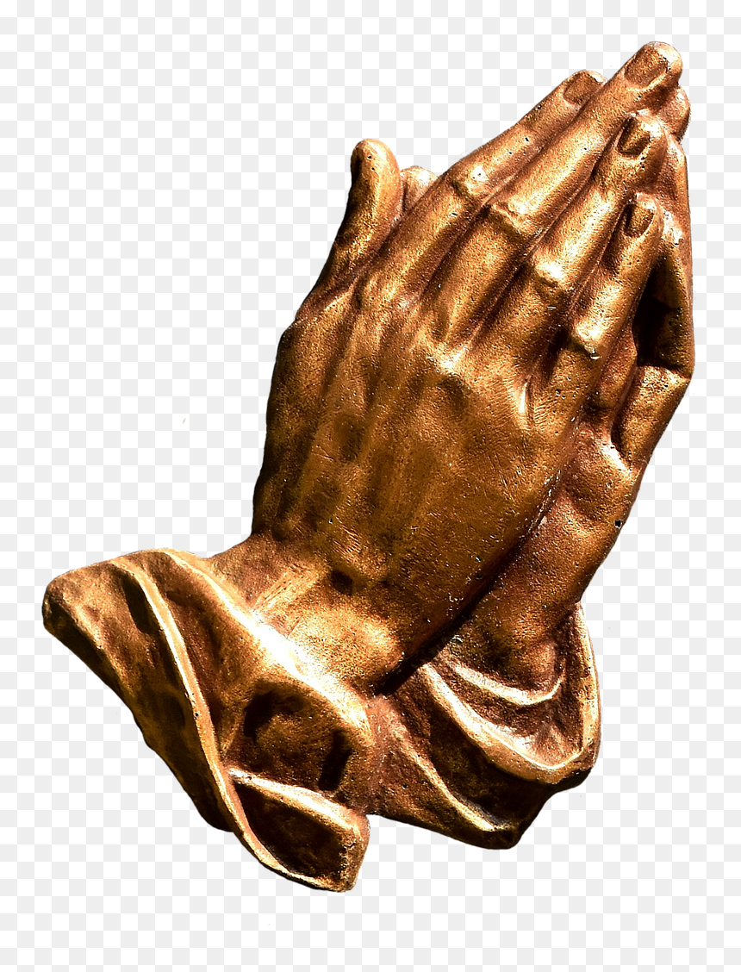
Small Group Prayer (at church and on YouTube)
Prayer Cards (9) on salvation, sanctification, witness in southern Maryland, SMCA & Jude House, Missionaries & Ministries, Pastor Marvin and Sunday, Healing, the Poor - Orphan - Widow - outcast, Our Rulers in Govt and jobs.
2. Groups of two (2). 2 microphones.
3. Pray from 7:05 to 7:30
4. After Action Report (AAR) with people at church, and comments on YouTube.
5. Invite to small group prayer on March 10th (we will continue until 8:00 pm)

