Slide 1
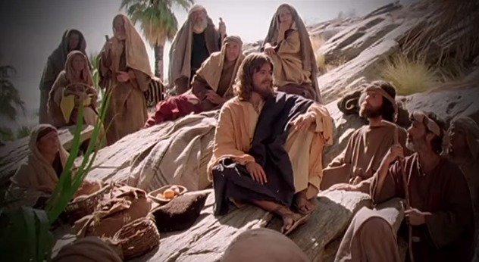
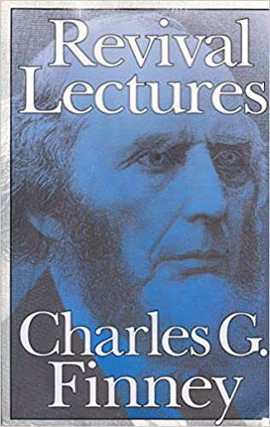
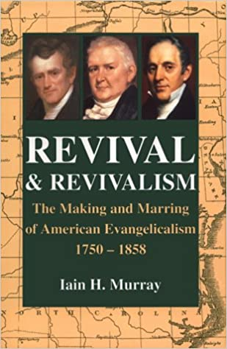
Fellowship Church - Wednesday Service – March 10, 2021
Title: Let us Pray series
Text: Luke 11
Established the need to pray together after study of Hosea and
1 Corinthians 10 in Sunday School, and Pastor Marvin’s approval “
Spotlight on Books about the School of Prayer

Slide 2
God Teaches us Five lessons on group prayer from Luke 11
11:1 Disciples ask Jesus Teach Feb10
11:2-4 Our Father in Heaven Pattern Feb 24
11:5-8 An Earthly Friend Persist Mar 10
11:9-10 Ask-Seek-Knock Pursue Mar 24
11:11-13 My Earthly & Heavenly Father Holy Spirit Apr 7
Luke 11:2-4 (KJV/WH paraphrase)
² Our Father in heaven, Hallowed (holy, set apart, special) be your name.
Your kingdom come. Your will be done, as in heaven, so in earth.
³ Give us day by day our daily bread.
⁴ Forgive us our sins; for we also forgive every one that is indebted to us.
Lead us not into temptation; but deliver us from evil.

Slide 3
The Persistent Prayer (5-8) builds upon the Pattern of Prayer (2-4) because of the request to teach us to pray (1)
5 And he said unto them, Which of you shall have a friend, and shall go unto him at midnight, and say unto him, Friend, lend me three loaves;
⁶ For a friend of mine in his journey is come to me, and I have nothing to set before him?
⁷ And he from within shall answer and say, Trouble me not: the door is now shut, and my children are with me in bed; I cannot rise and give thee.
⁸ I say unto you, Though he will not rise and give him, because he is his friend, yet because of his importunity he will rise and give him as many as he needeth.

Slide 4
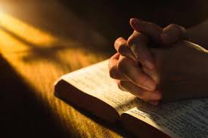
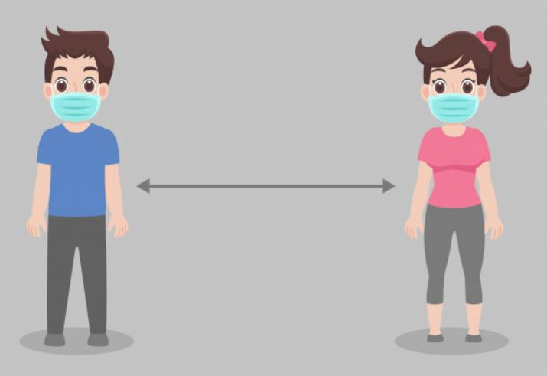
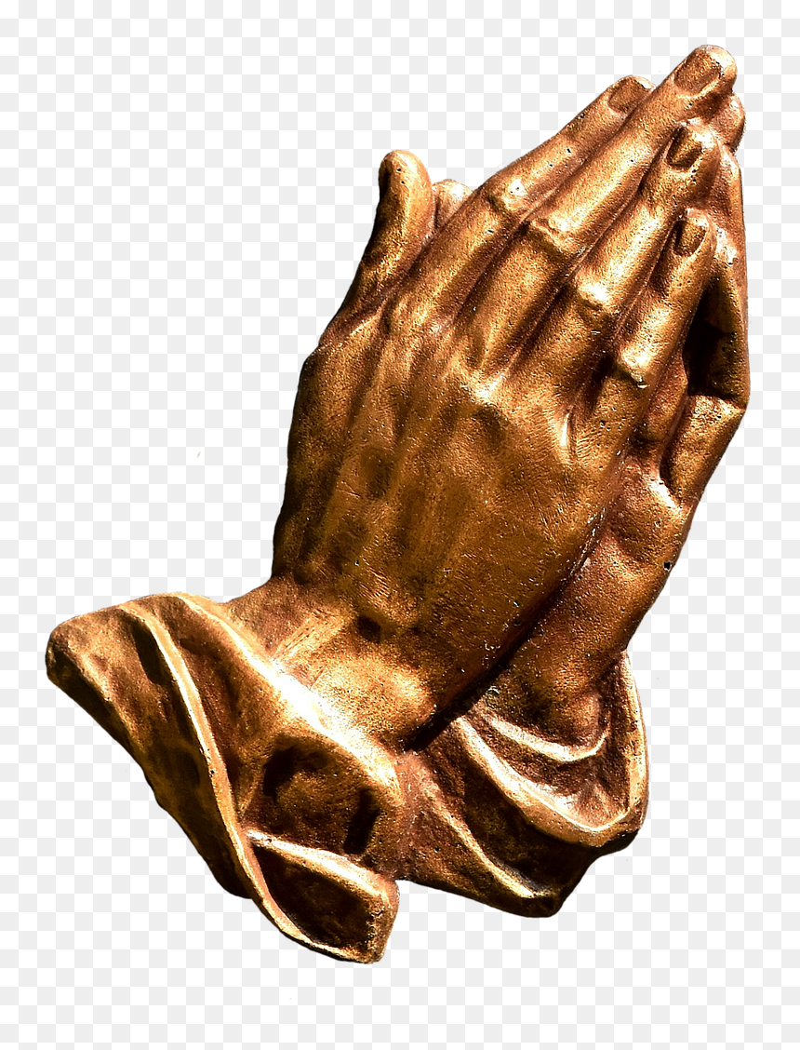
Small Group Prayer (at church and on YouTube)
Prayer Cards (9) on salvation, sanctification, witness in southern Maryland, SMCA & Jude House, Missionaries & Ministries, Pastor Marvin and Sunday, Healing, the Poor - Orphan - Widow - outcast, Our Rulers in Govt and jobs.
2. Groups of two or three. 2 microphones.
3. Pray from 7:10 to 7:30 (choice to continue praying until 8:00 pm)
4. After Action Report (AAR) with people at church, and comments on YouTube.
5. Invite to small group prayer on March 24th (we will continue until 8:15 pm)

