Slide 1
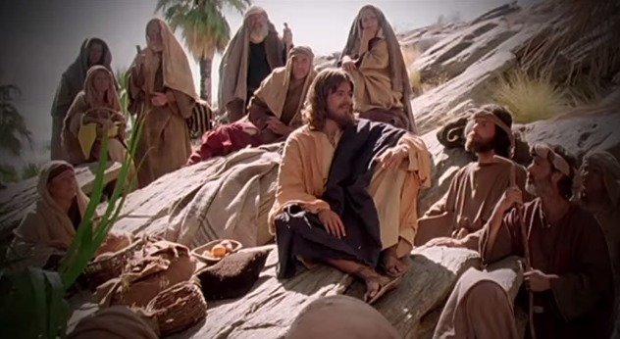
Fellowship Church - Wednesday Service – March 24, 2021
Title: Let us Pray series
Text: Luke 11
Established the need to pray together after study of Hosea and
1 Corinthians 10 in Sunday School, and Pastor Marvin’s approval “
Spotlight on Personal Revival

Slide 2
God Teaches us Five lessons on group prayer from Luke 11
11:1 Disciples ask Jesus Teach Feb10
11:2-4 Our Father in Heaven Pattern Feb 24
11:5-8 An Earthly Friend Persist Mar 10
11:9-10 Ask-Seek-Knock Pursue Mar 24
11:11-13 My Earthly & Heavenly Father Holy Spirit Apr 7
Luke 11:2-4 (KJV/WH paraphrase)
² Our Father in heaven, Hallowed (holy, set apart, special) be your name.
Your kingdom come. Your will be done, as in heaven, so in earth.
³ Give us day by day our daily bread.
⁴ Forgive us our sins; for we also forgive every one that is indebted to us.
Lead us not into temptation; but deliver us from evil.

Slide 3
The Basics of all Prayer
The Pursuant Prayer (9-10) builds upon the Persistent Prayer (5-8), which builds upon the Pattern of Prayer (2-4) because of the disciples request to teach us to pray (1)
⁹ And I say unto you,
Ask, and it shall be given you;
seek, and ye shall find;
knock, and it shall be opened unto you.
¹⁰ For every one that asketh receiveth;
and he that seeketh findeth;
and to him that knocketh it shall be opened.

Slide 4
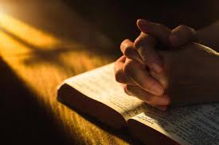
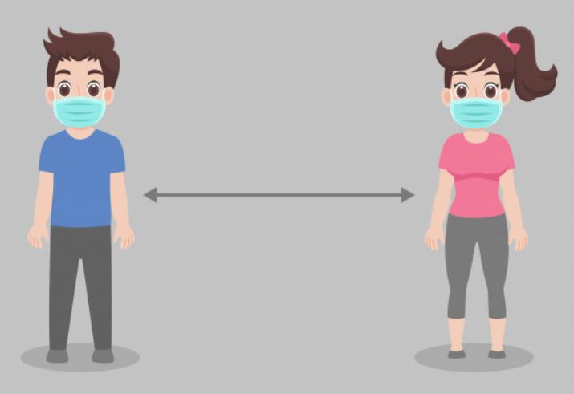
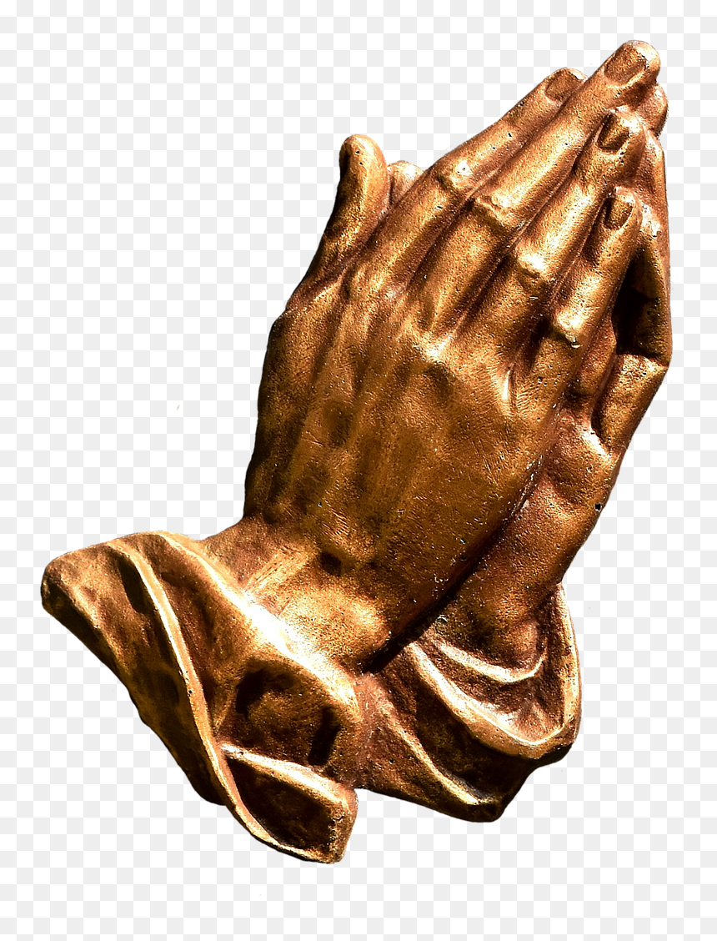
Small Group Prayer (at church and on YouTube)
Prayer Cards (9) on salvation, sanctification, witness in southern Maryland, SMCA & Jude House, Missionaries & Ministries, Pastor Marvin and Sunday, Healing, the Poor - Orphan - Widow - outcast, Our Rulers in Govt and jobs.
2. Groups of two or three. 2 microphones.
3. Pray from 7:15 to 7:30 (choice to continue praying until 8:15)
4. After Action Report (AAR) with people at church, and comments on YouTube.
5. Invite to small group prayer on April 7th (we will continue until 8:30 pm)

