Slide 1
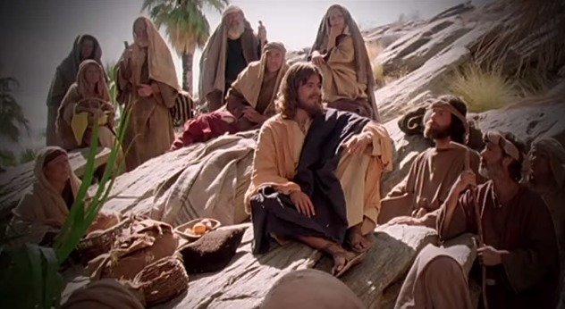
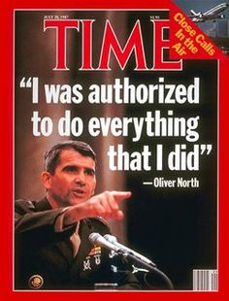
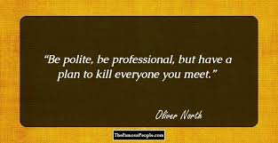
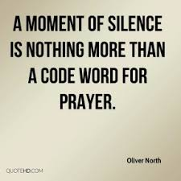
Fellowship Church - Wednesday Service – February 10, 2021
Title: Let us Pray
Text: Luke 11
Established need after study of Hosea and 1 Corinthians
10 in Sunday School

Slide 2
Fellowship Church White Plains Maryland
Sunday Service - at church or YouTube Live
10:00 School handout (1 Corinthians 10:13, Victory in Temptation)
10:40 Service music
11:00 Message by Pastor Marvin Harris
Wednesday Service - at church or YouTube Live
6:30 pm Prayer Helps, Handout
Thursday at Bob Evans
8:30 am Breakfast-Prayer-Small Group Bible Study
2021 Daily Quiet Time Schedule Hebrews finishes today. 1 John starts tomorrow.
Pure Flix - Spiritually healthy movies (30 days free trial) Recommend: John Light

Slide 3
3
Three Priorities of Sound Doctrine, mind, words, speech, & faith
Tier (bottom-up) Severity Consequence Scripture
1-Salvation Most Important Eternal Life or death John 3:16-17, Eph 2:8-9
2-Sanctification Very Important Eternal Reward 1 Thes 5:23, 1 Cor 3:1-4
3-Solid Rock Important Sound Doctrine Parable in Luke 6:47-49
Other
Sand Not Important Parable in Luke 6:47-49
(myths, fables, wives tales, psychology, philosophy, tradition, culture)
2
1

Slide 4
Luke 11 (KJV)
SPEAK LORD: Prayer Music
Luke 11:1 (KJV) ¶ And it came to pass, that, as he was praying in a certain place, when he ceased, one of his disciples said unto him, Lord, teach us to pray, as John also taught his disciples.
Three lessons on how to pray
11:2-4
11:5-8
11:9-13

Slide 5
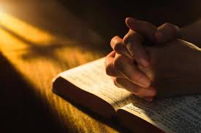
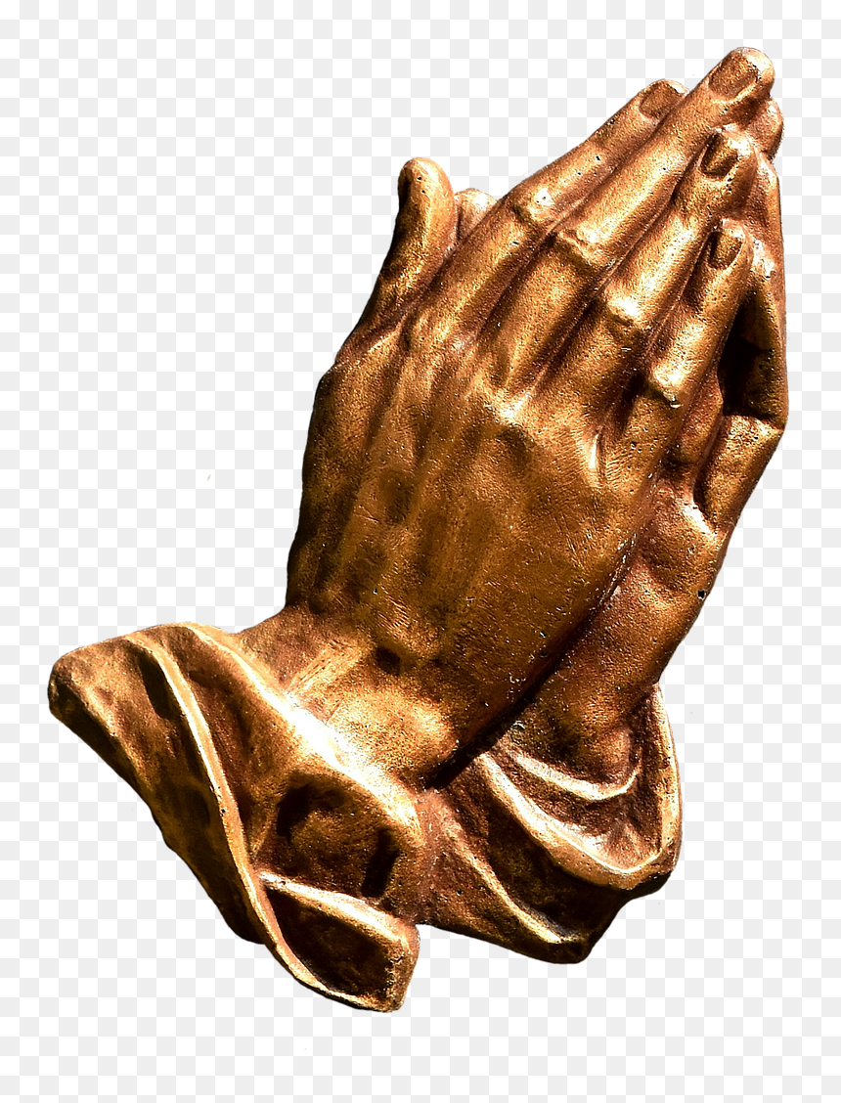
Small Group Prayer (at church or on YouTube)
1. Meet in families or men with men and women with women (and C19 rules)
Prayer Cards. Establish a group leader for procedure and posture.
Pray from 7:10 to 7:25
Finish in prayer, then YouTube stops. AAR for people at church.
Continue in prayer as long as small group desires at church or at home
Invite to small group prayer on February 24th

