Slide 1
Fellowship Church Sunday School Aug - Sep 2022, Our Lord Jesus Christ Sermon on the Mount Today – Turn to Matthew 11 He must increase, but I decrease Speaker: Bill Heath

Slide 2
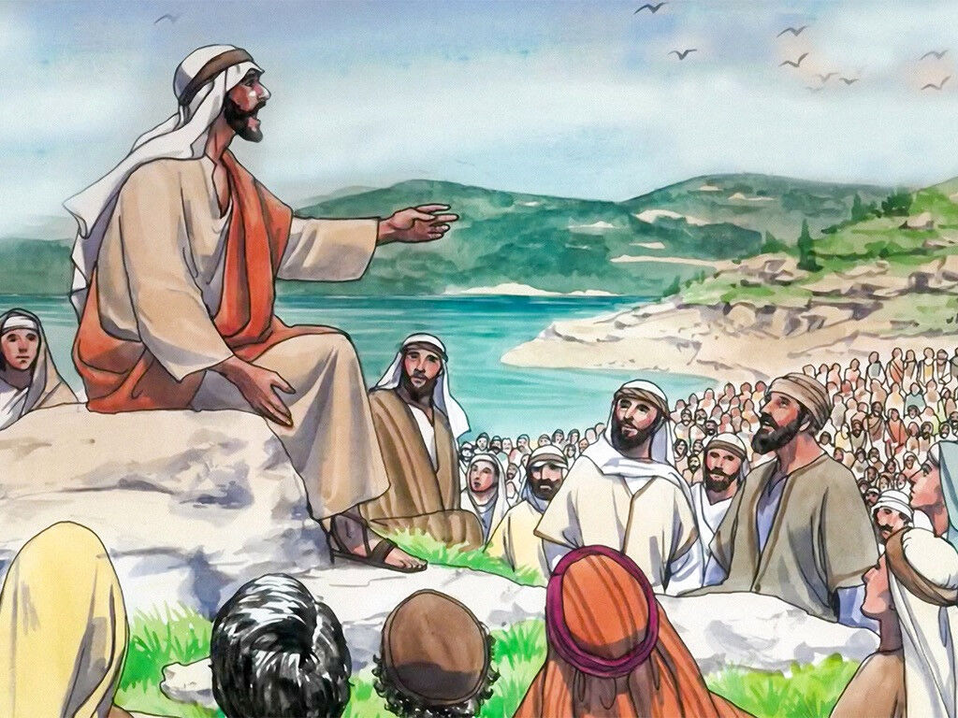
Matthew Outline Part 1, chapters 1-12 The Open Rise of Jesus Christ The Sermon on the Mount (Mt 5-7) reveals the “New and Better Way “ (Heb 12:24, 8:5, 10:1, Col 3, 2:17, Ro 15:4) for all Christ followers from Acts 2 until the rapture of the body of Christ in Revelation 4:1. 8-9 cluster of 11 miracles (New Wine requires New Bottles) 10 :1-2 Twelve Apostles selected and sent with authority 11 – He must increase, but I decrease 12 Part 2, chapters 13-28
Cluster of 11 Miracles (Mt 9:1-5)
1. Still the sea (nature)
2. Cleanse a leper (heal)
3. Heal centurion’s servant
4. Heal Peter’s mother-in-law
5. Heal sick at evening (multitude)
6. Heal a paralytic
7. Heal hemorrhaging woman
8. Heal two blind men
9. Raise ruler’s daughter (dead)
10. Demon’s enter herd of pigs
11. Demon-possessed mute

Slide 3
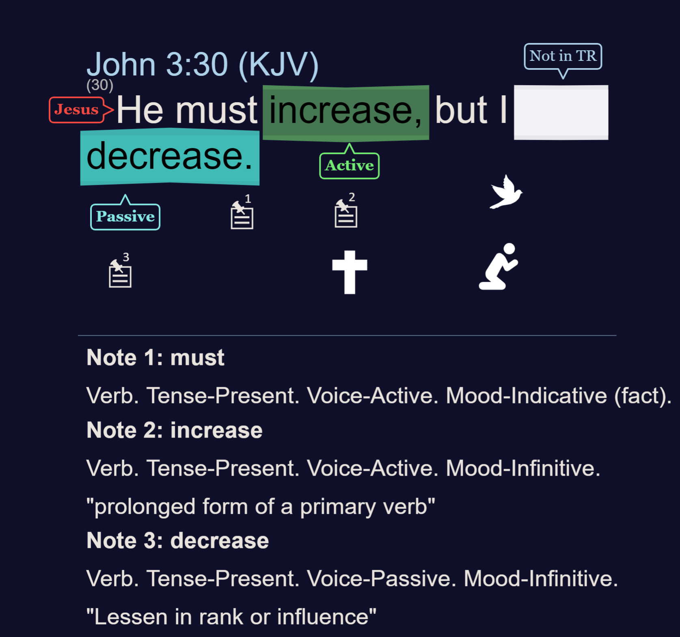
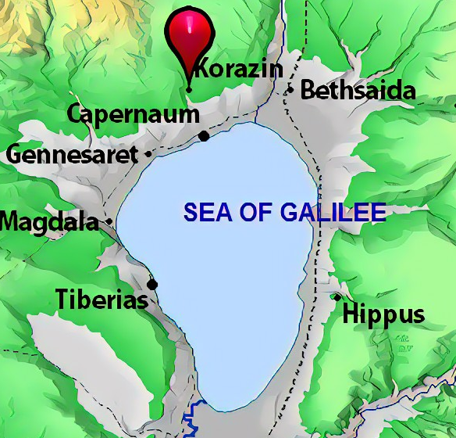
Matthew 11:20-24
The Day of Judgment is coming
(Books are opened at the
Great White Throne, Rev 21:27)

Slide 4
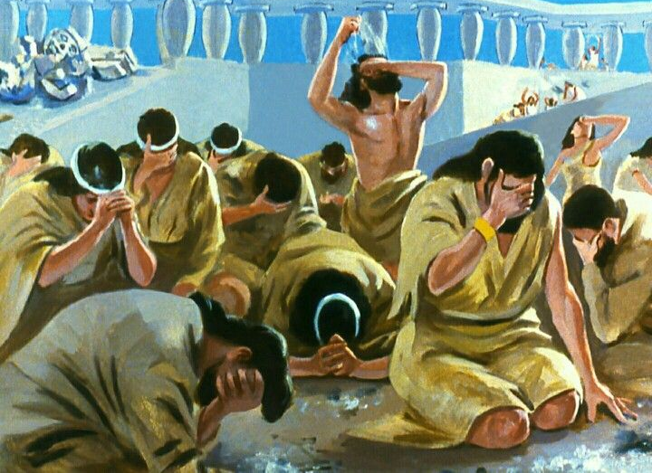
Matthew 11 – He Must Increase, but I Decrease (John 3:30, Luke 10:18, Gal 2:20, 2 Cor 4:12)
11:1-19 John the Baptist Prepares the Way
1-6 Jesus comforts John (who is in prison)
7-15 Jesus lifts up John (before the multitude)
16-19 Wisdom is justified of her children
(Luke 11:31, James 1:5-8, 3:13-18, 1 Corinthians 1:30-31)
11:20-30 More Light – More Judgment (20-24) John 9:1-5
or More Light – More Mercy (25-30) Romans 6:1
20-24 Degrees of judgment (Sodom > Capernaum > ? )
25-27 Prayer of thanks (God hides and reveals truth )
28-30 Take my yoke upon you, and learn of me
(John 5:30, 15:5, Phil 4:13 – Phil 4:9, 2 Tim 3:14)
Questions? Added Scripture for personal study. Next Sunday: Matthew 12 by Bill Heath

