Slide 1
Fellowship Church Sunday School Aug - Sep 2022, Our Lord Jesus Christ The Gospel of Matthew Today – Turn to Matthew 12 Jesus Increases above the Law, the Prophets, and the Kings Speaker: Bill Heath

Slide 2
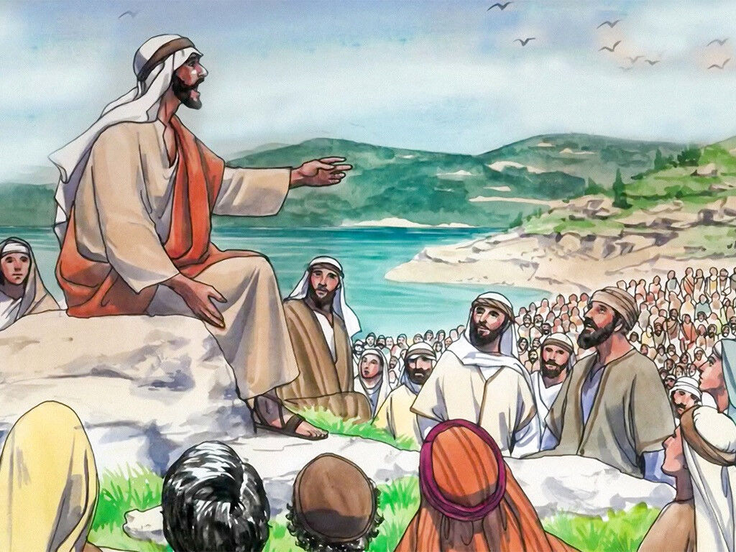
Matthew Outline Part 1, chapters 1-12 The Open Rise of Jesus Christ The Sermon on the Mount (Mt 5-7) reveals the “New and Better Way “ for all Christ followers 8-9 cluster of 11 miracles (New Wine requires New Bottles) 10:1-2 Twelve Apostles selected and sent with authority 11 He must increase, but I decrease 12 Jesus increases above the Law, the Prophets, and the Kings Part 2, chapters 13-28

Slide 3
Matthew 12 - Jesus Increases Above the Law, the Prophets, and the Kings
11:28-30 “I will give you rest,” “take my yoke upon you and
learn of me”, and “I am meek and lowly”
12:1-13 Jesus is greater than the Temple (the Law). He is the Sabbath rest.
12:14-21 The Pharisees (Israel) decide to kill Jesus, the meek and lowly king
---------------------------------------------------------------------------------------
12:22-37 Miraculous healing, good fruit, and blasphemy against the Holy Ghost
12:38-45 Jesus is greater than Jonah (the prophets) and Solomon (the kings)
12:46-50 Believers that “do” the will of our Father in Heaven are our family
Questions? Next Sunday: Matthew 13 by Bill Heath

Slide 4
Matthew 13: A seven-day devotional schedule from September 12 to 18
Monday 13:1-9 The Sower (#1 of 8)
Tuesday 13:10-17 Purpose of Parables
Wednesday 13:18-23 The Sower, explained
Thursday 13:24-35 Wheat & Tares (#2), Mustard Seed (#3) , Leaven (#4 )
Friday 13:36-43 Wheat & Tares, explained
Saturday 13:44-52 Field with Treasure (#5), Merchant with Pearl (#6),
Good and Bad Fish (#7)
Sunday 13:51-58 Scribe’s Treasure (#8), Rejection at Nazareth

