Slide 1
Fellowship Church Sunday School Aug - Sep 2022, Our Lord Jesus Christ The Gospel of Matthew Today – Turn to Matthew 13 Mystery Revealed in 7 Parables Speaker: Bill Heath

Slide 2
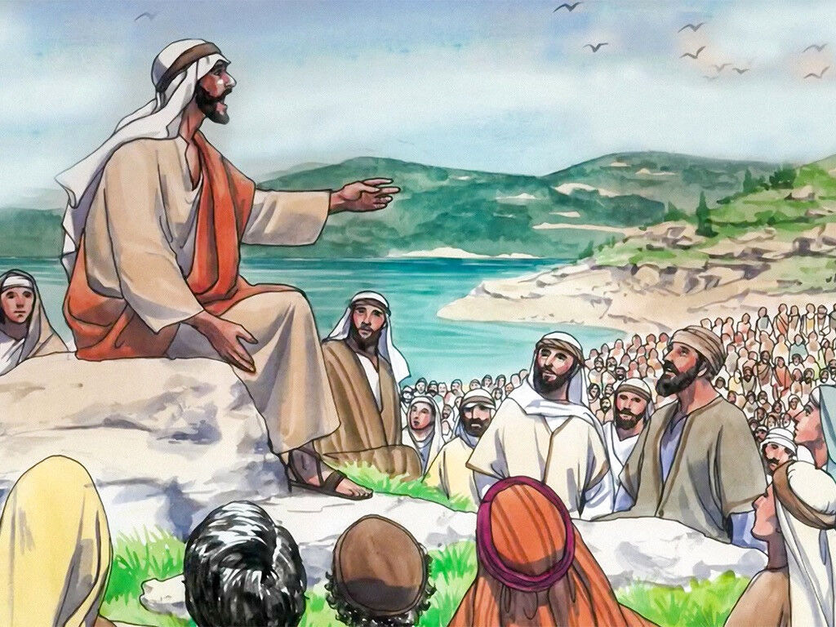
What is a Parable? 1. A mystery concealed in the Old Testament that the Holy Spirit reveals in the New Testament, (Mt 13:11, 51; Eph 3:3-6, Col 1:26-28). 2. Reveals the 5-fold kingdom of heaven: past, present, and future Past: Old Testament prophecy of Christ reigning on earth (Rev 19-20). Jesus on earth was “at hand” (Matthew 3:2, 4:17, 10:17) or “within you” (Luke17:1). Present: In the believer from Pentecost to Rapture (Romans 14:17). Future: When Christ returns (Revelation 19-20). The New Heaven and the New Earth (Revelation21:1-22:15). 3. Truth understood by possession of Christ (inward), but not profession of Christ (outward). 4. Earthly story that reveals eternal truth.

Slide 3
Matthew 13 - Seven Parables of the Kingdom of Heaven (mysteries revealed to true believers)
13:1-9 (1) Sower, Seed, & Soils 13:18-23 revealed Luke 8:4-15 Rev 2:1-6 * (1) to (4) to the multitudes 13:10-17 The purpose of parables revealed
13:24-30 (2) Wheat & Tares 13:36-43 revealed Rev 2:7-11
13:31-32 (3) Mustard Seed & Birds Mark 4:30-31, Luke 13:18-19 Rev 2:12-17
13:33-35 (4) Leaven Hid in Bread Luke 13:20-21 Rev 2:18-29
---------------------------------------------------------------------------------------------------------------------------
13:44 (5) Man Buys a Field for Treasure Rev 3:1-6
13:45-46 (6) Merchant Buys a Pearl of Great Price Rev 3:7-13
13: 47-48 (7) Separation of Good Fish & Bad Fish 13:49-50 revealed Rev 3:14-22
* (5) to (7) to the disciples 13:51-52 The scribe’s treasure of new & old
13:53-58 Jesus rejected at Nazareth
Questions? Next Sunday: Matthew 24 by Bill Heath

Slide 4
Matthew 24: A seven-day devotional schedule from September 19 to 25
Monday 24:1-3 A Response by Jesus and the Disciples Triple Question
Tuesday 24:3-14 Jesus Answers the Disciples about the Church Then and Today
Wednesday 24:15-22 Jesus Answers the Disciples about Israel
Thursday 24:23-26 “put your own title”
Friday 24:32-35 Jesus Answers the Disciples about the Church with 4 Parables
Saturday 24:36-39 No One Knows When Jesus Will Return
Sunday 24:40-51 “put your own title”

Slide 5
Matthew 13: A seven-day devotional schedule from September 12 to 18
Monday 13:1-9 The Sower (#1 of 7)
Tuesday 13:10-17 Purpose of Parables
Wednesday 13:18-23 The Sower, explained
Thursday 13:24-35 Wheat & Tares (#2), Mustard Seed (#3) , Leaven (#4 )
Friday 13:36-43 Wheat & Tares, explained
Saturday 13:44-52 Field with Treasure (#5), Merchant with Pearl (#6),
Good and Bad Fish (#7)
Sunday 13:51-58 Scribe’s Treasure, Rejection at Nazareth

