Slide 1
Fellowship Church Sunday School Aug – Oct 2022, Our Lord Jesus Christ The Gospel of Matthew Today – Turn to Matthew 24 The End of the World Speaker: Bill Heath

Slide 2
End of the World Views (when and what sign)
Biblical View
Jesus Christ is the Son of God who came 2000 years ago and is coming again.
2 phases (New Testament and literal, especially 1 & 2 Thessalonians, & 1 Cor 15)
For His saints (rapture: we go up to meet Christ in the air, Pre-tribulation)
With His saints (coming to reign on the earth for 1000 years, Matthew 24-25)
OR
1 phase (Old Testament and figurative, avoid the book of Revelation)
Jesus returns for His saints at unknown time (the 7–year tribulation is historic)
OR The church will make earth like heaven (amillennial)
World Views (Danger - Danger, Do not mix world views with Biblical views)
Philosophy, tradition, many ways or prophets to know God.
Evolutionist and evolutionary creationist. Hedonist.
Heat or cold from the sun, meteor, nuclear war, aliens, environmental
Globalist, humanist, atheist, communist, World Council of Churches, United Nations.

Slide 3
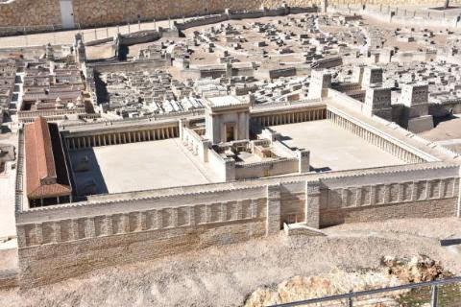
The last week of Jesus
Matthew 21:1-24:1a
Sunday – Palm Sunday
Cleanses temple
Curses fig tree
Teaches in temple court
Matthew 24:1b-26:2
Teaches at Mount of Olives
In sight of the temple >>>
Matthew 26:2 - after 2 days
is the feast of Passover

Slide 4
Matthew 23-25, Judgment for Sin of Israel (7 years)
before Jesus Returns and Reigns (Daniel 9:24-27)
Jesus at the temple court
23:1-39 Judgment on the scribes, pharisees, that generation, & Jerusalem
24:1-3 Judgment on the temple, then the disciples two questions (when and what sign)
Jesus at the Mount of Olives Jesus answers
24:4-14 Future Tribulation of Israel (after rapture of the church, 1 Thes 5:9, 1 Cor 15:51-57)
24:15-31 Future Great Tribulation of Israel /world (time of Jacob’s trouble, Jeremiah 30:7)
24:32-35 When: Parable of fig tree (Israel until fullness of the Gentiles, Romans 11:25-27)
24:36-39 When: Only God knows the day and hour (times of the Gentiles, Luke 21:24)
24:40-51 Parable of wise servant (“left” on earth), and evil servant (“taken” to hell)
25:1-46 Next Sunday with teacher Ray Remos

