Slide 1
Fellowship Church Sunday School Aug – Oct 2022, Our Lord Jesus Christ The Gospel of Matthew Today – Turn to Matthew 27 Jesus’ Last Day, Persecution (part 2) taught by: Bill Heath

Slide 2
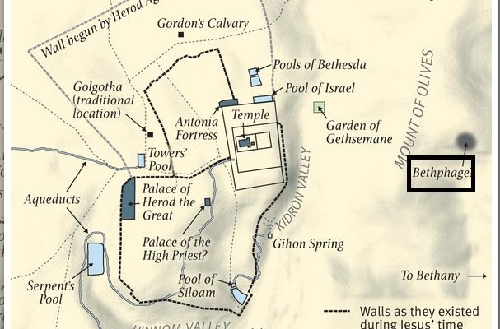
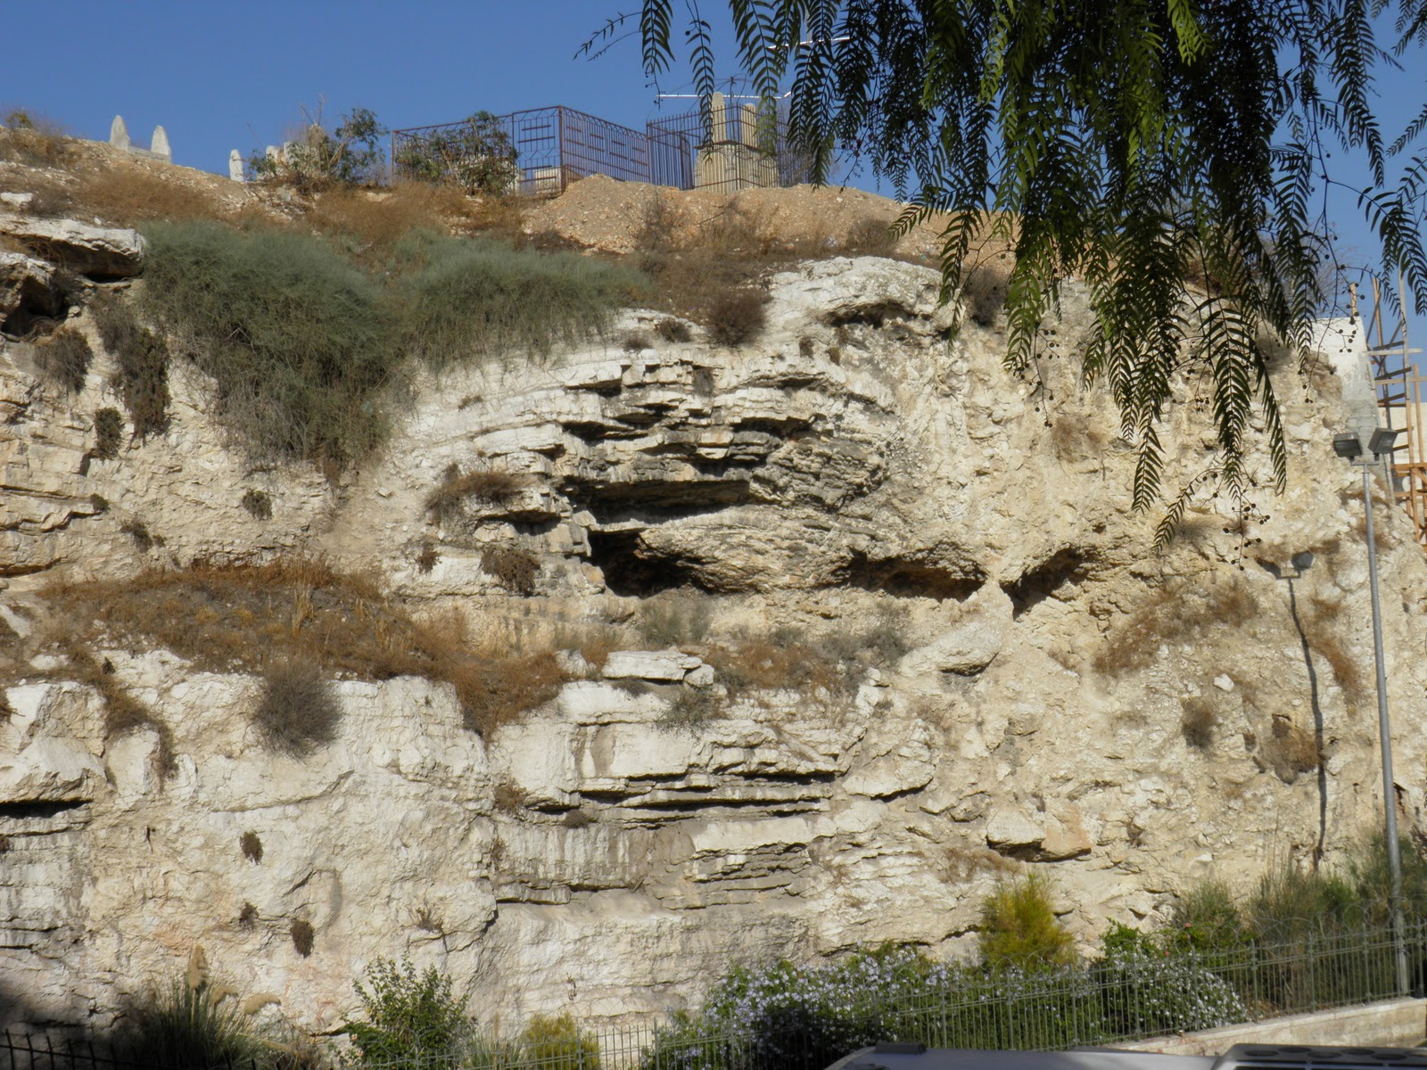
Tiberias
Herod Antipas
Pilate
Caesarea
Israel &
Jerusalem
Passover Feast
33 AD
Woman of
Bethany

Slide 3
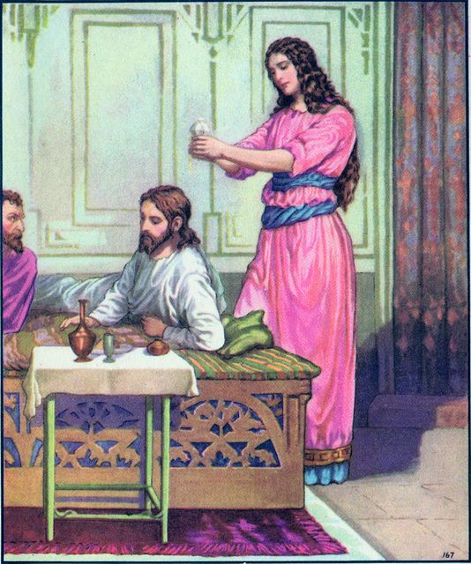
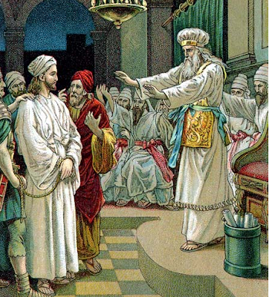
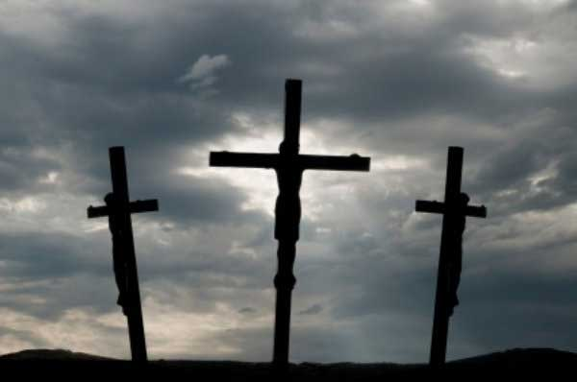
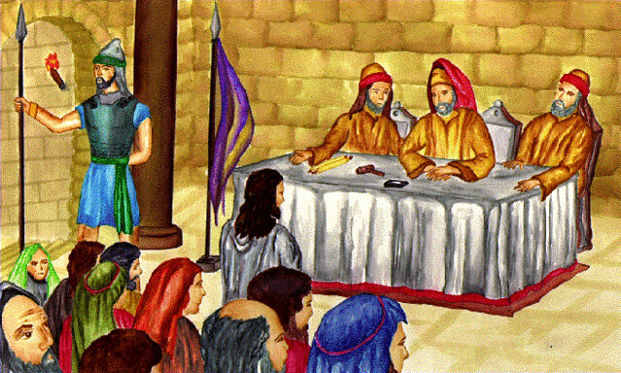
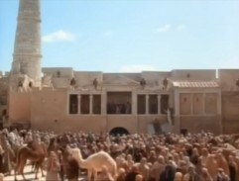
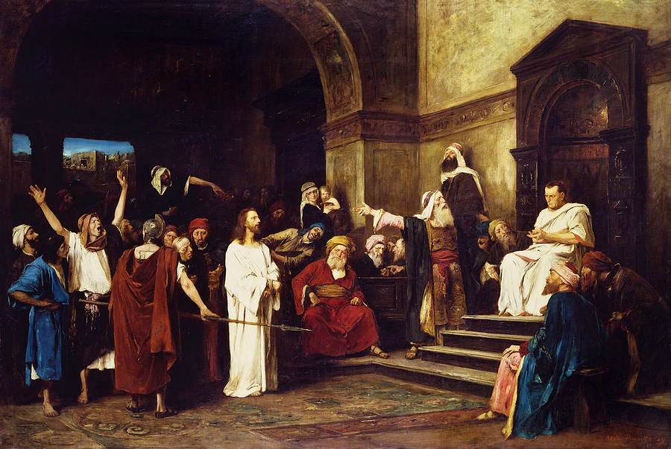
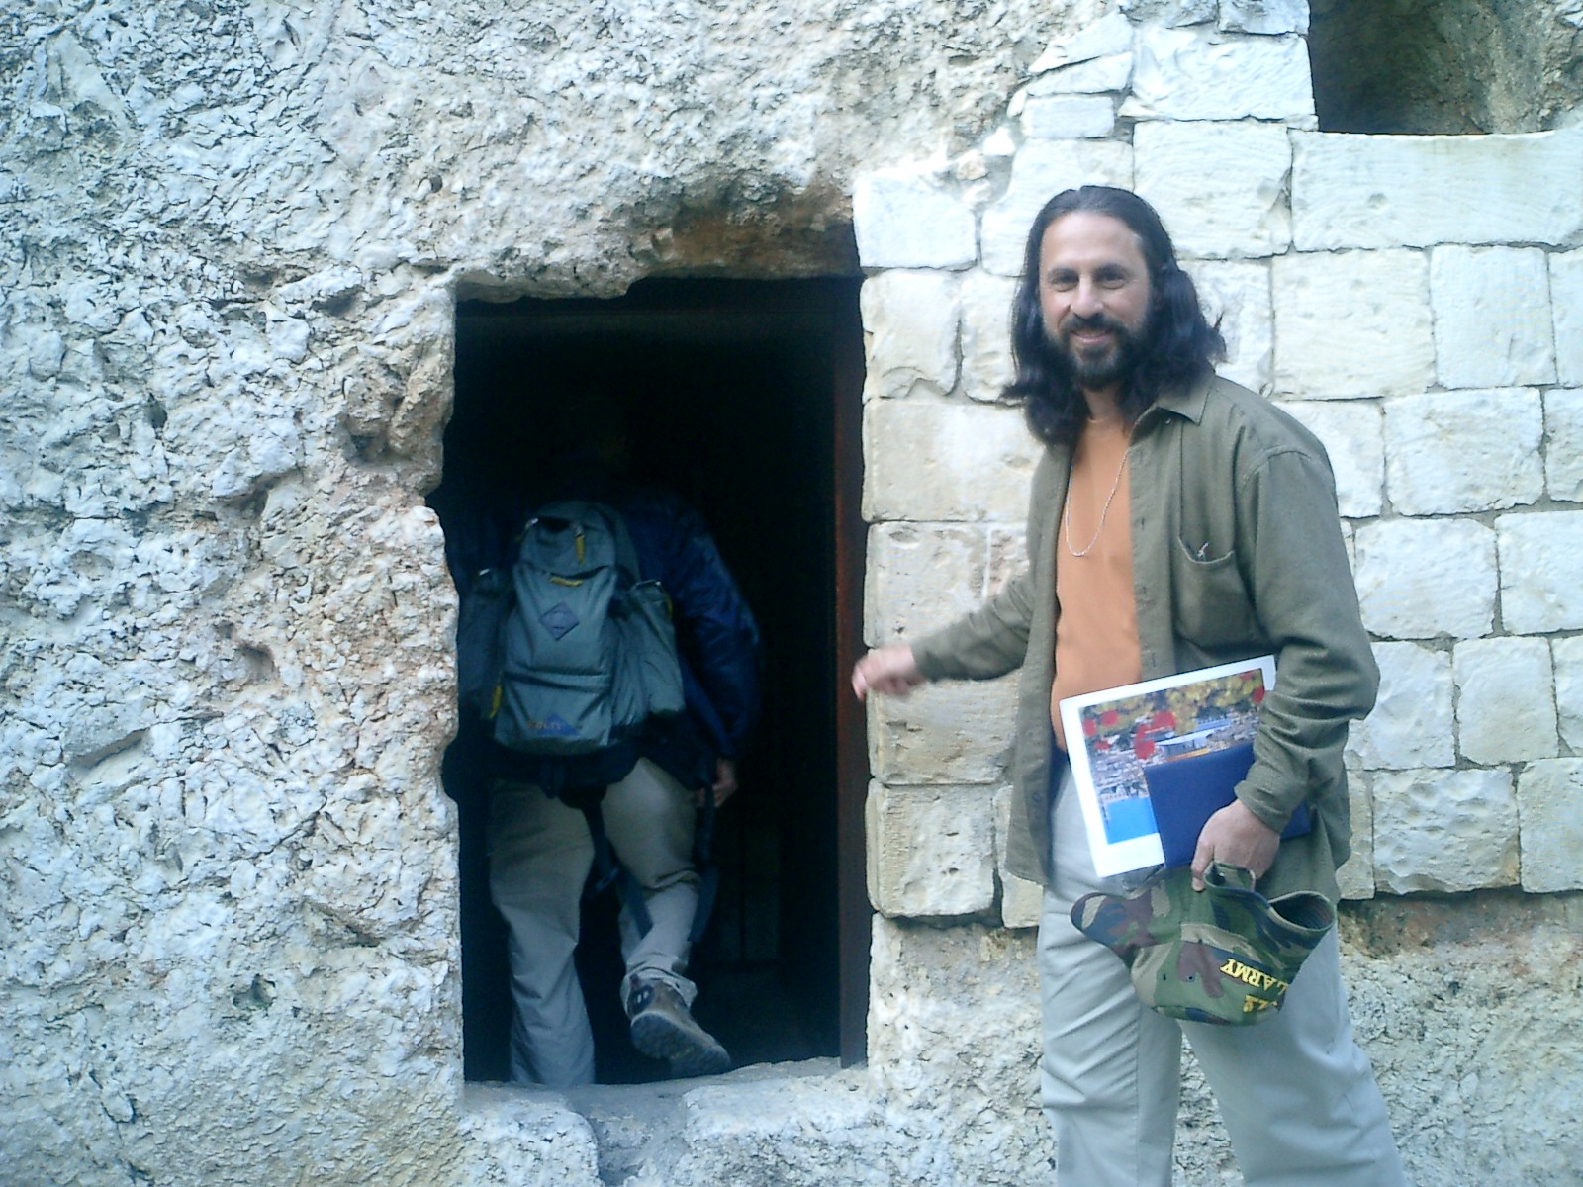

Slide 4
Jesus’ Last Day, Persecution (part 2)
Matthew Jesus’ last day , Persecution (part 2)
26:20 Passover Meal (sunset Thursday)
27:1-10 3rd trial, & suicide of Judas (before sunrise)
27:11-19 4th & 6th trials of Jesus (after sunrise)
27:20-25 7th trial of Jesus
27:26-34 Jesus is mocked & beat (Friday 7-9 )
27:35-50 Jesus is crucified (9-3)
27:51-56 After Jesus dies (Friday before sunset )
27:57-66 Jesus’ burial (after sunset and Saturday)
Women
26:6-13 anoints Jesus’ head-2 days before Passover
27:55-56 ministered unto Jesus, vs 61 Friday at grave
28:1-10 Sunday at the grave
Matthew 28 Next Sunday with Bill Heath
Jesus’ 7 Trials
Religious – Jewish Gospels
1 Annas OK (1)
2 Caiaphas Death Mt 26 (4)
3 Sanhedrin Death (3)
Secular – Roman
4 Pilate Not guilty (4)
5 Herod Not guilty (1)
6 Pilate Not guilty (4)
People – Multitude
People Guilty (4)

