Slide 1
Fellowship Church Sunday School
Aug – Oct 2022, Our Lord Jesus Christ
The Gospel of Matthew
Today – Turn to Matthew 28
Women, Sin, and Men taught by: Bill Heath

Slide 2
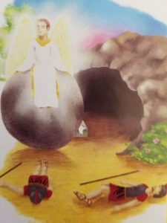
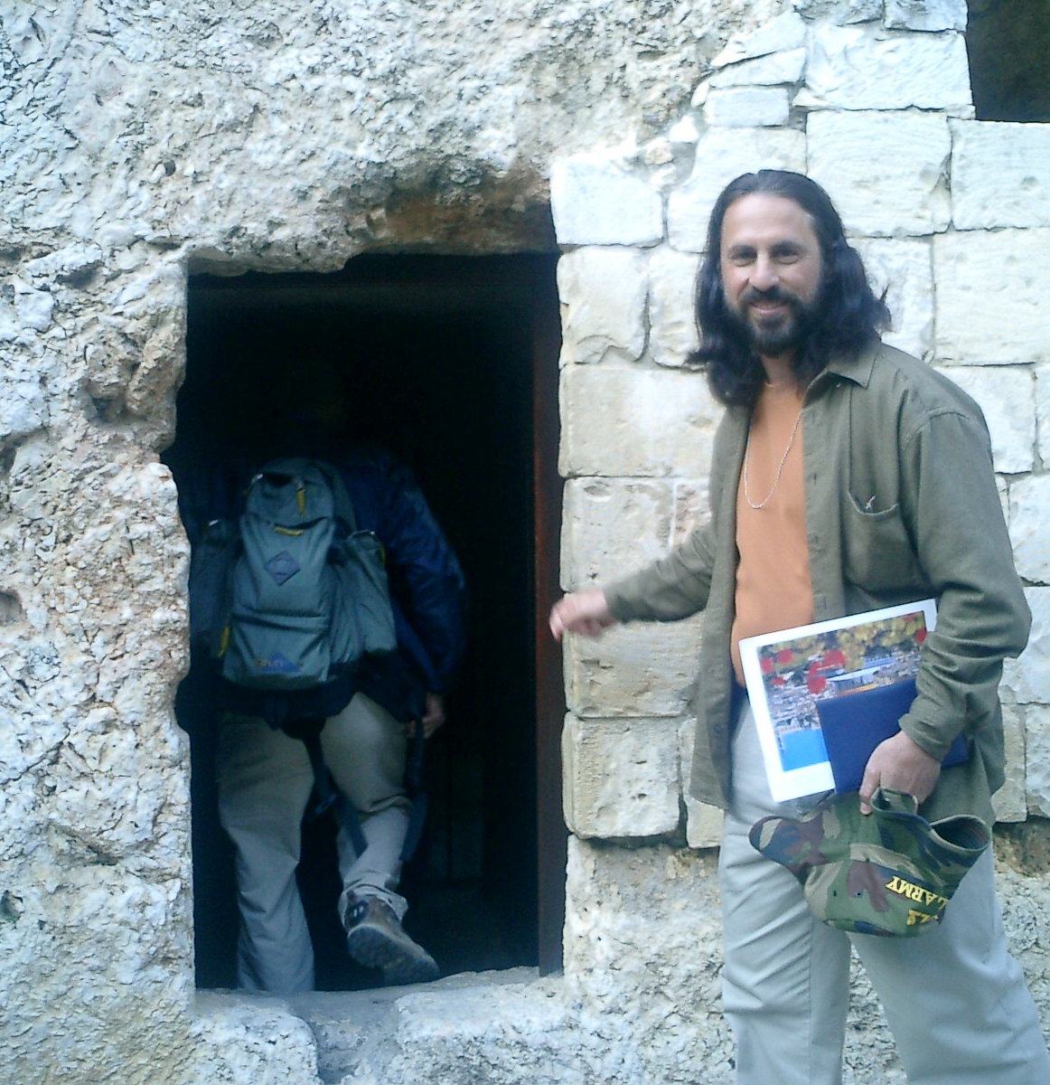

Matthew 28 - A Time and a Place

Slide 3
Women, Sin, and Men
Differences in the 4 Gospels
Matthew Genealogy - Abraham
Son of David. Lion face – Rev 4:7.
28:1-15 Resurrection (after)
28:18-20 commission until rapture
Mark Genealogy - none
Son of None. Ox face – Rev 4:7.
16:15-18 commission until 100 AD
16:19-20 Ascension (during)
Luke Genealogy - Adam
Son of Man. Man face – Rev 4:7.
24:46-48 commission until rapture
24:49 Promise Holy Spirit (Acts 2)
John Genealogy - God
Son of God. Eagle face – Rev 4:7.
21:15-22 Feed my sheep, follow me
21:23 Return (far future)
Matthew
28:1-10 Women follow Jesus
(vs 1-4) 1. Minister
(vs 5-8) 2. Obey
(vs 9-10) 3. Worship
28:11-15 Sin: Jewish elders bribe ($) soldiers
- Lies and coverup (humanism)
28:16-17 Sin: Some Apostles doubted Jesus
- no Pentecost yet (Romans 14:23)
28:18-20 Men follow Jesus (11 Apostles)
(vs 18) 1. Authority of Jesus
(vs 19) 2a. Go Teach salvation (disciple)
(vs 20a) 2b. Go Teach obedience
(vs 20b) 3. Security of Jesus
Daniel 1 Next Sunday with Bill Heath

