Slide 1
Fellowship Church Sunday School Aug - Sep 2022, Our Lord Jesus Christ Today – Turn to Matthew 4 Temptation & Turnover Speaker: Bill Heath

Slide 2
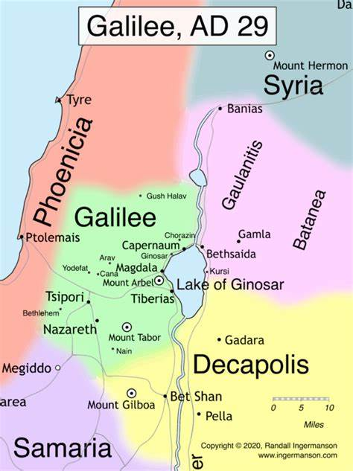
Matthew 4:12-13 in John 2-4 Early Judean Ministry (8 months) Cana: 1st miracle – changes water into wine. Capernaum: Jerusalem: Cleanses the Temple. Talks with Nicodemus. Samaria: Talks with a woman at the well. Cana: 2nd miracle – healed nobleman’s son. Nazareth: Rejected from his hometown.

Slide 3
Matthew 4 – Temptation & Turnover
4:1-11 Temptation (Genesis 3:6, Luke 4:1-3, 1 John 2:16)
1-4 1 - Lust of the flesh Deuteronomy 8:3
5-7 2 - Pride of life Psalm 91:11a-12, Deuteronomy 6:16
8-10 3 - Lust of the eyes Deuteronomy 6:13
11 Angels minister to Jesus
4:12-17 Turnover - John Decreases and Jesus Increases
12-13 Around 8 months recorded in John 2-4
14-16 Prophecy for Galilee of the Gentiles (Isaiah 9:1-2, light & darkness)
17 Repent for the kingdom of heaven is at hand (Matthew 3:2)
4:18-22 Turnover - Four Fishermen Surrender all to Follow Jesus
18-20 Peter & Andrew (before - John 1:35-51, after – Matthew 4:18-22)
21-22 James & John (before - ?, after – Matthew 4:18-22)
4:23-25 Jesus Teaches, Preaches and Heals/multitudes come to Jesus in Galilee
Questions? Next Sundays: Matthew 5-6-7 Sermon on the Mount

