Slide 1
Fellowship Church Sunday School Aug - Sep 2022, Our Lord Jesus Christ Today – Turn to Matthew 5 Sermon on the Mount – the Better Way Speaker: Bill Heath

Slide 2
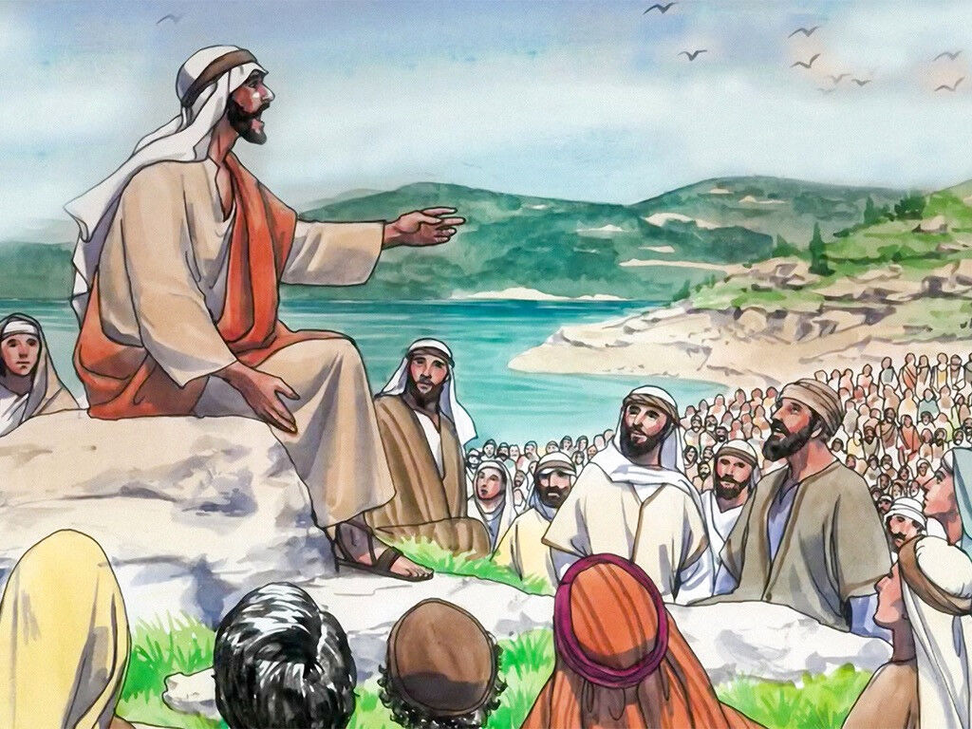
The Sermon on the Mount is not the plan of salvation nor for unsaved people. The Sermon on the Mount is a new standard for all past, present and future Christ followers (Jeremiah 31:31-34, John 12, Acts, Romans 11, Rev 1-3) and future: Tribulation saints (Rev 4-18) Millennial saints Heaven on earth (1 Cor 6:2, Rev 19-20) New Jerusalem (Rev 21-22)

Slide 3
1 Corinthians 6:2 (KJV) Do ye not know that the saints shall judge the world? and if the world shall be judged by you, are ye unworthy to judge the smallest matters? /Hebrews 10:24-25 “PROVOKE UNTO LOVE AND GOOD WORKS”/
2 Timothy 2:12 (KJV) If we suffer, we shall also reign with [him]: if we deny [him], he also will deny us:
Revelation 2:26-27 (KJV) And he that overcometh, and keepeth my works unto the end, to him will I give power over the nations: And he shall rule them with a rod of iron; as the vessels of a potter shall they be broken to shivers: even as I received of my Father. /“WE MUST ALL STAND BEFORE THE JUDGMENT SEAT OF CHRIST” 2 Cor 5:10-11 , 1 Cor 3/
Revelation 3:21 (KJV) To him that overcometh will I grant to sit with me in my throne, even as I also overcame, and am set down with my Father in his throne. /Revelation 2-3 “I KNOW THY WORKS”/
Revelation 5:10 (KJV) And hast made us unto our God kings and priests: and we shall reign on the earth.
Revelation 20:6 (KJV) Blessed and holy [is] he that hath part in the first resurrection: on such the second death hath no power, but they shall be priests of God and of Christ, and shall reign with him a thousand years.
Revelation 21:7 (KJV) He that overcometh shall inherit all things; and I will be his God, and he shall be my son.

Slide 4
Sermon on the Mount – the Better Way
5:1-12 The Eight Blessings (beatitudes are within 3-6, without 7-9, persecution 10-12)
Poor in spirit - Kingdom of Heaven
Mourn - Comforted
Meek - Inherit the earth
Hunger & thirst after righteousness - Filled
Merciful - Obtain mercy
Pure in heart - See God
Peacemakers - Children of God
Persecuted - Kingdom of Heaven
5:13-16 Believers are the Salt (13) and the Light of the World (14-17)
5:17-20 Christ Fulfills the Law & Teachers of the Kingdom of Heaven
5:21-48 Six Contrasts between the Law of Moses & the New Testament
1-Kill /Anger, 2-Adultery, 3-Divorce, 4-Oaths-Yes/No, 5-Go Extra Mile, 6-Hate/Love enemy
Questions? Next Sunday: Matthew 6 Raymund Remo

