Slide 1
Fellowship Church Sunday School Aug - Sep 2022, Our Lord Jesus Christ Sermon on the Mount Today – Turn to Matthew 7 Wisdom for the New & Better Way Speaker: Bill Heath

Slide 2
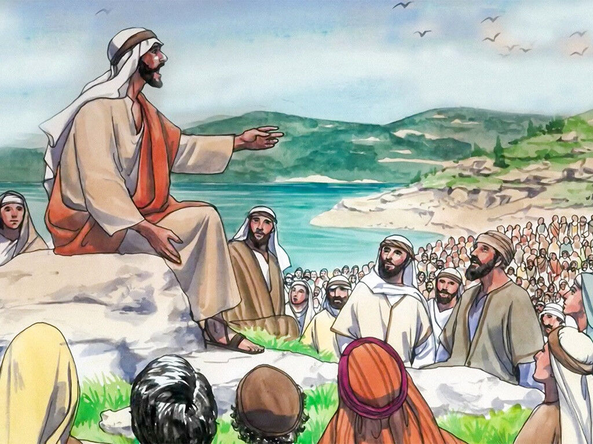
The Sermon on the Mount in Matthew chapters 5-7 is a New and Better Way for all past and present Christ followers until the rapture of the body of Christ. (Rev 1-5, 22:16-21, 1-2 Thessalonians) and future Tribulation saints Wrath on earth (Rev 6-18, 7 years) and future Millennium saints Kingdom of Heaven on earth (Rev 19-20, 1000 years) and future New Jerusalem (Rev 21-22:15, eternity)
* Water Baptism (show first 5 seconds)
The Sermon on the Mount is not the plan
of salvation nor for unsaved people. It is:
5 Knowledge for the New & Better Way (OT/NT)
Understanding for the New & Better Way (inward)
Wisdom for the New & Better Way (outward)

Slide 3
Matthew 7 – Wisdom for the New and Better Way (Heb 12:24, 8:5, 10:1, Col 3: 2:17, Ro 15:4)
7:1-12 Growing Outward in the New and Better Way
1-2 Judge not (saved 3-5 or unsaved 6)
3-5a Judge your self first, before a brother in Christ
5b Judge your brother in Christ (Mt 18, 1 Cor 6:1-8)
6 Judge not the unsaved (Colossians 4:5)
7-11 Ask, Seek, and Knock (Luke 11:7-11)
12 Do the Royal Law (James 2:8)
7:13-27 Be sure you and others are in the New and Better Way
13-14 Wide Gate (many) or Straight and Narrow Gate (few)
15-20 Evil Fruit or Good Fruit (Jeremiah 24, James 3)
21-23 Few Christians are in the New & Better Way (saved)
24-27 Build Your House on the Rock or Build Your House on the Sand (soul, 3 John 2)
28-29 Teach with Authority, not as the Scribes (Matthew 4:23 to 5:1)
Questions? Added Scripture for personal study. Next Sunday: Matthew 11 by Bill Heath

