Slide 1
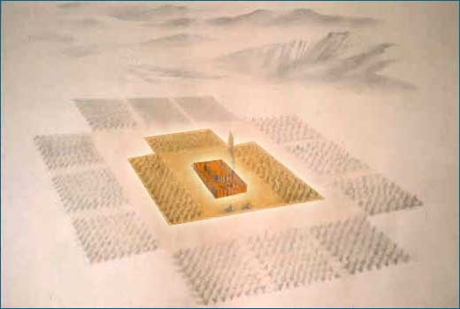
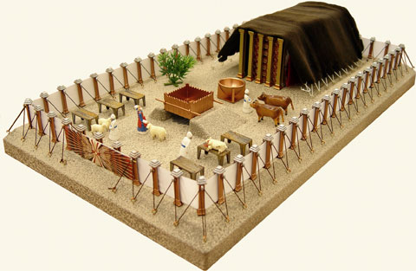
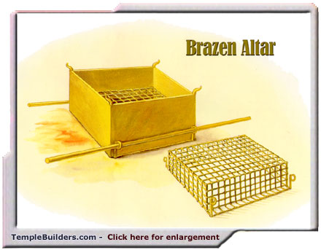
Fellowship Church – Sunday School – May 2, 2021
Title: Absolute Surrender
Text: Leviticus 1 and Romans 12:1-2
The Church in the Wilderness
The Tabernacle in the Wilderness
The Altar of Sacrifice

Slide 2
Leviticus 1 – Moses to the Children of Israel (Romans 15:4)
Offerer Any man that brings a burnt offering to the LORD
(1) Male without blemish. (2) own voluntary will. // First 3 offerings, Ro 12 //
(3) At the door of the tabernacle of assembly.
Put his hand upon the head for atonement. (only cattle or flock)
Kill the animal before the LORD. Sprinkle blood on the altar. (only cattle or flock)
Flay and cut the burnt offering into pieces (only cattle)
Priests Aaron’s sons (only cattle or flock)
7 -9, 11-13, 15-17 Maintain the altar fire and administer the offering
Result
9, 13, 17 a sweet savour to the LORD //First 3 offerings //
(First mention is Genesis 8:20-21. Matthew 5:13, 2 Cor 2:14-16, Eph 5:2)

Slide 3
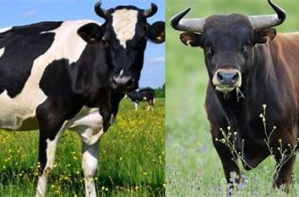
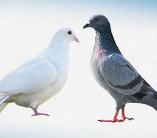
SIZE Large (Lev 1:3-9) Cattle: ox or bull | INCOME High (Lev 1:3-9) C-19 stimulus check > 160 K year (AGI) Married , filing tax jointly | NOTES Gain Income by: Work – Legal (good) Work – Illegal (evil) Work – Legal/Illegal Inheritance
Medium (Lev 1:10-13) Flock: sheep, goat, ram | Middle (Lev 1:10-13) C-19 stimulus check < 160 K year (AGI) | History: Time - Space National Cultural Family Personal
Small (Lev 1:14-17) Fowl: dove or pigeon | Low (Lev 1:14-17) Poverty < 26.5 K yr Joseph and Mary Luke 10:17-24, 1 Cor 1:25-31, 12:20-25, Romans14 | Equal access & opportunity Fair playing field Equal outcome: God - The Bible Jesus Christ The Holy Spirit The Congregation

Slide 4
Look ahead
Take it home
I volunteer absolute surrender
To follow Christ with the holy spirit
To be a sweet fragrance and living sacrifice unto god
Romans 12:1-2 in the context of romans chapters 12-16
May 9 – Daily Surrender, Leviticus 2
May 16 & 23 – Wayne Naylor teaches
May 30 – Fellowship Surrender, Leviticus 3
June – Leviticus 4 (sin), 5 (trespass), 6-7 (priesthood), and 23 (firstfruits)

