Slide 1
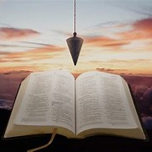
Fellowship Church, Sept 15, 2024 B Heath
Straight and Balanced
(Luke 3:4-6)
It's all about you Jesus (9:55-9:59)
1 – 12 beginnings (origins) of life with Adam, Genesis 1-2
2a – 12 beginnings (origins) of death with Adam, Genesis 3
2b – death with Cain & Noah, Genesis 4:1-9:17
2c – death with Nimrod & Babel, Genesis 9:18-11:32
3 – 12 beginnings of Israel with Abraham, Genesis 12-50
4a – exit from slavery in Egypt to the Red Sea, Exodus 1-12
4b – from the Red Sea to Mount Sinai, Exodus 13-18
4c – Mount Sinai (Law) 10 Commandments, Exodus 19-24
4d – Mount Sinai (Law) the Tabernacle, Exodus 25-40
5a – Mount Sinai (Law) approach a holy God, Leviticus 1-17
5b – Mount Sinai (Law) live a holy life, Leviticus 18-27
6a – Mount Sinai (Law) prepare to depart, Numbers 1-10
OT: Ps 5:8, Pr 4:25-27
Amos 7:7-8
Isaiah 28:13, 17
NT: Mt 3:3, Acts 9:11
Hebrews 12:13, Jude 3
1 Corinthians 15:1-4
2 Timothy 3:10, John 7:16
OT: Deut 25:13-16
Proverbs 20:10
Daniel 5:25-28
NT: Hebrews12:1
1 Cor 3:11-15
Philippians 4:5
James 3:17

Slide 2
at Mount Sinai (Law) & Tabernacle, Exodus 25-40
Date: 1490-1489 BC, appx 1 year camped at Mount Sinai (Exodus 19:1 to Numbers 10:10)
New Testament: Matthew 26:61, 27:40, 27:63, John 2:19-22, Acts 7:43-44, 1 Cor 6:19-20, 2 Cor 5:1,
Hebrews 8:2-5, 9:1-28, 13:10-14, 2 Peter 1:13-14, Revelation 15:5, 21:3
Exodus
Tabernacle Design 25-27
Offerings >Ark > Lampstand > Curtains > Boards > Sockets (silver) >Veil > Altar > Court (Lev 24:1-4)
Ceremonial laws 28-31
Priest’s clothes > Consecration (Leviticus 8:1-36) > Sacrifices > Altar of Incense > Anointing oil > Incense >
Skilled workers > Sabbath sign (In Genesis – no rules, testimony o 6-day creation)
3) Golden Calf 32-34
Moses comes down from Mt Sinai > Golden Calf (Deut 9:6-29, 10:1-5) > Moses’ entreaty and anger >
Journey resumed > Moses intercedes > 2 Tablets replaced > Covenant renewed > Moses face shines
Tabernacle Built 35-40
Sabbath > Skilled workers > Gifts received >Tabernacle underwritten > Construction proceeds >
Tabernacle completed > Cost > Priest’s clothes > Tabernacle erected > Glory of the LORD (Numbers 9:15-28)
Example and Shadow of heavenly things. Temporary, external, incomplete. 7 months w/Philistines. 50 chapters. 500 years.

Slide 3
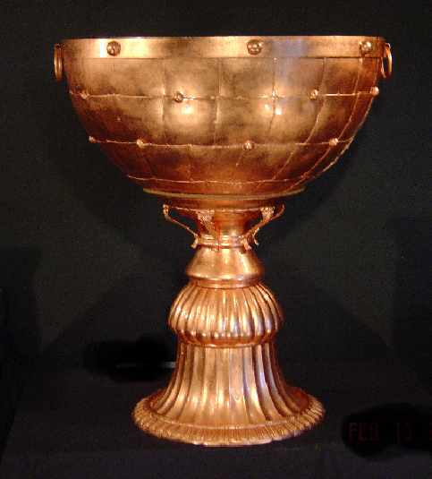
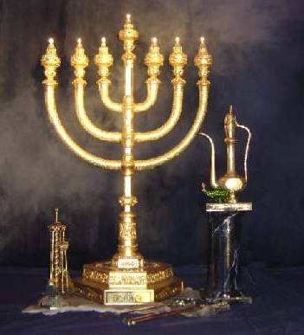
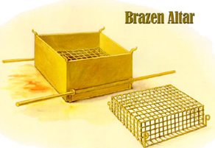
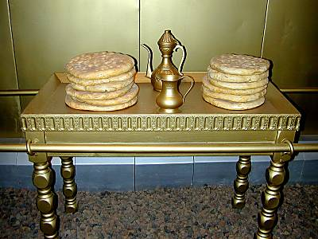
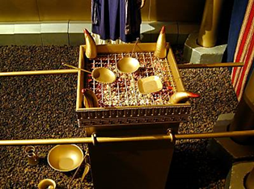
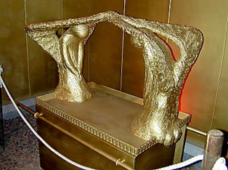
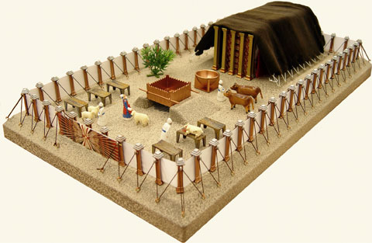
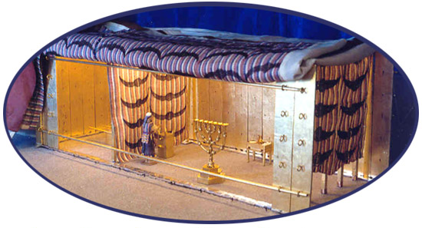
at Mount Sinai (Law) & Tabernacle, Exodus 25-40
John 1
Lamb of God
John 4
Living water
John 6-7
Bread of Life
John 8-9
Light of the World
John 10-17
Shepherd-vine
Revelation 1, 21-22
Alpha & Omega
John 1 –Lamb of God

Slide 4
Sunday School Schedule-2024
Mas de Cristo class
COMPLETED:
OT/ Genesis (4), Exodus (4), Psalms (4), Proverbs, Ecclesiastes, Amos, Obadiah, Malachi
NT/ Mark, Colossians, Philemon, James, Jude
The purpose of the Old Testament: (1) Learn – Romans 15:4 (2) Admonish – 1 Corinthians 10:1-10
(3) Shadow – Col 2:17, Heb 8:5, 10:1 (4) Figure – Ro 5:14, 1 Cor 4:6, Heb 9:9, 11:19, 1 Peter 3:21
(5) Type or antitype - specific people are like God or the Devil to help New Testament Christ-followers to
discern good from evil, obey God, follow Jesus, and be filled with the Holy Spirit.
Invitation to the 2024 daily Bible reading schedule.
Isaiah from May 9 to Oct 18. Copies on the back table.
Next Sunday, Leviticus 1-17, Approaching a Holy God
Notes:
-

