Slide 1
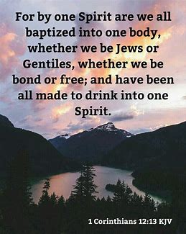

Slide 2
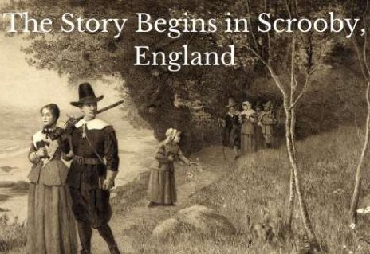
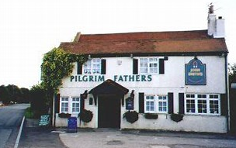
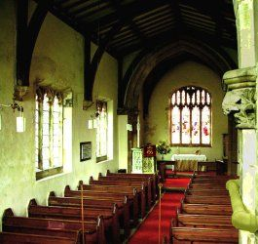
Pilgrims at Scrooby Manor, England
1604-1607
Congregation of 50 people (30 fled to Holland in 1608)
Leaders: John Robinson, William Brewster, and William Bradford
A "gathered" community, forming a simple church congregation around a Covenant. At this time it was treasonous to join voluntary associations or to form a church outside the Church of England.

Slide 3
Outline III of 1 Corinthians
Chapter Body (soma in Greek) Life
1-4 Body divided (0x) Problem
5-7 Body sins physically (12x) Problem
8-11 Body sins spiritually (6x) Problem
12-14 Body united (23x) Solution
What? 12:11-27, How? chapters 13-14
15 Body transformed (10x) Why? Resurrection
16 Body life (0x)

Slide 4
The Ekklesia is One Spirit and One Body
1 Corinthians 12:13 (context 12:10-27, doctrinal priority 2)
The more feeble are necessary (Romans 14)
Individuals Hate or Love one another Love one another
Foot-hand God has tempered the body
together
Ear-eye less honorable – more abundant honor No schism in the body
Eye-hear uncomely - more abundant comeliness Same care for one another
Hear-smell lacked – more abundant honor One member suffers,
All the members suffer with it
Eye-hand I have no need of you
Head-foot I have no need for you
1 Corinthians 12:31 “I show unto you a more excellent way” 1 Corinthians 13

