Slide 1
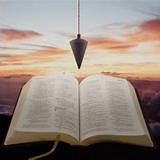
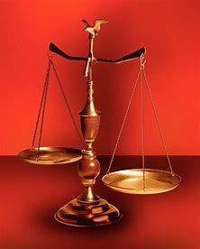
Fellowship Church, June 5, 2024 B. Heath
Straight and Balanced
(Luke 3:4-6)
Biblical characters (Hebrews 11:1-3)
#1 – Abel’s Faith & Innocent Blood (Heb 11:4, Gen 4)
#2 – Walking with God & with Enoch (Heb 11:5-6, Gen 5)
#3 – Secure on the Ark with Noah (Heb 11:7, Gen 6-11)
#4a – Our Faith with Abraham (Heb 11:8-19, Gen 12-23)
#4b – Sarah (Heb 11:11-12, 1 Peter 3:6-7)
#4c – Strangers & Pilgrims (Heb 11:13-16)
#5 – Isaac (Heb 11:20, Gen 24)
#6 – Jacob (Heb 11:21, Gen 25-36)
#7 – Joseph (Heb 11:22, Gen 37- 50)
#8 – Moses (Heb 11:23-29, Exodus-Deut)
#9 – Joshua (Heb 11:30, Joshua)
#10 – Rahab (Heb 11:31, Joshua 6)
#11 – Gideon, Barak, Samson & Jephthah (Heb 11:32, Judges)
#12 – David (Heb 11:32, 2 Samuel, 1 Chronicles)
#13 – Samuel (Heb 11:32, 1 Samuel)
#14 – Prophets (Heb 11:32-38, Isaiah-Malachi)
#15 – All (Heb 11:39-40, Old Testament saints)
OT: Ps 5:8, Pr 4:25-27
Amos 7:7-8, Is 28:13, 17
NT: Mt 3:3, Acts 9:11
Hebrews 12:13, Jude 3
1 Cor 15:1-4, 2 Tim 3:10
John 7:16
OT: Deut 25:13-16
Pr 20:10, Dan 5:25-28
NT: Hebrews12:1
1 Cor 3:11-15,
Philippians 4:5,
James 3:17

Slide 2
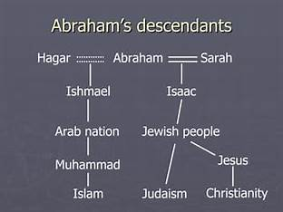
Genesis 1-2, 3-8, 9-11: truth passed in the Hebrew language
Genesis 12-23: the story of Abraham’s faith in God
Life of Sarah
Old Testament: Gen 11-25, Isaiah 51:2
Jesus: no reference
Acts: no reference
Letters: Romans 4:19 – salvation
Romans 9:9 – Israel past
Hebrews 11:
Revelation: no reference
50% of the world religions (Judaism, Islam, Christian)

Slide 3
Our Faith with Abraham (Hebrews 11:8-10, 17-19)
Time: 2000 BC. Places: Ur (Garden of Eden after the flood), Canaan, Egypt, Canaan
People: A man, a husband, a father, & extended family - Abraham (Abram), Sarai (Sarah), angels
Scripture
Hebrews 11:8-10 ⁸ By faith Abraham, when he was called to go out into a place which he should after receive for an inheritance, obeyed; and he went out, not knowing whither he went. ⁹ By faith he sojourned in the land of promise, as [in] a strange country, dwelling in tabernacles with Isaac and Jacob, the heirs with him of the same promise: ¹⁰ For he looked for a city which hath foundations, whose builder and maker [is] God.
17-19 ¹⁷ By faith Abraham, when he was tried, offered up Isaac: and he that had received the promises offered up his only begotten [son], ¹⁸ Of whom it was said, That in Isaac shall thy seed be called: ¹⁹ Accounting that God [was] able to raise [him] up, even from the dead; from whence also he received him in a figure. /figure=Hebrew parabole/
Decision: Let us go by faith in God as “our father Abraham”! (Romans 4:1, 12, 18)
Notes:
-

