Slide 1
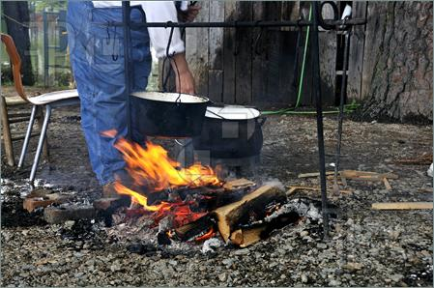
My/Our God Squad
(Nine Commanding Officers (CO) that Love Us)
1 John 2:12-14, 2 Timothy 2:1-7
Discipleship Bible study
9 phases to invite Jesus in 2024
16 May 2014, update Jan 10, 2024
Brother Bill Heath

Slide 2
My/our God Squad (9 COs that Love Us) 1 John 2:12-14
EVANGELIZE (spiritual baby)
-------------------------------------------------------
2. BASIC DISCIPLE (spiritual child)
1ST COntent Fire Team Leader # 1
2nd COntext Automatic Rifleman
3rd COncise Rifleman #1
4th COncept Rifleman #2
---------------------------------------------------------
3. MINISTERING DISCIPLE (spiritual young man)
5th COnfirm or COnvict Rifleman # 2
6th COmfort or COnfess Rifleman # 1
7th COnverse or COnsult Automatic Rifleman
8th COntrol and COnduit Fire Team Leader # 2
_--------------------------------------------------------
4. DISCIPLE MAKER (spiritual father)
9th COntinue with COnsistency, and COnsumed
for the glory of God

Slide 3
Our Squad Leader is Jesus, the Anointed One, the one in front. He has binoculars & a pistol for the distant & close up warfare.
EVANGELIZE (spiritual baby)
Repent & believe on the Lord Jesus Christ (Mark 1:15, John 3)
---------------------------------------------------
2. BASIC DISCIPLE (spiritual child) 1 John 2:12-13
1ST COntent Fire Team Leader # 1 (Applies to All)
2nd COntext Automatic Rifleman (Applies to Many)
3rd COncise Rifleman #1 (Applies to Few)
4th COncept Rifleman #2 (Applies to All)
(spiritual laws - we learn patience, contentment and to trust in God)
Our renewed MIND (Romans 12:1-2) learns the content of the Bible, which produces faith and hope in our HEART (Romans 5:1-5).
Result: We are GROUNDED in the faith (Ephesians 3:17, 4:11-16).
DOCTRINE Romans 1-11, Ephesians 1-3, 1 Corinthians 3:1

Slide 4
3. MINISTERING DISCIPLE (spiritual young man)
(character development to equip the saints for labor) 1 John 2:13-14
5th COnfirm or COnvict Rifleman # 2
(Obedience/good or Disobedience/evil)
6th COmfort or COnfess Rifleman # 1
(Comfort or Conviction by the Holy Spirit)
7th COnverse or COnsult Automatic Rifleman
(with God & man, by the school of prayer and witness)
8th COntrol and COnduit Fire Team Leader # 2
(We can deny self, take up our cross, and follow Jesus with
other believers, Acts 2:42-47, Luke 9:23)
Love – Outward (thoughts, words & acts toward others)
Holy – Inward (truth, meekness, sexual purity, and virtue)
APPLICATION Romans 12-16, Ephesians 4-6, 2 Corinthians 7

Slide 5
4. DISCIPLE MAKER (spiritual father) 1 John 2:12-14
9th COntinue (to the end, by faith – not by sight) 1 Cor 9:19-27
with COnsistency, 1 Peter 1:22-25
and COnsumed John 21:18-22
for the glory of God Romans 15:7
10-11: Two more squad members are behind the scene, at the rear.
Grenadier. Used when the enemy is entrenched. Used to cause brokenness and bring me to the foot of the cross. (trial/chastise)
Medic. Heal the wounds inflicted by self, others, and the enemy. Healed from pride, anger, greed, envy, and selfishness. (comfort)
The disciple maker knows when they are needed, or being used, in self and others. This is wisdom from above (James 1:5-8, 3:13-18).
John 15:19, 1 John 2:15, Ecclesiastes 12:9-14, 2 Timothy 2:2

Slide 6
My/our God Squad (9 COs that Love Us)
EVANGELIZE (spiritual baby)
-------------------------------------------------------
2. BASIC DISCIPLE (spiritual child)
1ST COntent Fire Team Leader # 1
2nd COntext Automatic Rifleman
3rd COncise Rifleman #1
4th COncept Rifleman #2
---------------------------------------------------------
3. MINISTERING DISCIPLE (spiritual young man)
5th COnfirm or COnvict Rifleman # 2
6th COmfort or COnfess Rifleman # 1
7th COnverse or COnsult Automatic Rifleman
8th COntrol and COnduit Fire Team Leader # 2
_--------------------------------------------------------
4. DISCIPLE MAKER (spiritual father)
9th COntinue with COnsistency, and COnsumed
for the glory of God

Slide 7
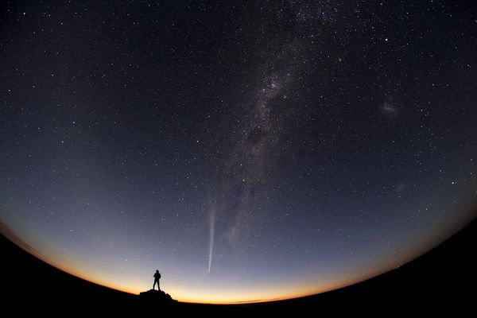
Consider your creator and His will for your life
Invite Jesus Christ to grow in your life
HERE AND NOW in 2024

