Slide 1
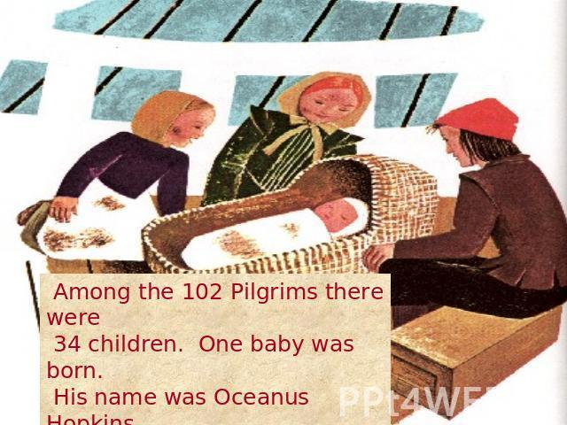
Pilgrim Baby and Child Names
Sep/Nov – only baby born on the ocean named Oceanus
1620 Nov - 1st baby born in Plymouth colony named Peregrine (Resolved)
Others: Bartholomew, Fear, Isaac, James, Jonathan, John, Joseph, Love, Moses, Peter, Samuel, Solomon, Stephen, Thomas, Wrestling, Desire, Elizabeth

Slide 2
Prayer and the Ministry of the Word (Acts 6:4)
But we (apostles then - pastors, teachers, elders, and deacons today)
will give ourselves (we follow the leaders we choose, Luke 9:23, 1 Pe 2:21)
continually to prayer, (personally and with others, Luke 11:1)
and to the ministry of the word. (teach, preach, or support, 2 Tim 2:2)
Acts 6:1-7 context.
Review Key Scripture in Acts
concerning Prayer and the Ministry of the Word

Slide 3
How is the Holy Spirit speaking to you now?
(these questions are for all Christ followers)
Do I pray at times set apart daily and continually?
Am I discipling or being discipled in prayer?
Do I listen to the Word when taught or preached?
Do I search the Scriptures to validate the speaker?
Is my time in prayer and the Word balanced and helping me press toward the high mark of the calling of God (Philippians 3)

