Slide 1
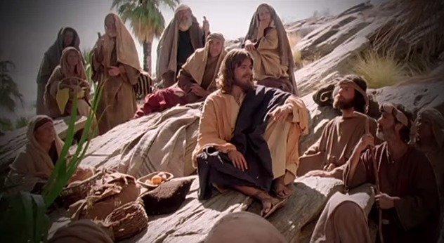
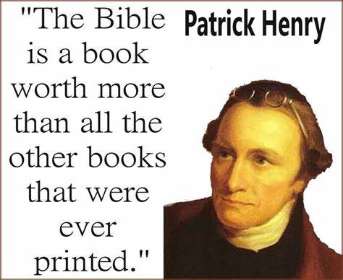
Fellowship Church - Wednesday 7pm service - January 27, 2021
Title: A Time of Laughter & a Time of Mourning
Text: Proverb 29
Proverbs 29:2 (KJV) When the righteous are in authority, the people rejoice: but when the wicked beareth rule,
the people mourn.
Quote from one of our founding fathers
The famous orator and five time governor of Virginia,
Patrick Henry, argued at the state's convention in
insisting “a bill of rights indispensably necessary”
to protect citizens from “the commands of tyrants.”

Slide 2
3
Three Priorities of Sound Doctrine (mind, words, speech, faith)
Tier (bottom-up) Severity Consequence Scripture
1-Salvation Most Important Eternal Life or death John 3:16-17, Eph 2:8-9
2-Sanctification Very Important Eternal Reward 1 Thes 5:23, 1 Cor 3:1-4
3-Solid Rock Important Sound Doctrine Parable in Luke 6:47-49
Other
Earth Not Important Parable in Luke 6:47-49
(myths, fables, wives tales, psychology, philosophy, traditions)
2
1

Slide 3
God is the King of Israel
Jesus is the King of the Jews and Returns as King of Kings
FACT > FAITH > FEELING
Discern the time
Proverbs Hosea
King (ruler) 29:2 (rejoice or mourn) 4:2 (they break out)
Government 29:4 (judgment or gifts) 13:10 (cities & princes)
3. King & Princes 29:12 (lies) 7:3 (wickedness & lies)
Prayer James 4:7-10 (laugh or mourn) 14: 2 (words)
Hosea 10:12 “Sow to yourselves in righteousness, reap in mercy;
break up your fallow ground, for it is time to seek the LORD,
till he come and rain righteousness upon you.”
Invite to small group prayer during February during Wednesday services (10th, 24th)

