Slide 1
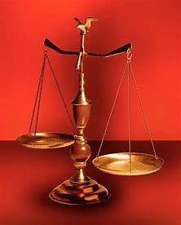
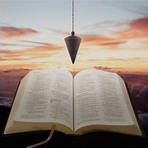
Perplexity to Praise, Trouble to Triumph, Grief to Glory
Fellowship Church, February 1, 2023 by Bill Heath
Following Christ in a
Balanced and Straight Way
Precept upon precept,
line upon line, here a little,
there a little (Isaiah 28:10,13)
#1 – Daily Scripture & Prayer Plan
#2 – Recognize Worldly Sin (Ro 1-3)
#3 –
#4 –
#5 –
#6 –
#7 –
#8 –
OT: Deut 25:13-16
Daniel 5:25-28
NT: Hebrews12:1
1 Cor 3:11-15
OT: Ps 5:8, Pr 4:25-27
Amos 7:7-8
NT: Mt 3:3, Acts 9:11
Hebrews 12:13

Slide 3
The God Squad or 9 Commanding Officers (CO)
Leader: Jesus Christ with binoculars & a pistol
Doctrine (by faith, from the heart)
1st: COntent
2nd: COntext
3rd: COncise
4th: COncept
Application (obey or disobey)
1st: COnfirm or COnvict
2nd: COmfort or COnfess
3rd: COnverse or COnsult
4th: COnduit and COnduit
Medic & grenadier: behind as needed
Goal: COnsistently, COnsumed for the glory of God
Recognize Worldly Sin (Rom 1:18-3)
Know God’s witness of sin in
1st Creation
- only man is created in the image of
God (Genesis 1, not humans or mankind)
- there are degrees of severity of sin and
consequences
2nd Conscience
- every man has a conscience
- God knows our and other’s conscience
3rd Scripture
- Reveals none are right, not one
- All have sinned and come short of the
glory of God, right by faith in Jesus Christ
Next: Know God’s Salvation (Romans 4-5)

