Slide 1

Fellowship church Sunday school
December 19
John the apostle‘s “I AM” series
I am Alpha and omega revelation chapters 1, 21-22
Next Sunday, December 26
I am Christmas and New Year

Slide 2
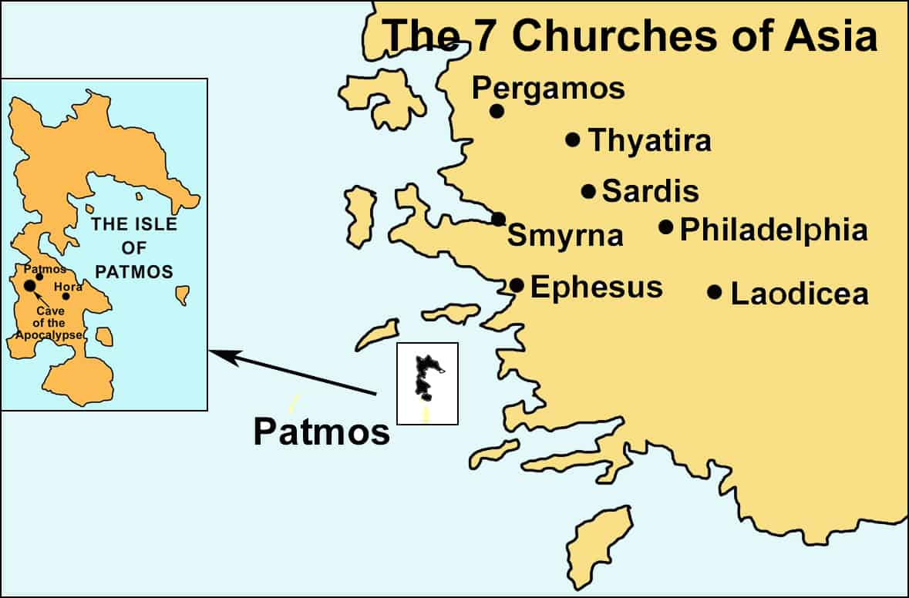
Revelation 1:9 “the isle that is called Patmos”
Time and Place
94-96 A.D., The Apostle John in political exile
81-96 A.D. Roman Emperor Domitian
Island of Patmos
Did the Apostle John spend
his last years
in Ephesus?
When did John write 1, 2, 3 John?
Historical local churches & individuals. (2) Prophetic, universal church periods of time from Ephesus to Laodicea. (3) Present local churches and individuals.

Slide 3

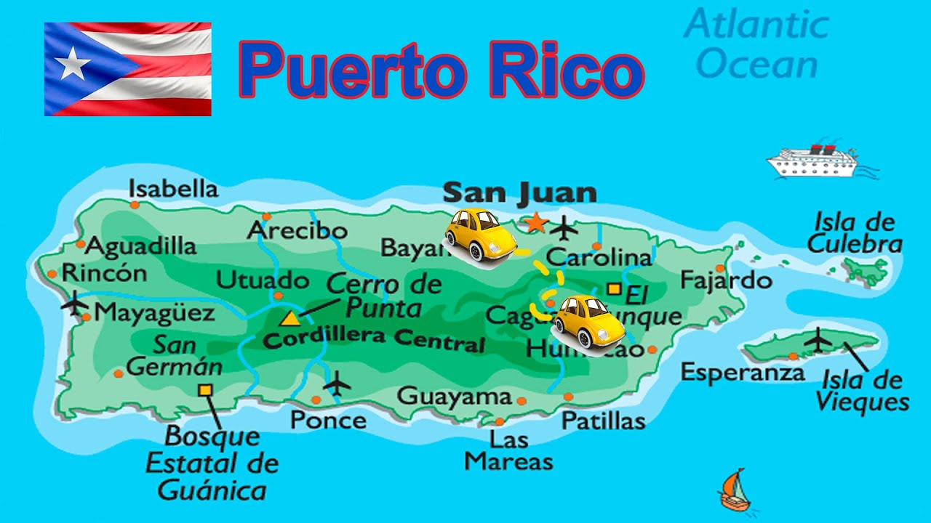

Slide 4
Looking ahead to the Cross
Looking back to the Cross
myrrh < frankincense, < gold
(Prophet < Priest < King)

Slide 5
Revelation - I AM Alpha and Omega
1:8 I AM Alpha and Omega, the beginning and the ending
To Israel. Why? Context of 1:4-8 the “Almighty” (2 Cor 6:14-18).
1:11 I AM Alpha and Omega, the first and the last (1 Cor 15:45).
To the local churches. Why? Context of 1:9-11
1:17 I Am the first and the last
To the local churches. Why? Context of 1:12-20.
1:18 I am alive for evermore, Amen.
Note: “I am” is imperative “I AM”
or declarative “I Am” related to imperative
or declarative “I am”

Slide 6
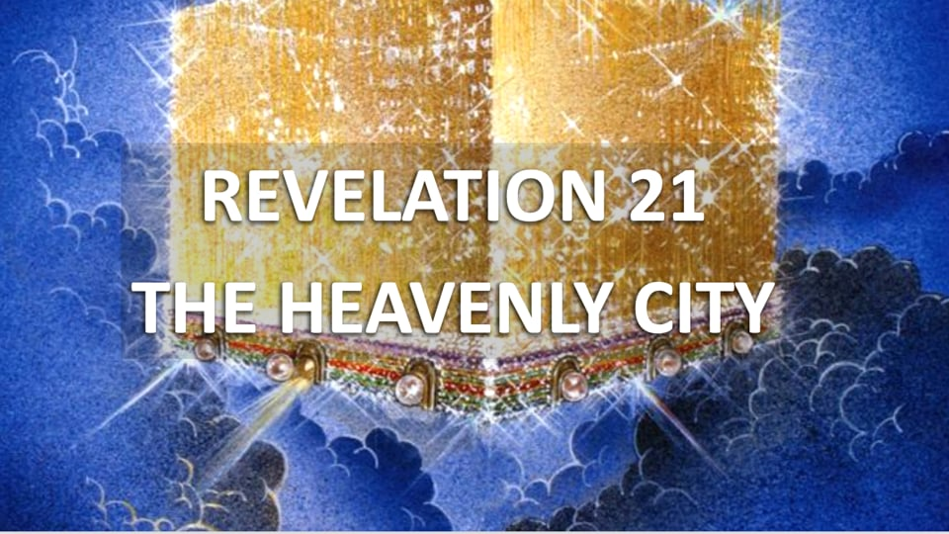
Revelation - I AM Alpha and Omega
21:6 I AM Alpha and Omega, the beginning and the end
To overcomer. Why? Context of 21:1-7, and 21:8 (lake of fire)
22:13 I AM Alpha and Omega, the beginning and the end,
the first and the last
To believer. Why? Context of 22:12-14 and 16, and 22:15 (outside)
22:16 I Am the root and offspring of David, the bright and morning star
To each local church. Why? Context of 22:12-16 and 17-21.
Revelation chapter 22
22:9 I am your fellow servant, and of your brethren the prophets, and of them that keep the sayings of this book: worship God.
22:6-21 Jesus’s last words “in the churches”

