Slide 1

Revelation 19-22

Slide 2
Revelation 19-22
Preview before the Second Coming
Revelation 1-3 The Dispensation of the Church (Acts 2)
Revelation 4-5 The rapture of the Church (Rev 4:1)
Revelation 6-18 The 7 Year Tribulation of 7 Seals, 7
Trumpets, and 7 Vials. Babylon destroyed. (Jerusalem & National Israel)

Slide 3
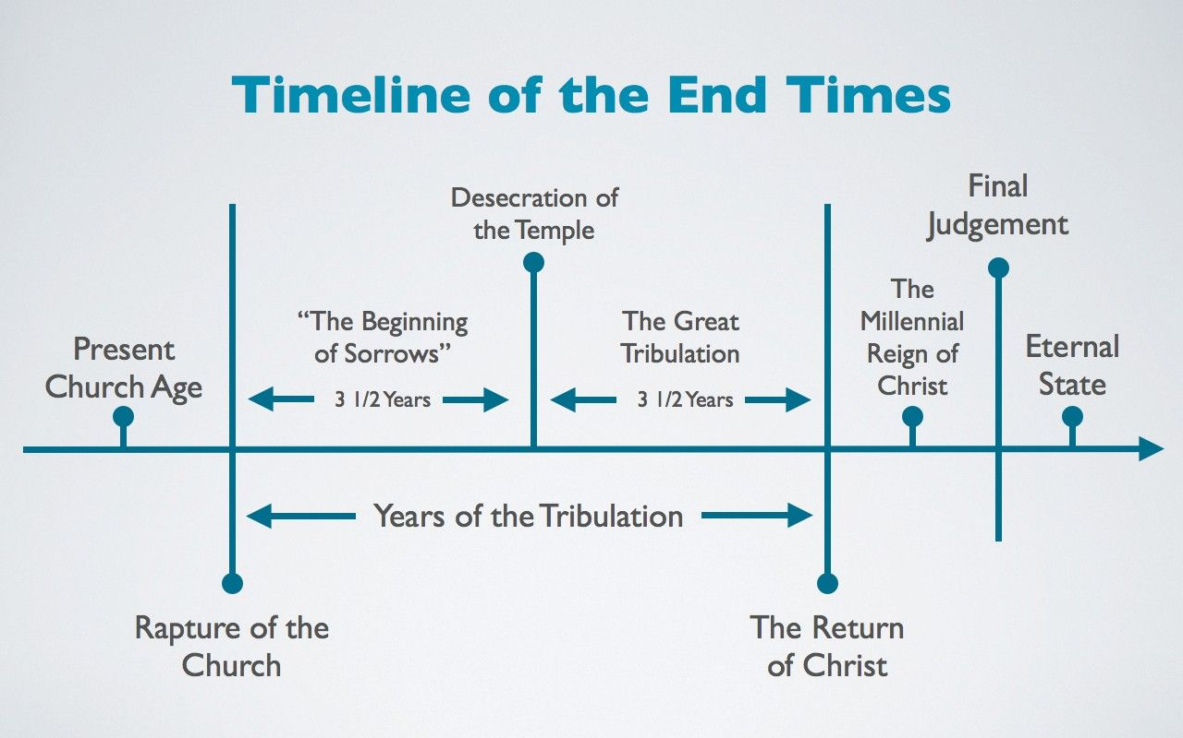
Daniel 12:4 (seal-run-knowledge)
R6B
S1
S2
R1
R3
R5
R6A
R2
R4
Next four Sundays: Justin – Rev 1 (S2), Phil – Rev 3 (S2), Raymond – Rev 4 to 18 (R3), Bill – Rev 19-22 (R4-6)

Slide 4
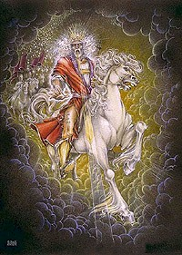
Revelation 19
The Return of Christ to the Earth
19:1-10 Five Heavenly Announcements, vs 7-9
19:11-16 The Word of God (Christ)
on a White Horse, vs 14-15
3. 19:17-21 Armageddon, vs 17-18, 21
The Beast and False Prophet thrown
into the Lake of Fire, vs 19-20

Slide 5
Chapter 20
Christ Reigns 1000 Years
1. 20:1-10 Satan is Bound and Christ Reigns on the Earth
with the Saints for 1000 Years, vs 4, 6
20:11-15 The Second Death. The Great White Throne
where the Books are Opened, and Peoples
Works are Judged, vs 13-15

Slide 6
Revelation 21-22
Heaven
21:1-4 Our Inheritance with the Lord Jesus Christ and
God in New Jerusalem, vs 4.
2. 21:5-8 Jesus Looks Back to the Great White Throne, 20:11-15
3. 21:9-23 An Angel Describes the Architecture of Future
New Jerusalem (a cube about the size of the moon)
21:24-27 Jesus Refers Back to the Great White Throne, 20:11-15
22:1-5 Our Inheritance with the Lord Jesus and God
in the New Jerusalem, vs 5.

Slide 7
Revelation 22:6-21
Last Words to the Church come-7x, this book-7x, quickly-5x, prophecy-4x
The bride is called to:
Serve, vs 6
(2) Worship, vs 9
(3) Works, vs 12
(4) Witness, vs 17
1. 22:6-11 The Angel says, vs 7, 11
2. 2:12-16 Jesus says, vs 16
3. 22:17-21 The Spirit and the bride say

Slide 8
Next Sunday (October 24)
End Times Panel Q&A
Tribulation is the time of God’s wrath upon the sin of the World (Doctrine Tier 3)
1. Pre Trib View (FUTURIST: church raptured before the trib)
2. Mid Trib View (FUTURIST: church raptured after 3 ½ years of the trib)
3. Post Trib View (FUTURIST: church raptured after the trib)
Pan Trib View (Any view of the trib is acceptable. True salvation and
our sanctification are more important, Paul’s letter to the Thessalonians)
HISTORICIST/Preteritist or IDEALIST (Allegory & Symbolism)
Replacement theology – Jesuit Priest Luis de Alcazar, 1614 AD
4. No Trib View (tribulation happened in the early church, 70 AD+)
A. Millenial (1000-year reign) View B. Amillenial (1000-year reign) View

