Slide 1
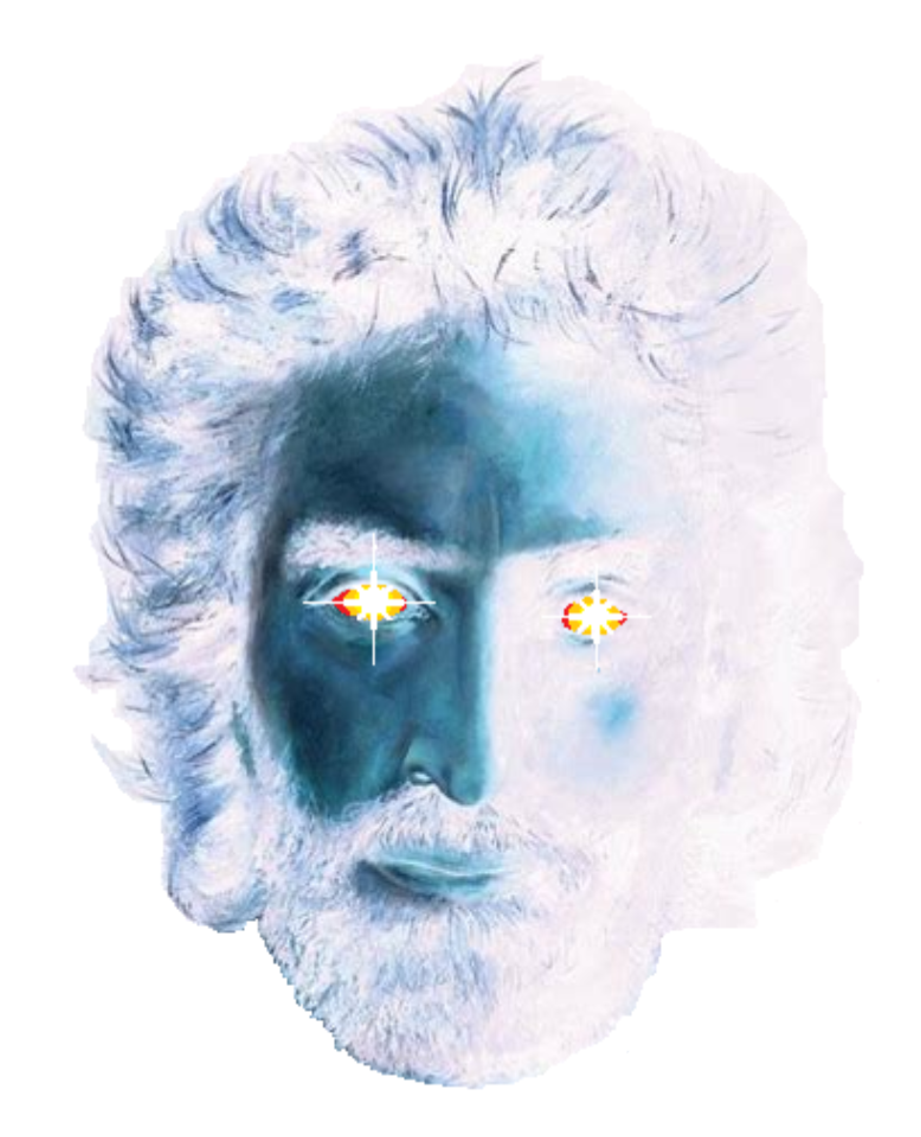
WISDOM,
KNOWLEDGE and UNDERSTANDING
Revelation
Steve Prior

Slide 2
Revelation 1
1:1 The Revelation of Jesus Christ, which God gave Him to show His servants—things which must shortly take place. And He sent and signified it by His angel to His servant John,
1:2 who bore witness to the word of God, and to the testimony of Jesus Christ, and to all things that he saw.
1:3 Blessed is he who reads and those who hear the words of this prophecy, and keep those things which are written in it; for the time is near.

Slide 3
The Trinity
Initiator
Father
1 + 1 + 1 = 3
Persons
1 * 1 * 1 = 1
Nature
is not
is
God
nature
is not
Implementor
Sanctifier
Son
Holy Spirit
is not
I-2

Slide 4
Hypostatic Union
Body
Human Spirit
Soul
Holy Spirit
V-7

Slide 5
Revelation 1
1:1 The Revelation of Jesus Christ, which God gave Him to show His servants—things which must shortly take place. And He sent and signified it by His angel to His servant John,
1:2 who bore witness to the word of God, and to the testimony of Jesus Christ, to all things that he saw.
1:3 Blessed is he who reads and those who hear the words of this prophecy, and keep those things which are written in it; for the time is near.

Slide 6
Revelation 1
1:4 John, to the seven churches which are in Asia: Grace to you and peace from Him who is and who was and who is to come, and from the seven Spirits who are before His throne,
I-3

Slide 7
Revelation 1
1:9 I, John, both your brother and companion in the tribulation and kingdom and patience of Jesus Christ, was on the island that is called Patmos for the word of God and for the testimony of Jesus Christ.
I-4

Slide 8
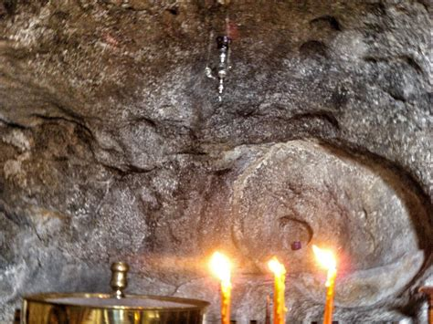
Revelation 1
1:9 I, John, both your brother and companion in the tribulation and kingdom and patience of Jesus Christ, was on the island that is called Patmos for the word of God and for the testimony of Jesus Christ.

Slide 9
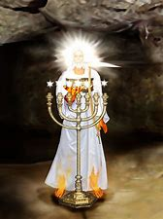
I-5

Slide 10
Revelation 1
1:20 The mystery of the seven stars which you saw in My right hand, and the seven golden lampstands: The seven stars are the angels of the seven churches, and the seven lampstands which you saw are the seven churches.
I-6

Slide 11
Revelation 1
Chapter 1 The things you have seen
The glorified Christ
Chapters 2 – 3 The things that are
The seven churches, our focus
Chapters 4 – 22 The things that will be
The end of man and return to paradise

Slide 12
WISDOM,
KNOWLEDGE and UNDERSTANDING
Revelation
Steve Prior

