Slide 1

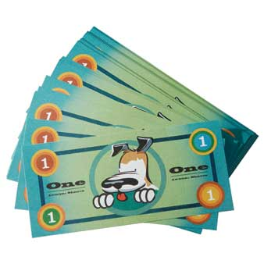

Cubbies and Sparks and T&T
STORE NIGHT- Wednesday, January 29th, 2020
Trek and Journey-
Cubbies and Sparks and T&T
STORE NIGHT- Wednesday, January 29th, 2020
Trek and Journey-

