Slide 1
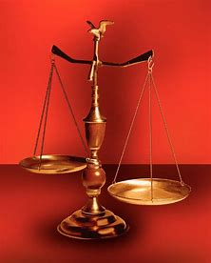
From Perplexity to Praise with Habakkuk
Fellowship Church, January 18, 2023 by Bill Heath
Following Christ in a
Balanced and Straight Way
Precept upon precept,
line upon line, here a little,
there a little (Isaiah 28:10,13)
#1 – Daily Scripture & Prayer Plan
#2 – Perplexity to Praise, Habakkuk
#3 – Circle of Right Decisions
#4 – Job 23
#5 – Psalm 88
#6 – Proverb 15
#7 – Ecclesiastes 7
#8 – Song of Songs 5
OT: Deut 25:13-16
Daniel 5:25-28
NT: Hebrews12:1
1 Cor 3:11-15
OT: Ps 5:8, Pr 4:25-27
Amos 7:7-8
NT: Mt 3:3, Acts 9:11
Hebrews 12:13

Slide 2
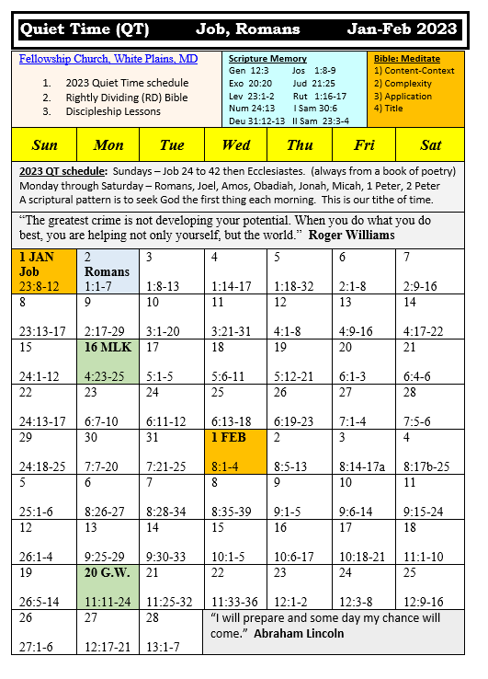
Daily Scripture and Prayer Plan 1. Meet me where I am now 2. Use my god given abilities (gifts) 3. Examples applicable for today - Acts 3:1 time & timing - Acts 6:1-7 time mgmt. & priority 4. Personal scripture & prayer life 5. Public scripture & prayer life

Slide 3
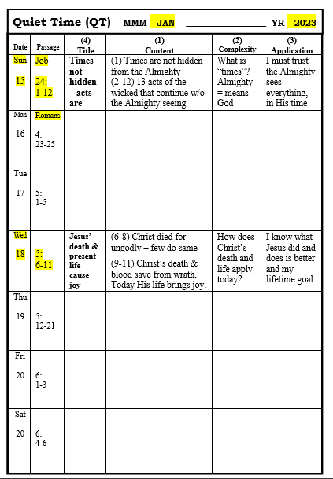
Date: Wednesday, January 18, 2023
Passage: Romans 5:6-11
(4) Title: Jesus’ Death & Present Life Cause
Joy
Content:
(6-8)
(9-11)
(2) Complexity: Difficult for me or others
(3) Application: personal, for my life
Discipleship (fellowshipchurchwhiteplains.com)

Slide 4
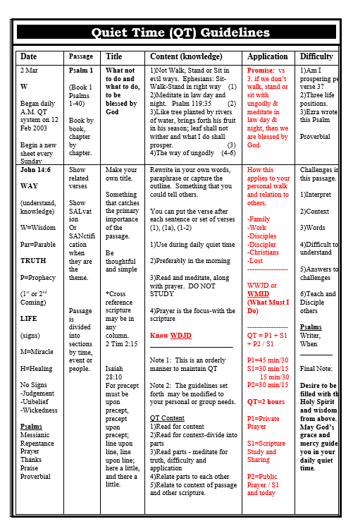
The God Squad
Leader: Jesus Christ with binoculars & a pistol
Doctrine (faith)
1st: COntent
2nd: COntext
3rd: COncise
4th: COncept
Application (obey)
1st: Confirm or Convict
2nd: Comfort or Confess
3rd: Converse or Consult
4th: Conduit
Medic & grenadier: behind as needed

