Slide 1
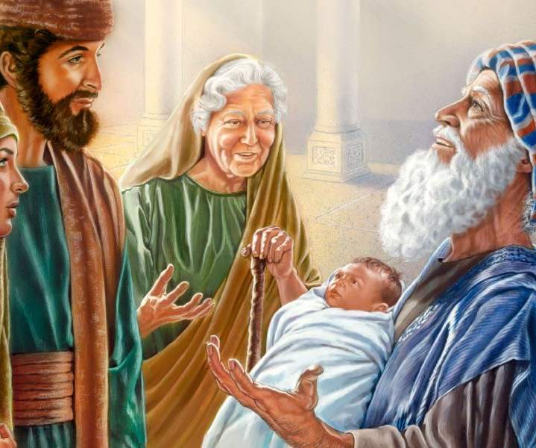
New Worship In Spirit with Simeon & Anna 1st coming – prophet Simeon and Anna Wait for the Lord, See the Lord, and Worship the LORD 2nd coming – king Today, you and I Wait for the Lord, See the Lord, and Worship the Lord

