Slide 1
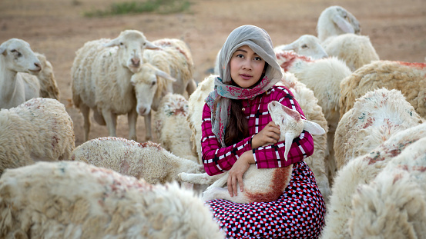
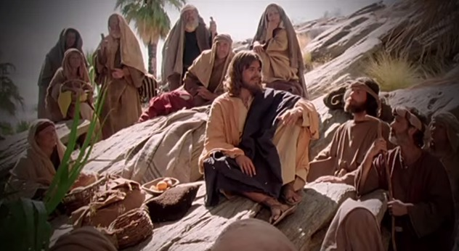
Fellowship Church – Wednesday Night Service – June 16, 2021
Song of Songs 3:1-11
Title: My Growing Relationship with the King
Lesson 5. The Precursor then Procession for Marriage

Slide 2


Outline of the Song of Songs
Our Growing Relationship with the King
of Kings
DOCTRINE
Part 1) The Courtship (Leave) 1:2-3:5
Part 2) The Wedding (Cleave) 3:6-5:1
Part 3) The Family (Weave) 5:2-8:14
ublication date
  Jul 1, 2006
Bill Heath Tim Hennings
A Time The Bible
A People Grace
A Place Mercy
A Language Time
“In His Time”
Positional/Experiential Truths
ublication date
  Jul 1, 2006
Genesis 2:24 Therefore shall a man leave his father and his mother, and shall cleave unto his wife: and they shall be one flesh.
1918 – 2006
young Earth creationist,
Christian apologist and engineer

Slide 4
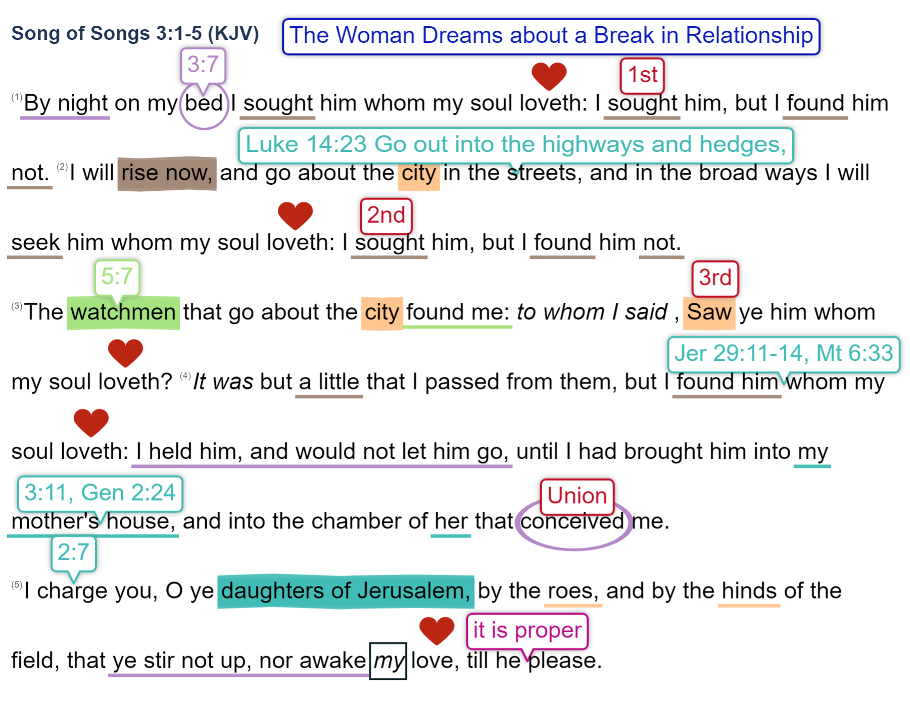

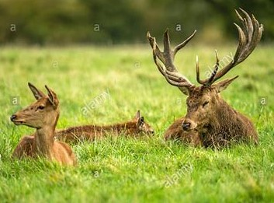
My Growing Relationship
with the King
Courtship: love Grows 1:12-3:5 (leave)

Slide 5
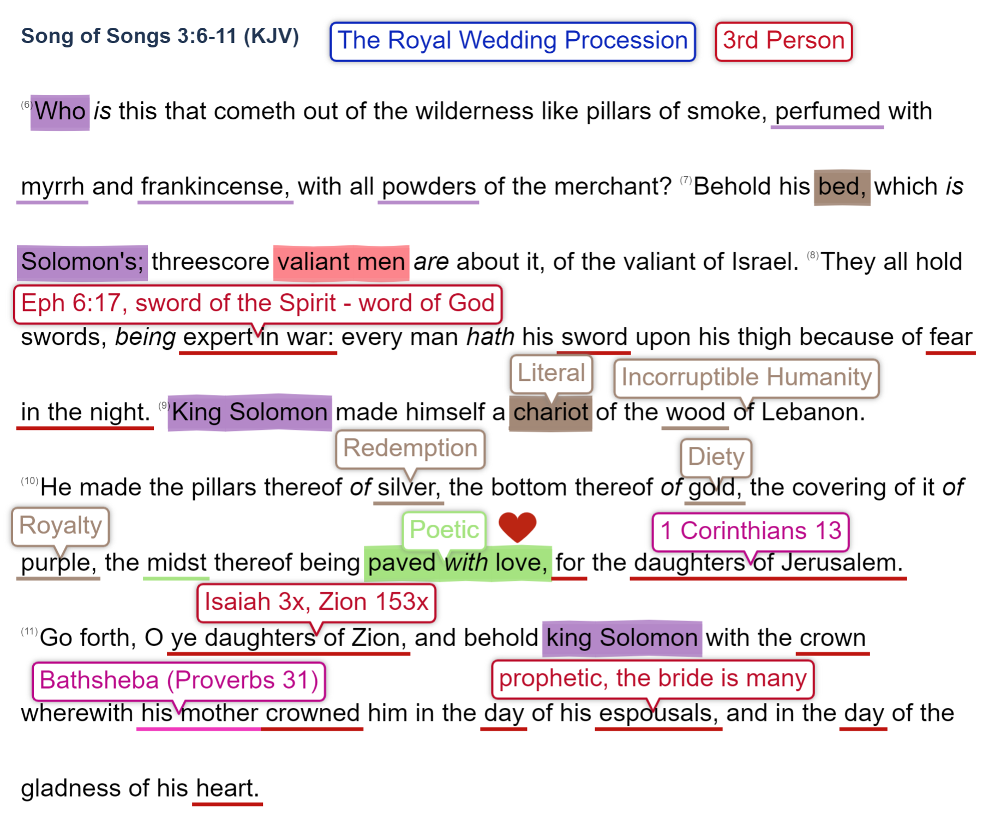
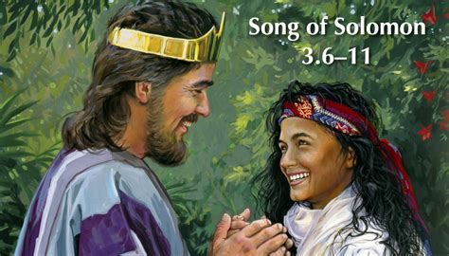
My Growing Relationship
with the King
The Wedding (Cleave) 3:6-5:1
Eph 3:14-21 Paul’s prayer for us
Eph 3:21 Unto Him /God/ [be] glory in the church /ekklesia-called out ones / by Christ Jesus
throughout all ages, /until Christ’s return/ world without end /New Jerusalem/. Amen.

Slide 6
Part 1. The Courtship (LeavE) 1:2-3:5
A. love begins 1:2-11
B. love grows 1:12-3:5
Part 2. the wedding (cleavE) 3:6-5:1
A. Procession 3:6-11
B. 4:1-16 OR 5:1
NEXT in the (1) Song of (1005) Songs, 4:1-16
Challenge: does the woman or king speak in chapter 4?
Part 3. the family (weavE) 5:2-8:14
A. Love lost 5:2-6:3
B. Love restored 6:4-7:9
C. Love labors 7:10-8:3 d. Love empowers 8:4-14
Song of Songs Outline

