Slide 1
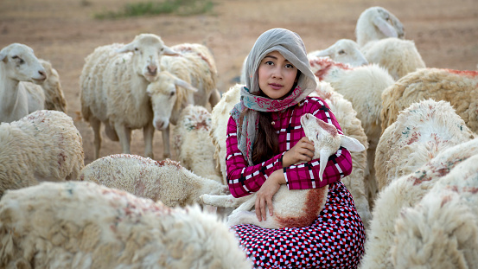
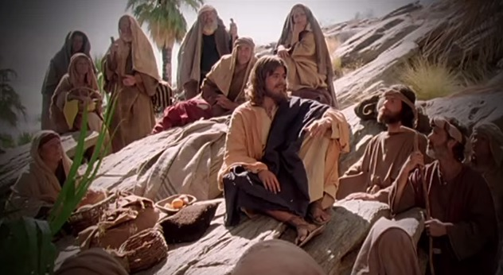
Fellowship Church – Wednesday Night Service – July 7, 2021
Song of Songs 4:1-5:1
Title: My Growing Relationship with the King
Lesson 6. Our Wedding Ceremony

Slide 2

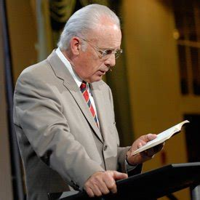
Our Growing Relationship with the King of Kings
DOCTRINE
Part 1) The Bethrodal (Leave) 1:2-3:5
A. Love Begins 1:2-11
B. Love Accepts 1:12-3:5
Part 2) The Wedding (Cleave) 3:6-5:1
A. Procession 3:6-11
B. Ceremony 4:1-5:1
Part 3) The Family (Weave) 5:2-8:14
A.
B.
Bill Heath Tim Hennings
A Time The Bible
A People Grace
A Place Mercy
A Language Time
“In His Time”
1939 to present
John MacArthur
“Rape of Solomon’s Song”
Genesis 2:24 Therefore shall a man leave his father and his mother, and shall cleave unto his wife: and they shall be one flesh.

Slide 3
Old Testament
Jewish
Read the Song of Songs annually on the 7th day of the
Passover Feast
4 stages
Bethrodal
Acceptance
Preparation
Wedding
New Testament
Christian
Compares the husband/
wife relationshipto the Christ/
Church relationship
in Ephesians
5:22-33
and
1 Corinth.
12:12-14

Slide 4
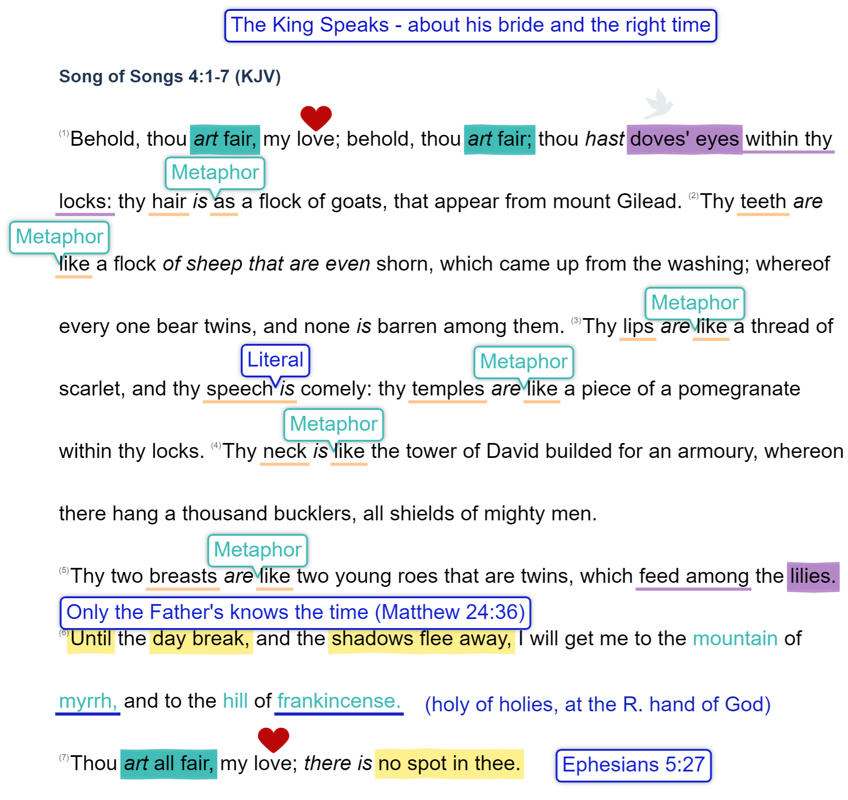
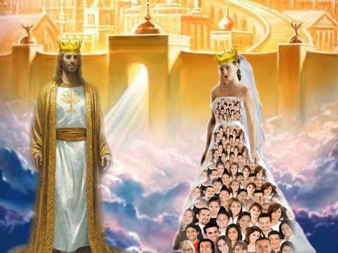
My Growing Relationship
with the king
The wedding Bride
and the right time

Slide 5
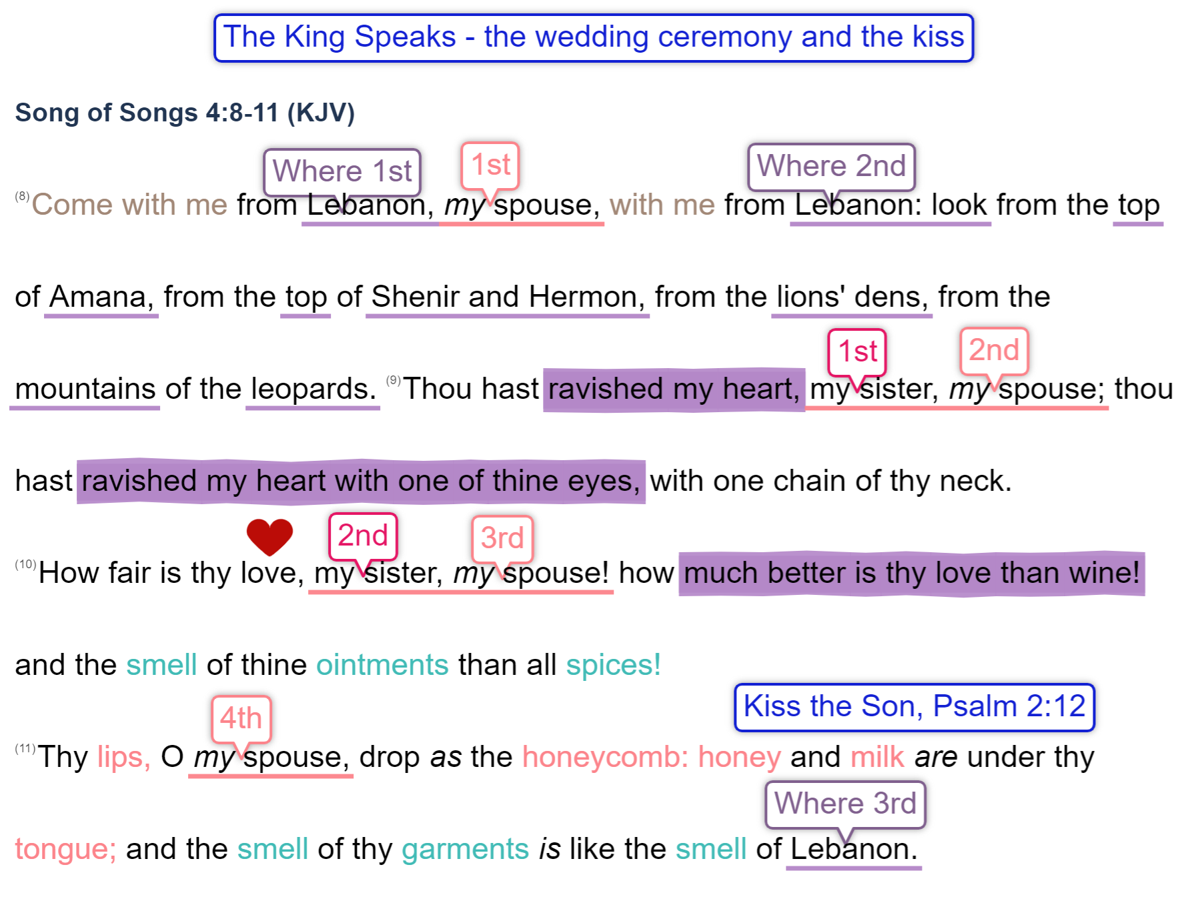

My Growing Relationship
with the king
The wedding Ceremony
and the Kiss

Slide 6
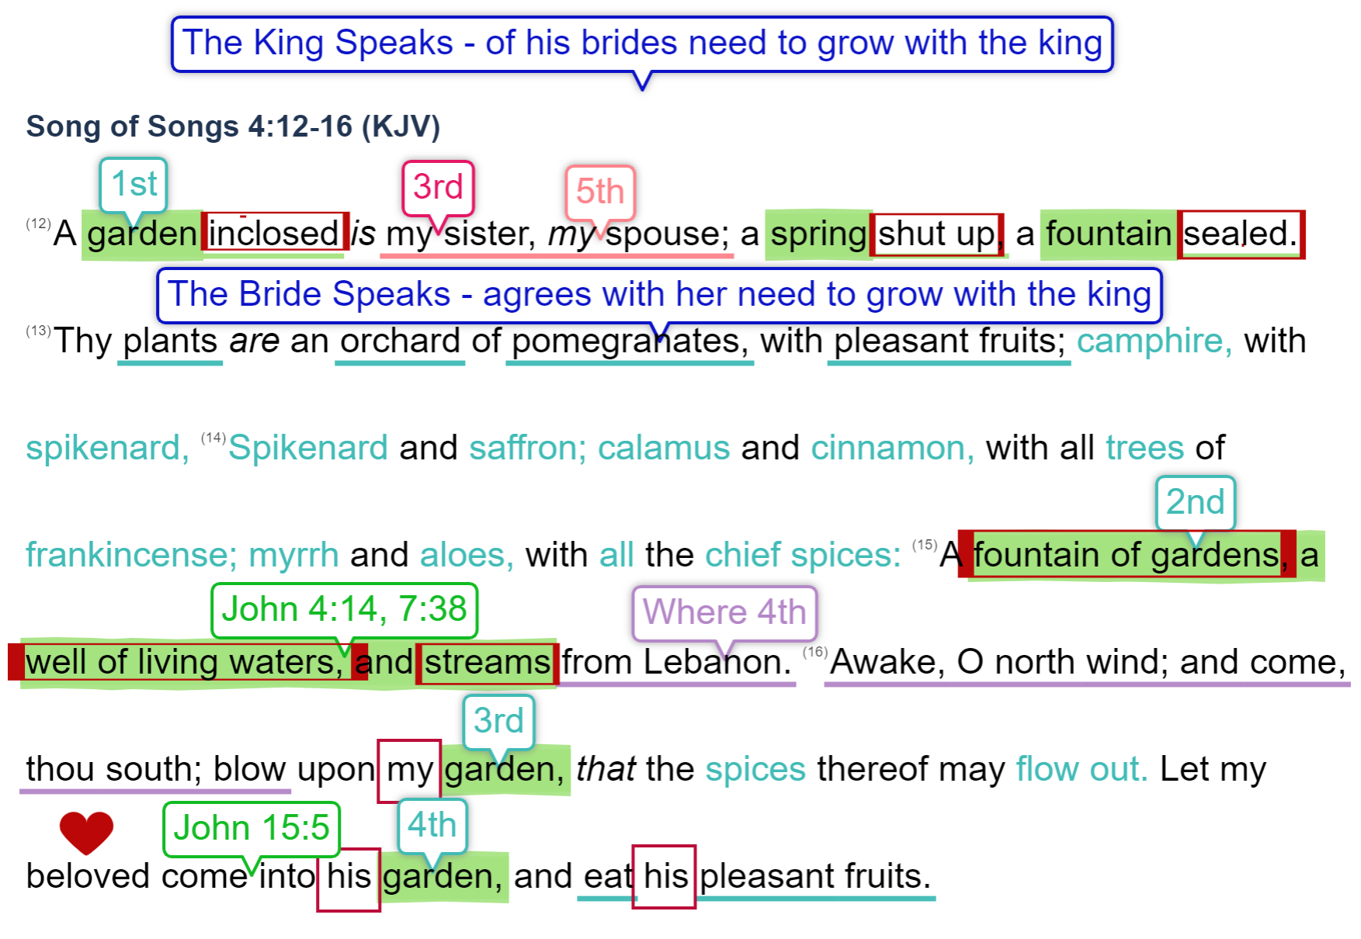
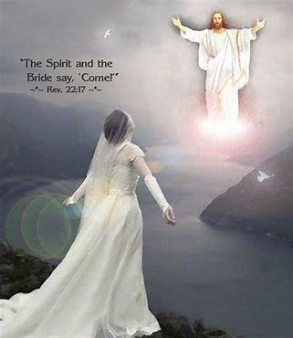
I must Acknowldege my Need
of a Growing Relationship
with the king
The King Speaks
5:1 I am come into my garden (5th ) my sister, (4th) [my] spouse: (6th )
I have gathered my myrrh with my spice; I have eaten my honeycomb with my honey;
I have drunk my wine with my milk: eat, O friends; drink, yea, drink abundantly, O beloved.

