Slide 1
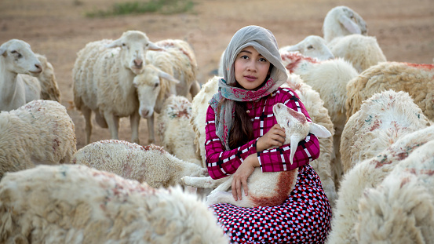
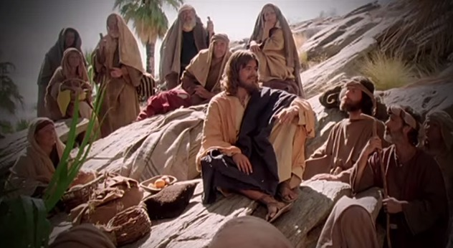
Fellowship Church – Wednesday Night Service – September 1, 2021
Song of Songs 8:5-14
Title: My Growing Relationship with the King (The Best Bridegroom)
Lesson 10. Love Empowers

Slide 2

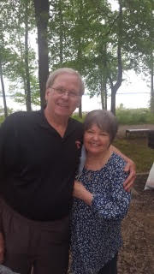
Our Growing Relationship with the King
DOCTRINE
Part 1) The Bethrodal (Leave) 1:2-3:5
A. Love Begins 1:2-11
B. Love Accepts 1:12-3:5
Part 2) The Wedding (Cleave) 3:6-5:1
A. The Procession 3:6-11
B. The Ceremony 4:1-5:1
Part 3) The Family (Weave) 5:2-8:14
A. Love Lost 5:2-6:3
B. Love Secured 6:4-7:9
C. Love Labors 7:10-8:4
D. Love Empowers 8:5-14
Bill Heath Tim Hennings
A Time The Bible
A People Grace
A Place Mercy
A Language Time
“In His Time”
Marvin and Dona Harris, 1946-
“The 1 Kings 11 Challenge”
Fellowship Church White Plains MD
Genesis 2:24 Therefore shall a man leave his father and his mother, and shall cleave unto his wife: and they shall be one flesh.

Slide 3
Old Testament
Jew
One nation
Read the Song of Songs annually on the 7th day of the
Passover Feast
4 stages
Bethrodal
Acceptance
Preparation
Wedding
New Testament
Christian
All nations
Compares the husband/
wife relationshipto the Christ/
Church relationship
in Ephesians
5:22-33
and
1 Corinth.
12:12-14

Slide 4
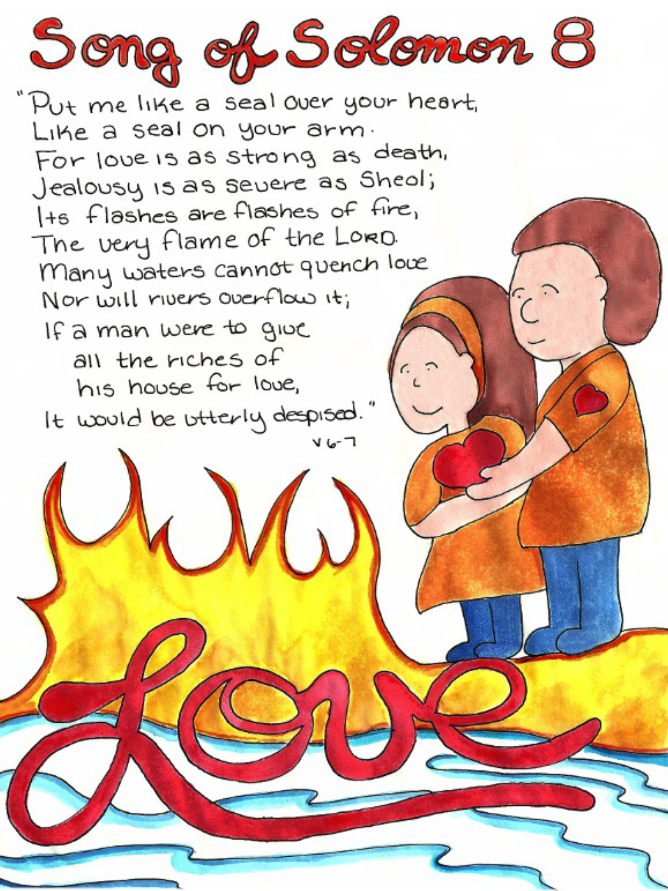
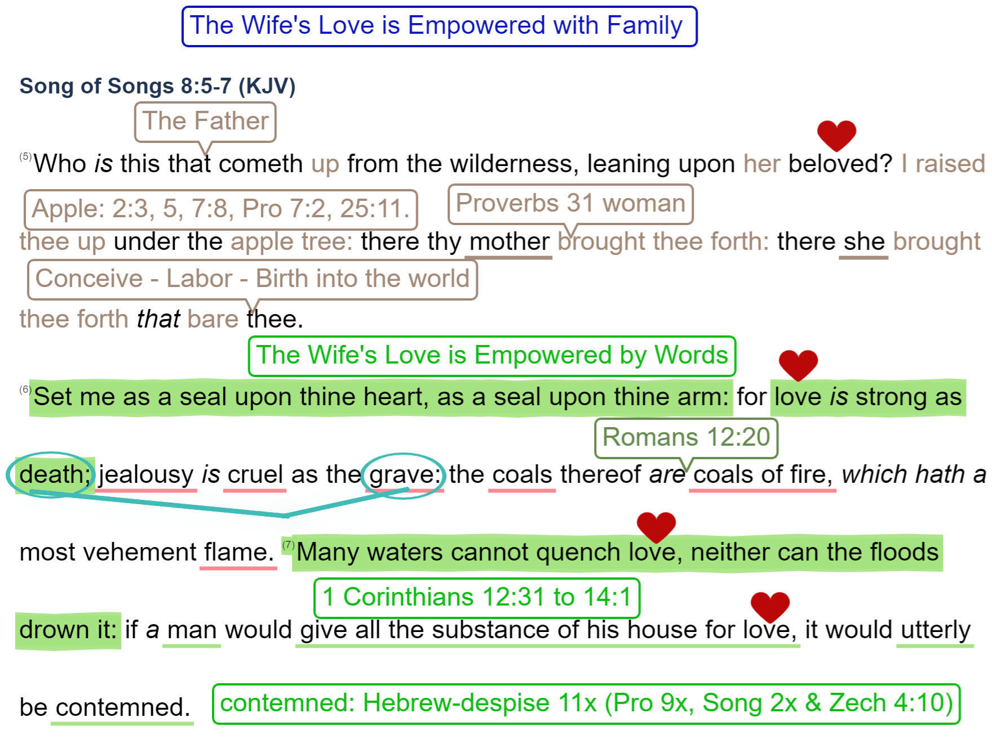

ERROR
w/ seals

Slide 5

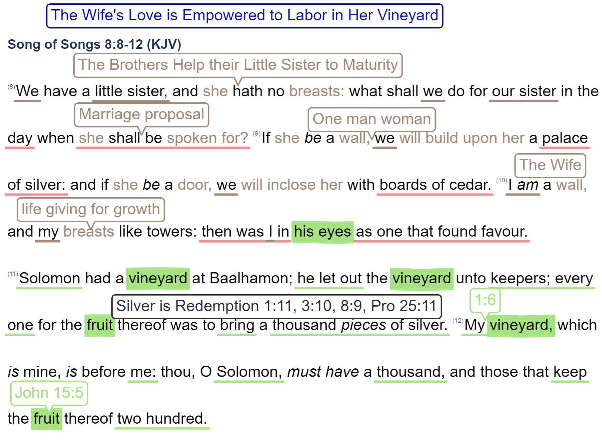
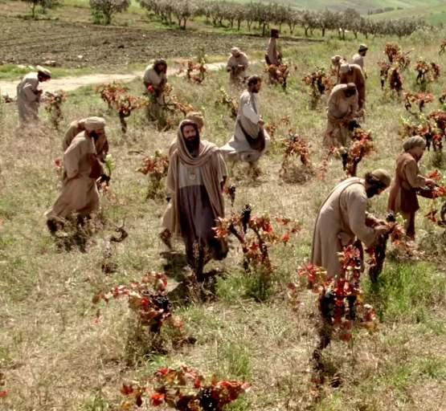

Slide 6
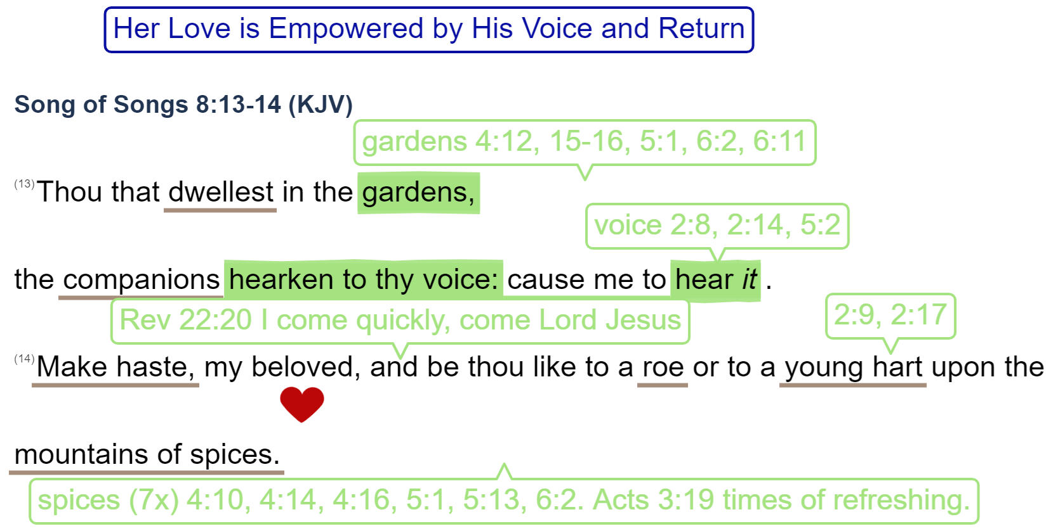
September 15: Song of Songs Review and Applications

