Slide 1
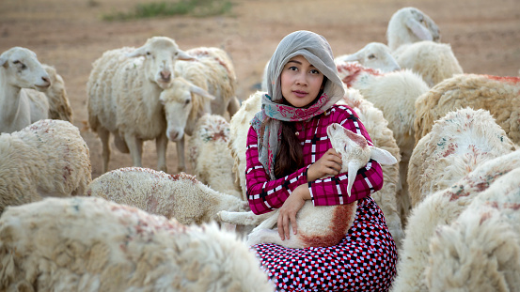
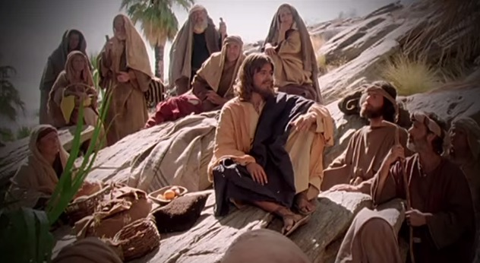
Fellowship Church – Wednesday Night Service – September 15, 2021
Song of Songs
Title: My/Our Growing Relationship with the King

Slide 2

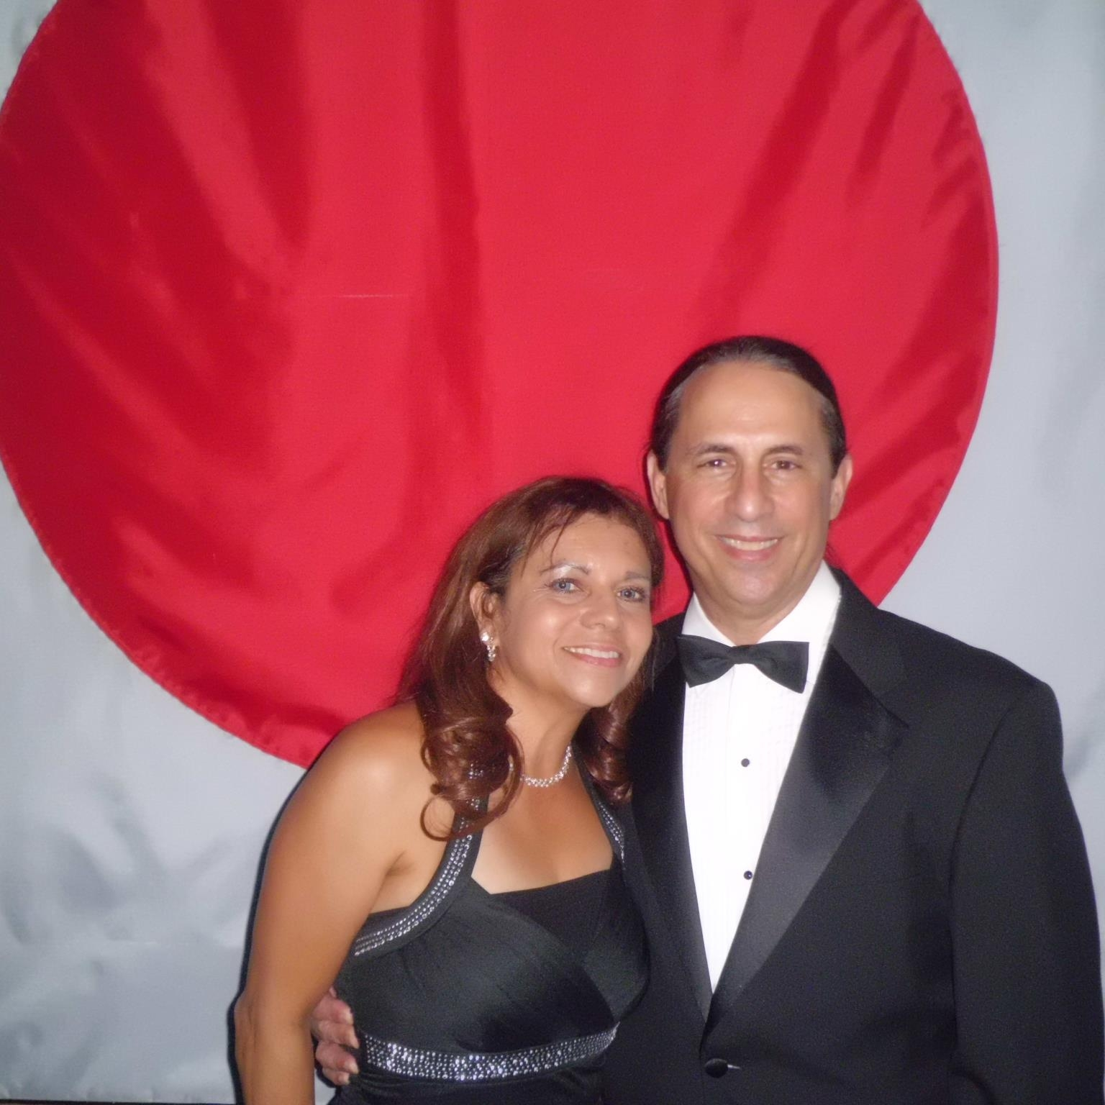
My/Our Growing Relationship with the King
DOCTRINE
Part 1) The Bethrodal (Leave) 1:1-3:5
A. Love Begins 1:2-11
B. Love Accepts 1:12-3:5
Part 2) The Marriage (Cleave) 3:6-5:1
A. The Procession 3:6-11
B. The Ceremony 4:1-5:1
Part 3) The Family (Weave) 5:2-8:14
A. Love Lost 5:2-6:3
B. Love Secured 6:4-7:9
C. Love Labors 7:10-8:4
D. Love Empowers 8:5-14
Bill Heath Tim Heddings
A Time The Bible
A People Grace
A Place Mercy
A Language Time
“In His Time”
Bill and Brunnie Heath, 1977-
My Genesis Diamond
Helpmate, Proverbs 31 wife
Genesis 2:24 Therefore shall a man leave his father and his mother, and shall cleave unto his wife: and they shall be one flesh.

Slide 3
1:1 ¹ The song of songs, which is Solomon’s. 26 changes of speakers.
Part 1) The Bethrodal (Leave) 1:1-3:5
A. Love Begins 1:2-11 Fiancee 1:2-7, King 1:8-11
B. Love Accepts 1:12-3:5 Fiancee 1:12-14, King 1:15,
Fiancee 1:16-2:9, King 2:10-15, Fiancee 2:16-3:5
Part 2) The Marriage (Cleave) 3:6-5:1
A. The Procession 3:6-11 Bride 3:6-11
B. The Ceremony 4:1-5:1 King 4:1-12, Bride 4:13-16, King 5:1
Part 3) The Family (Weave) 5:2-8:14
A. Love Lost 5:2-6:3 Wife 5:2a, King 5:2b-6, Watchmen 5:7, Wife 5:8
Daughters of Jerusalem 5:9, Wife 5:10-16, DoJ 6:1, Wife 6:2-3
B. Love Secured 6:4-7:9 King 6:4-7:9
C. Love Labors 7:10-8:4 Wife 7:10-8:4
D. Love Empowers 8:5-14 Father 8:5, King 8:6, Wife 8:7, Brothers 8:8-10
Woman 8:11-14

Slide 4
Bible References for Solomon
Old Testament
Family : Father & Mother – David & Bathsheba (20 yrs). Wife Naaman. Son Rehoboam & 2 daughters.
1) Proverbs: 5-7, The Lips and Dangers of a Strange Woman.
31:1-9 Warnings of Women and Wine. 31:10-31 Twenty-Two Ways of the Godly Woman
2) Ecclesiastes: Vanities of vanities . 12:13.
3) 1 Kings 1-10/11. 1 Chronicles 28 to 2 Chr 9. Kingdom divided by Son Rehoboam. Neh 15:26
New Testament
4) Jesus Christ: Matthew 6:29, 12:42
5) Hebrews 11 – no mention in the hall of fame.
Conclusion: Do not follow Solomon’s example. Without reward. Shame and dishonor. Ecc 12:14
We are in Christ, follow Jesus Christ Ephesians 5:3-4 or James 1:5-8 and 3:13-18

Slide 5
My/Our (Bride - Christ Follower) Growing Relationship with the King (Bridegroom – Jesus Christ)
Threads of truth in Song of Songs
Eyes
Vineyard
Wine
Voice
Daughters of Jerusalem, Watchmen, Woman’s Family
Garden
Spices
Woman – He is Altogether Lovely
King – Love is Stronger than Death
King – Many Waters cannot Quench Love
Conclusion: Seek to hear His voice and Desire His Return

Slide 6
Old Testament
Jew
One nation
Read the Song of Songs annually on the 7th day of the
Passover Feast
4 stages
Bethrodal
Acceptance
Preparation
Wedding
New Testament
Christian
All nations
Compares the husband/
wife relationshipto the Christ/
Church relationship
in Ephesians
5:22-33
and
1 Corinth.
12:12-14

