Slide 1
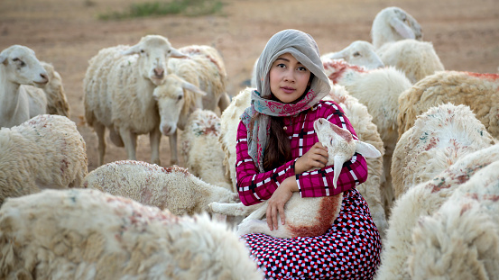
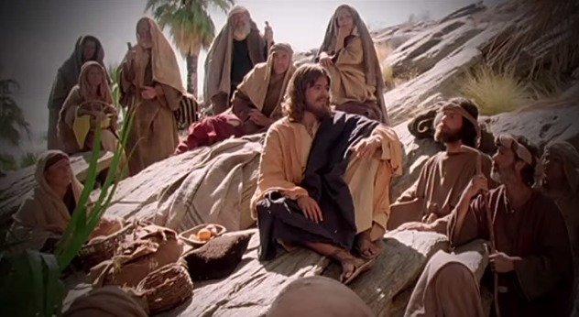
Fellowship Church – Wednesday Night Service – May 5, 2021
Title: Our Growing Relationship with the King of Kings (Song of Songs)
Lesson 1. Introduction and 1:1 ¹ The song of songs, which is Solomon’s.
Lesson 2. 1:2-11 The first exchange between the farmer and the king

Slide 2
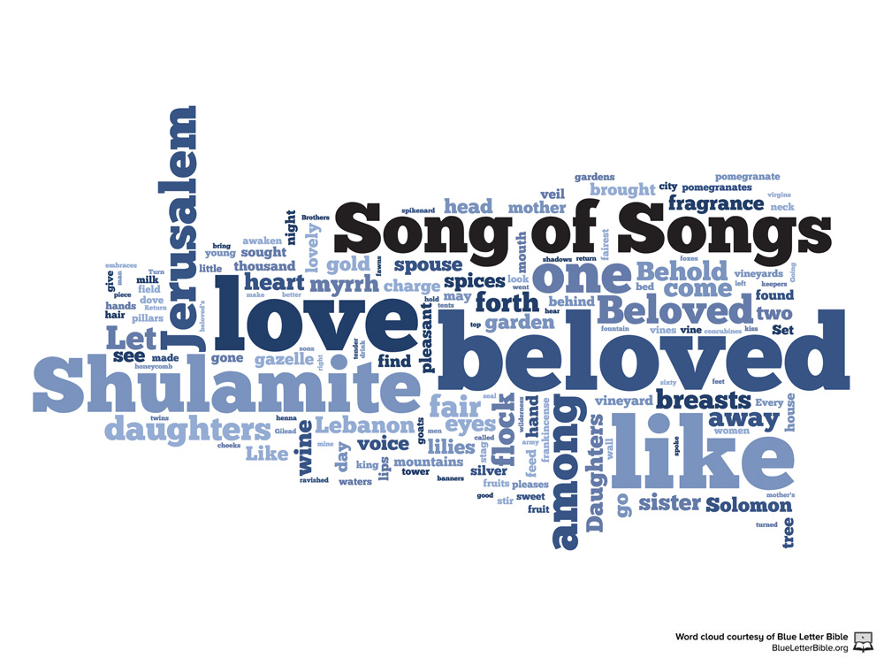
Outline of the Song of Songs
Our Growing Relationship with the King of Kings
DOCTRINE
Part 1) The Courtship (Leave) 1:2-3:5
Section 1: Love Begins 1:2-11
Section 2: Love Grows 1:12-3:5
Part 2) The Wedding (Cleave) 3:6-5:1
Part 3) The Family (Weave) 5:2-8:14
2 Timothy 3:16-17 All scripture [is] given by inspiration of God, and [is] profitable for doctrine, for reproof, for correction, for instruction in righteousness: That the man of God may be perfect, throughly furnished unto all good works.
Genesis 2:24 Therefore shall a man leave his father and his mother, and shall cleave unto his wife: and they shall be one flesh.

Slide 3
The farmer speaks to the king
the beginning of love 1:2-7 (leaving)
² Let him ^{b} kiss me with the kisses of his mouth: for thy love is better than wine. ³ Because of the savor of thy good ointments
^{c} thy name is as ointment poured forth, therefore do the virgins love you.
⁴ ^{d} Draw me, we will run after thee: the king has brought me into his chambers: we will be glad and rejoice in thee, ^{e} we will remember thy love more than wine: the upright love thee.

Slide 4
The farmer speaks to the king
the beginning of love 1:2-7 (Leaving)
⁵ I [am] black, but comely, O ye ª daughters of Jerusalem, as the tents of Kedar, as the curtains of Solomon. ⁶ ^{b} Look not upon me, because I am black, because the sun has looked upon me:
my mother's children were angry with me; they made me the keeper of the vineyards; [but] mine own vineyard I have not kept.
⁷ Tell me, O thou whom my soul lovest, ^{c} where thou feedest, where thou make thy flock to rest at noon: for why should I be as one that turnest aside by the flocks of thy companions?

Slide 5
The king speaks to the farmer
the beginning of love 1:8-11 (LEAVING)
⁸ If you know not, O you fairest among women,
go your way forth by ª the footsteps of the flock,
and feed your goats beside the shepherds' tents.
⁹ I have compared you, O my love,
to a ^{b} company of horses in Pharaoh’s chariots.
¹⁰ Your cheeks are comely with rows [of jewels],
your neck with chains [of gold].
¹¹ ^{c} We will make you borders of gold with studs of silver.

Slide 6
NEXT in the Song of Songs, 1:12-15 (4 verses) Part 1 continued. The Courtship (LeavE) 1:2-3:5 Section 1. love begins 1:2-11 Exchange 1 between the farmer and the king 1:2-11 Section 2. love grows 1:12-3:5 Exchange 2 between the farmer and the king 1:12-15 Exchange 3 between the farmer and the king 1:16-2:15 exchange 4 preparing for the wedding 2:16-3:5 Part 2. the wedding (cleavE) 3:6-5:1 Part 3. the family (weavE) 5:2-8:14

