Slide 1
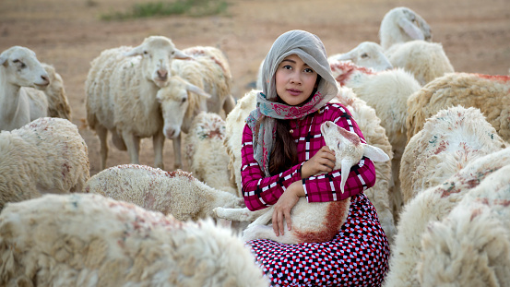
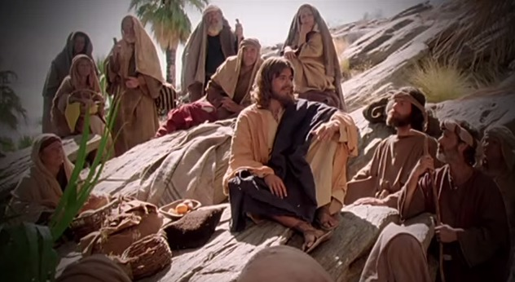
Fellowship Church – Wednesday Night Service – June 2, 2021
Song of Songs
Title: My Growing Relationship with the King
Lesson 3. 1:12-17 Love Grows in Courtship with my King

Slide 2

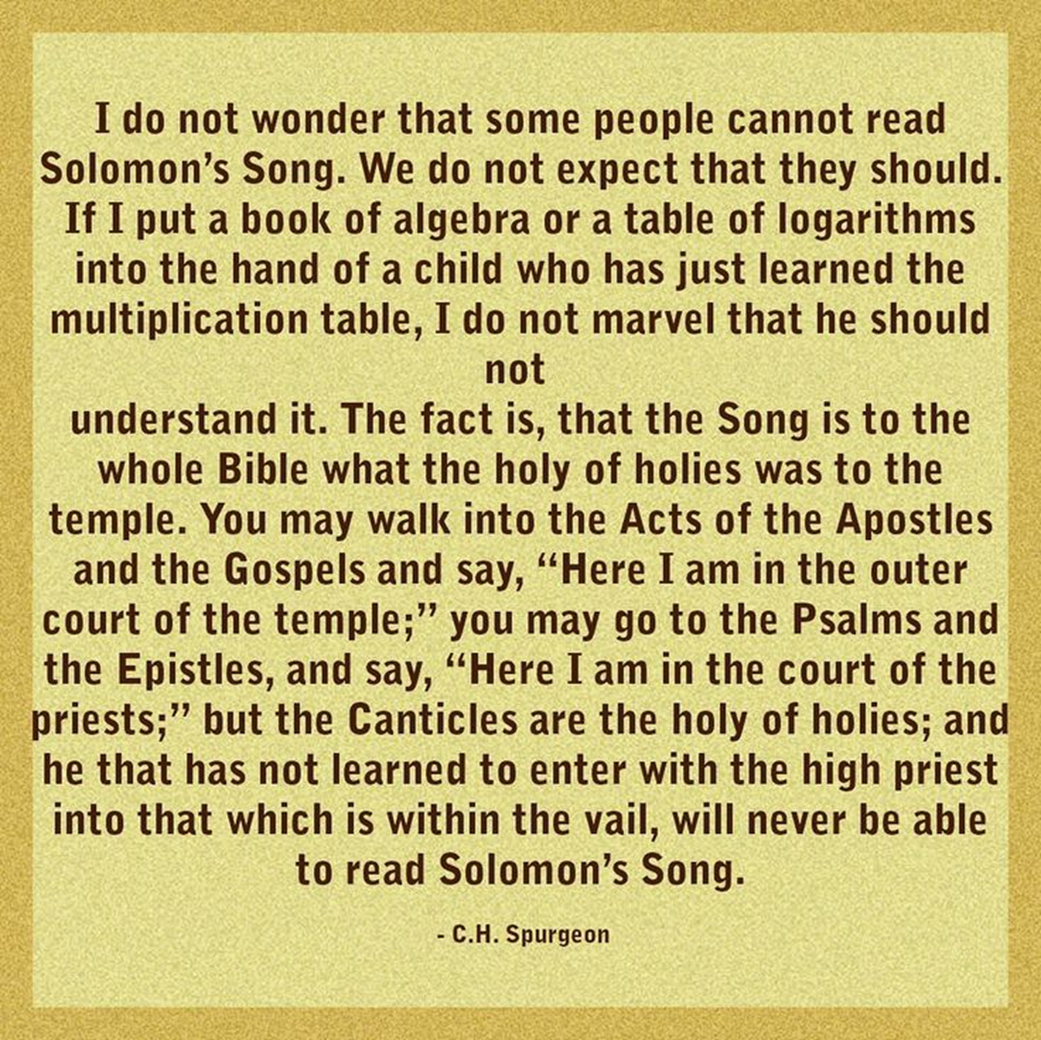
Outline of the Song of Songs
Our Growing Relationship with the King of Kings
DOCTRINE
Part 1) The Courtship (Leave) 1:2-3:5
Section 1: Love Begins 1:2-11
Section 2: Love Grows 1:12-3:5
Part 2) The Wedding (Cleave) 3:6-5:1
Part 3) The Family (Weave) 5:2-8:14
Bill Heath Tim Hennings
A Time The Bible
A People Grace
A Place Mercy
A Language Time
“In His Time”
Doctrine Practice
Genesis 2:24 Therefore shall a man leave his father and his mother, and shall cleave unto his wife: and they shall be one flesh.

Slide 4
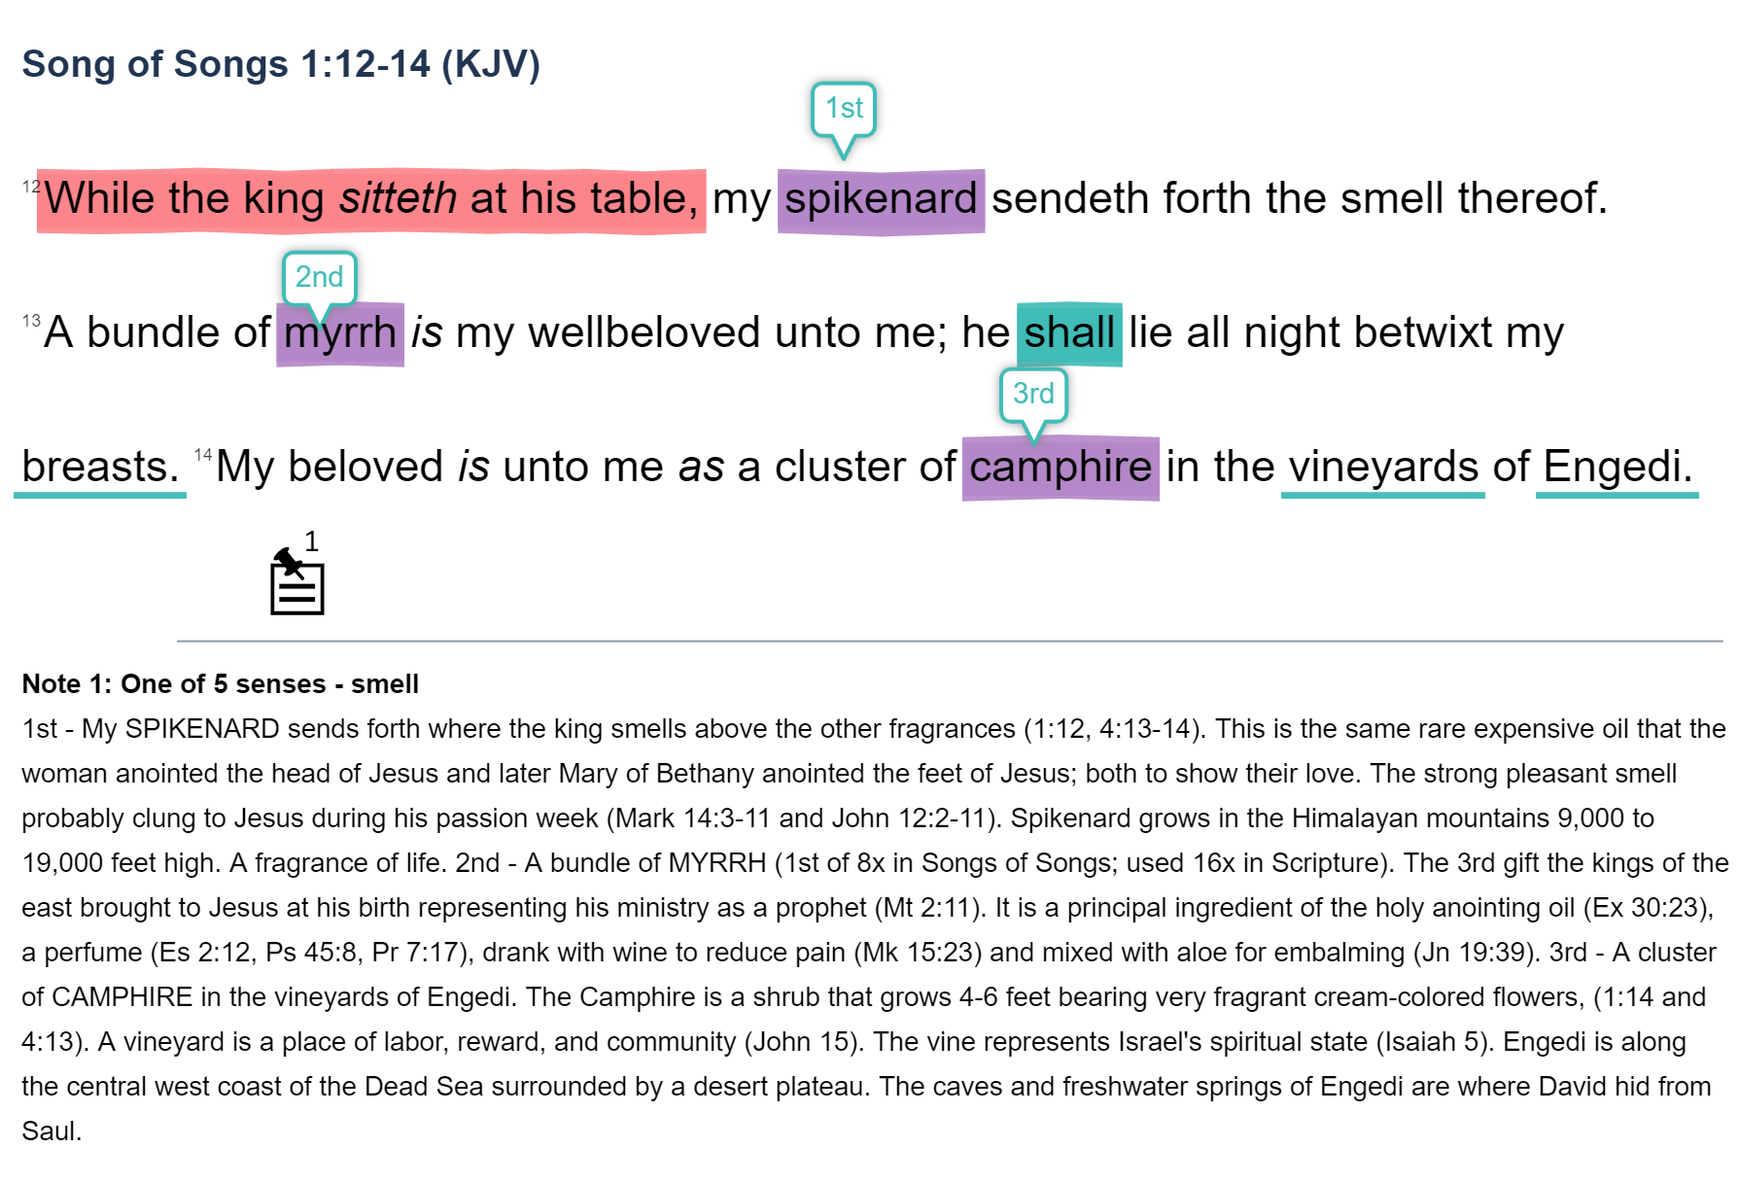
Courtship: My love Grows with the king 1:12-3:5 (leave)
The woman speaks to the king

Slide 5
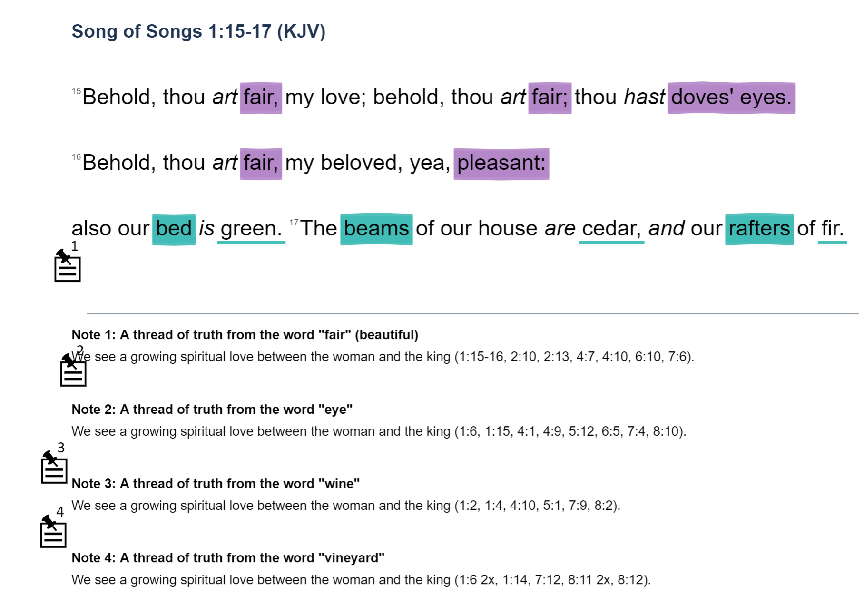
Courtship: my love Grows with the king 1:12-3:5 (leave)
The king speaks to the woman

Slide 6
Part 1. The Courtship (LeavE) 1:2-3:5
Section 1. love begins 1:2-11
Exchange 1 between the woman and the king 1:2-11
Section 2. love grows 1:12-3:5
Exchange 2 between the woman and the king 1:12-17
NEXT in the Song of Songs, 2:1-17
Challenge: in what verses does the king speak?
Part 2. the wedding (cleavE) 3:6-5:1
Part 3. the family (weavE) 5:2-8:14

