Slide 1
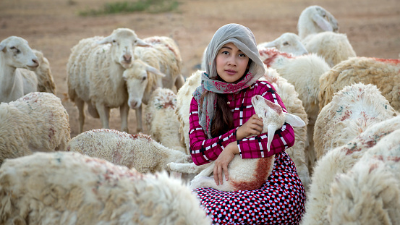
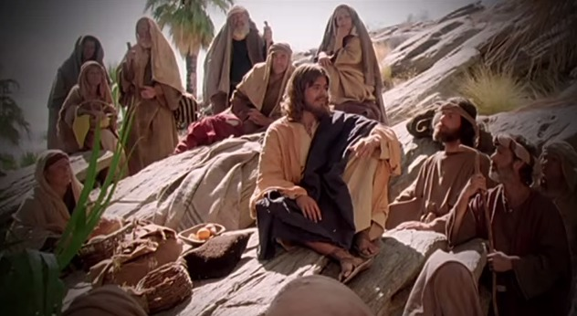
Fellowship Church – Wednesday Night Service – June 16, 2021
Song of Songs 2:1-17
Title: My Growing Relationship with the King
Lesson 4. Love Grows in Courtship (betrothal or engagement)

Slide 2

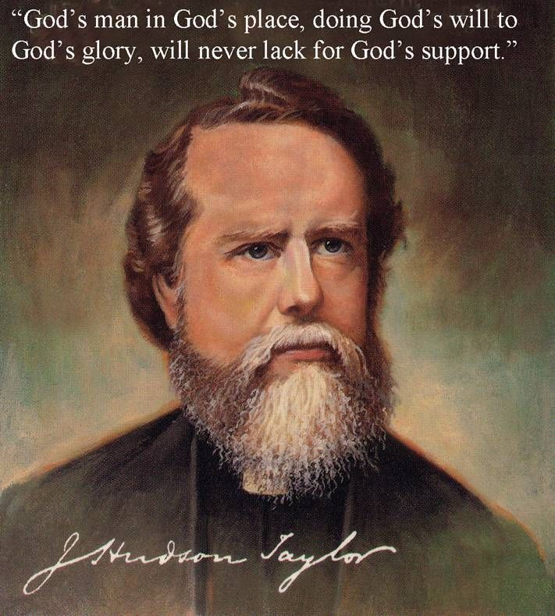
Outline of the Song of Songs
Our Growing Relationship with the King of Kings
DOCTRINE
Part 1) The Courtship (Leave) 1:2-3:5
Section 1: Love Begins 1:2-11
Section 2: Love Grows 1:12-3:5
Part 2) The Wedding (Cleave) 3:6-5:1
Part 3) The Family (Weave) 5:2-8:14
Bill Heath Tim Hennings
A Time The Bible
A People Grace
A Place Mercy
A Language Time
“In His Time”
Doctrine/position Practice/experience
Genesis 2:24 Therefore shall a man leave his father and his mother, and shall cleave unto his wife: and they shall be one flesh.
1832-1905
Union & Communion

Slide 4
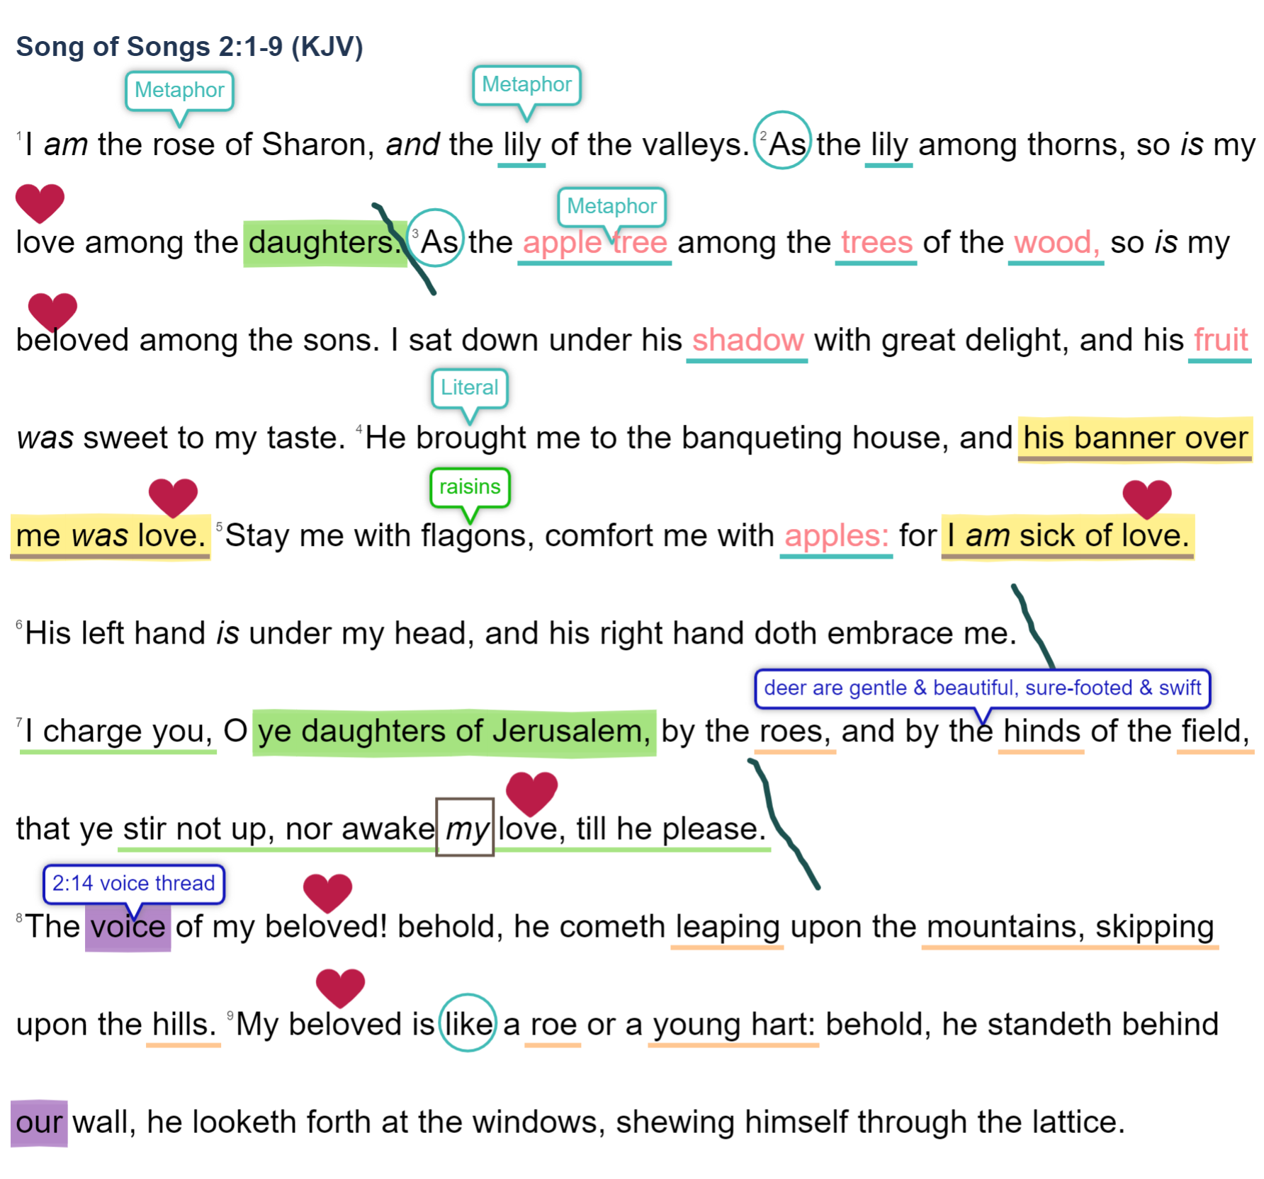


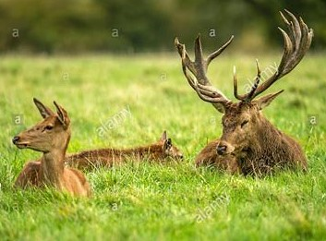
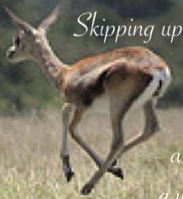
The woman speaks (about herself & the king)
My Growing Relationship with the King
Courtship: love Grows 1:12-3:5 (leaving)

Slide 5

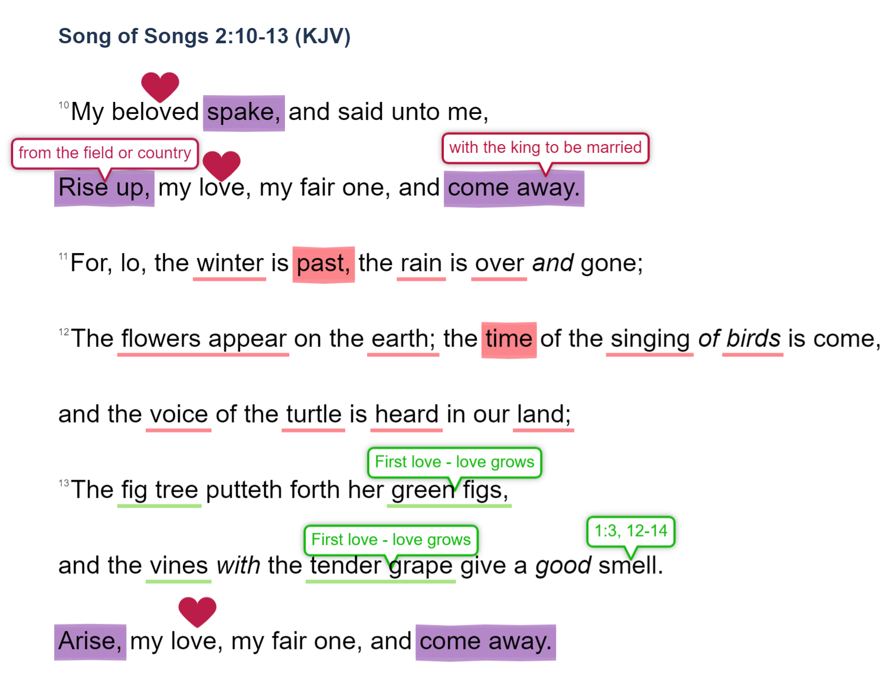


The king speaks (to the woman)
Courtship: love Grows 1:12-3:5 (leaving)

Slide 6
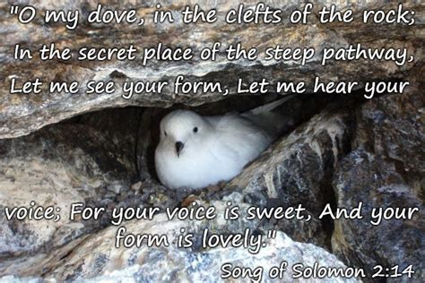
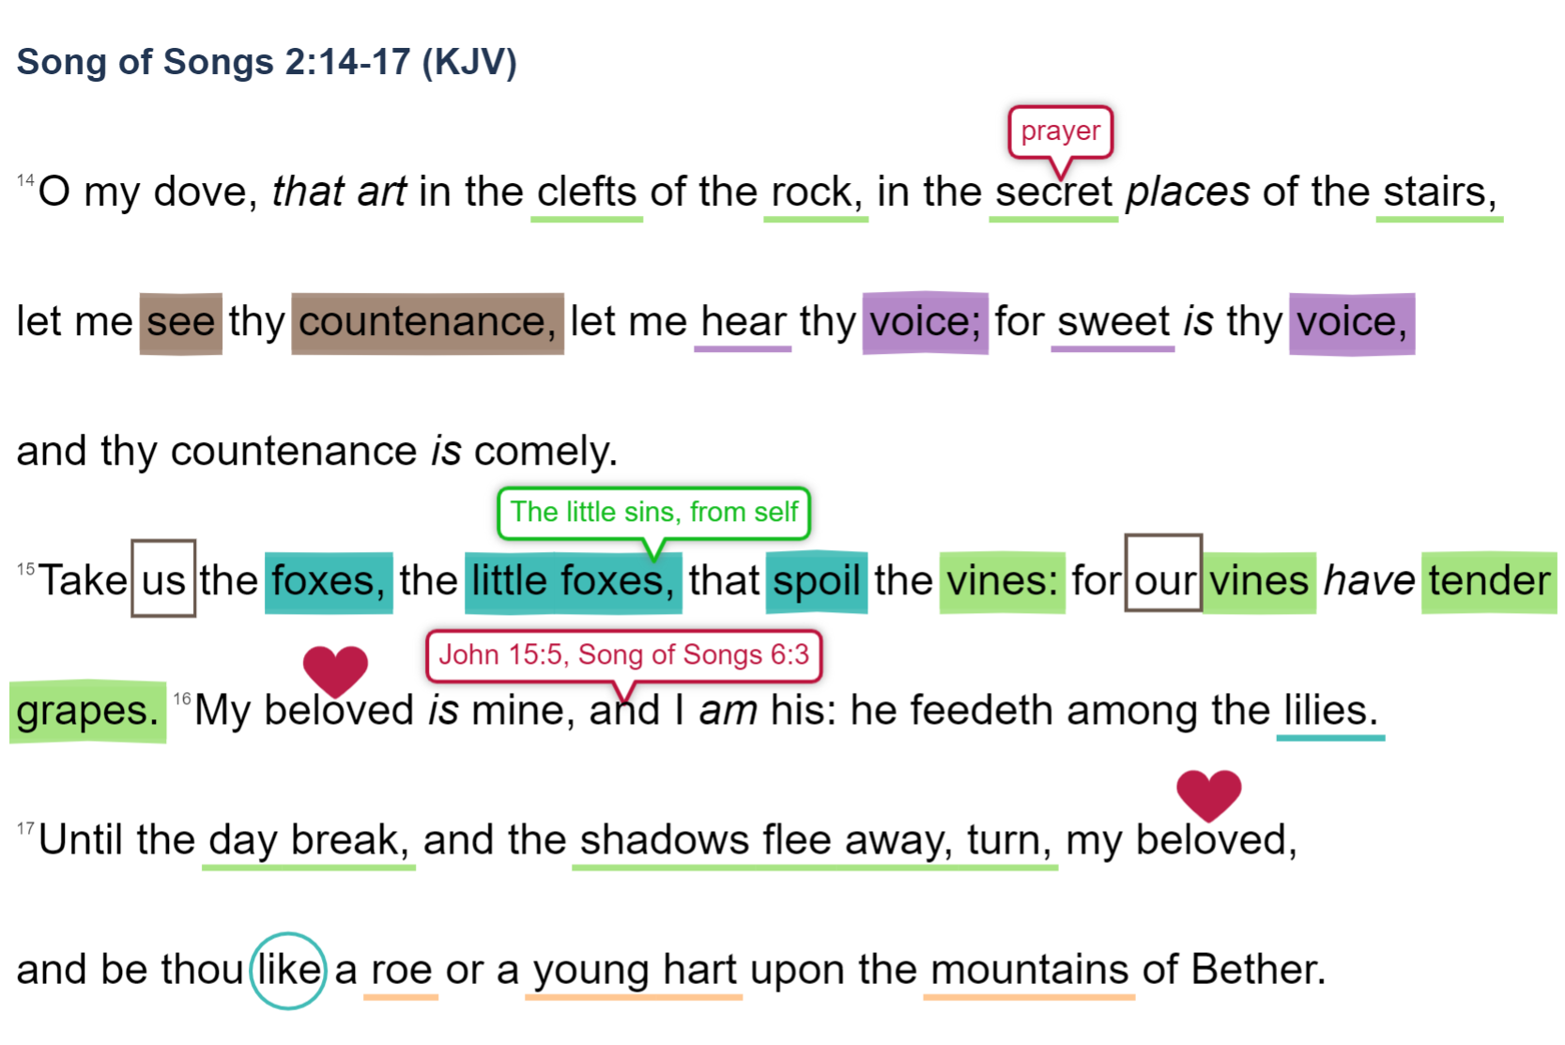
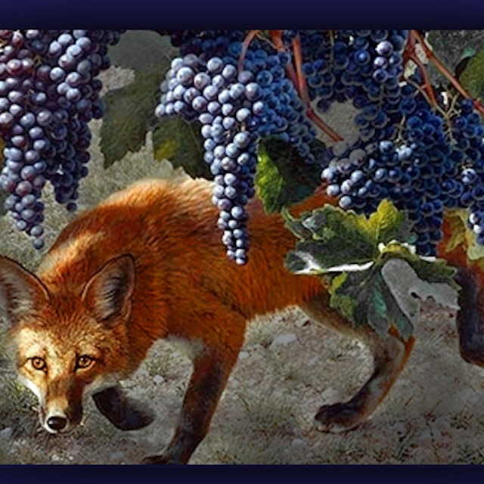

The woman speaks (about the king)
Courtship: love Grows 1:12-3:5 (leaving)

Slide 7
Part 1. The Courtship (LeavE) 1:2-3:5
A. love begins 1:2-11
B. love grows 1:12-3:5
NEXT in the (one) Song of (1005) Songs, 3:1-11
Challenge: what verses describe the wedding procession?
Part 2. the wedding (cleavE) 3:6-5:1
Part 3. the family (weavE) 5:2-8:14

