Slide 1
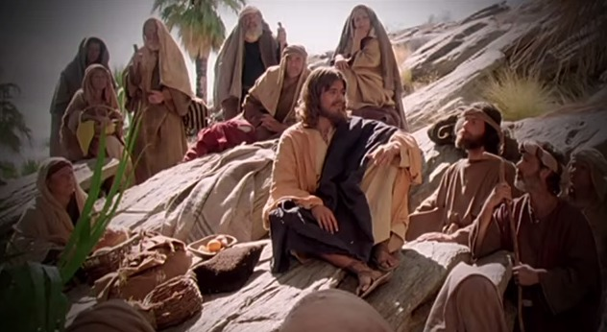
Fellowship Church – Wednesday Night Service – April 21, 2021
Title: Our Growing Relationship with the King of Kings
Text: Introduction to Song of Songs
¹ The song of songs, which is Solomon’s.

Slide 2
shadow
What is a “shadow” when comparing the Old Testament with the New Testament? (KJV)
Colossians 2:16-17 Let no man therefore judge you in meat, or in drink, or in respect of an holyday, or of the new moon, or of the sabbath [days]:
Which are a shadow of things to come; but the body [is] of Christ.
Hebrews 8:4-5 For if he were on earth, he should not be a priest, seeing that there are priests that offer gifts according to the law: Who serve unto the example and shadow of heavenly things,
Hebrews 10:1 For the law having a shadow of good things to come, [and] not the very image of the things, can never with those sacrifices which they offered year by year continually make the comers thereunto perfect.

Slide 3
wisdom
Deuteronomy 17:17-19 Neither shall he multiply wives to himself, that his heart turn not away: . . . that he shall write him a copy of this law in a book out of [that which is] before the priests the Levites: And it shall be with him, and he shall read therein all the days of his life: that he may learn to fear the LORD his God, to keep all the words of this law and these statutes, to do them:
Solomon’s tragic end: 1 Kings 11
Matthew 12:42 (KJV) The queen of the south shall rise up in the judgment with this generation, and shall condemn it: for she came from the uttermost parts of the earth to hear the wisdom of Solomon; and, behold, a greater than Solomon [is] here.
Wisdom for today in Christ: 1 Corinthians 1:30, James 1:5-8, James 3:13-18

